Slide 1


Pinellas County Schools “Planning for Progress”
Dena Collins – Executive Director, Human Resources
Allison Hearn – Staff Attorney
Gary Jeppesen – Chief Financial Officer
Michael Vigue – Chief Human Resources Officer
Tonya Womack – Director, Risk Management and Insurance

Slide 2
Agenda
1
PCS: Past, Present, and Future
2
Planning for Progress: Strategy, Timelines, and Processes
3
Human Resources: Employees and Unions

Slide 3
PCS: Past, Present, and Future
Birth Rates
District Enrollment & Building Capacity
Finances
  Budget Summary
  FEFP Students & Funding Summary
Academic Achievement
  Grade 3 ELA Achievement
  District Grade
Employee Counts
Salary Increases by Percent by Group
Healthcare

Slide 4
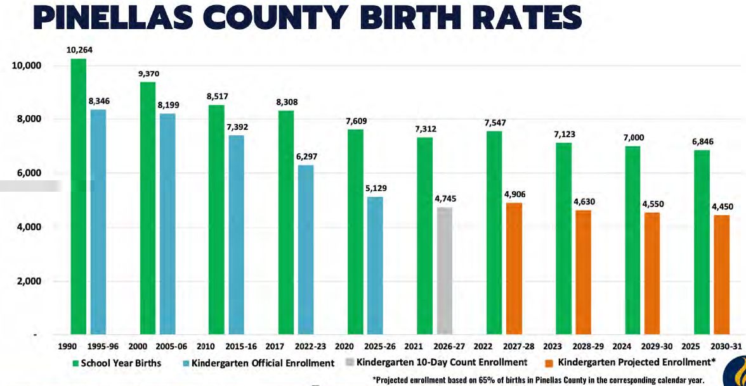

Slide 5
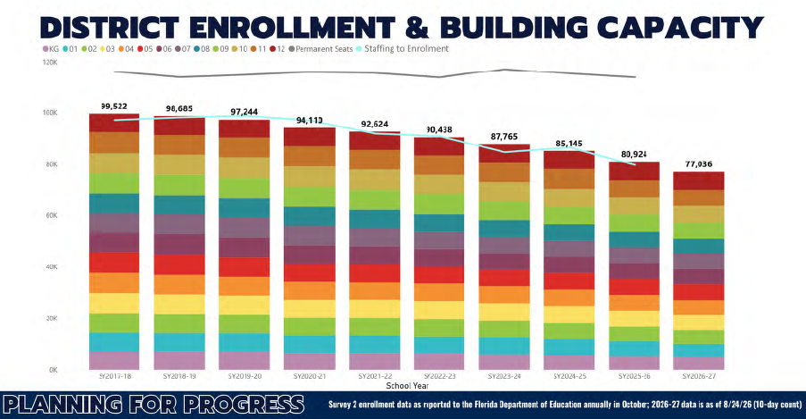

Slide 6
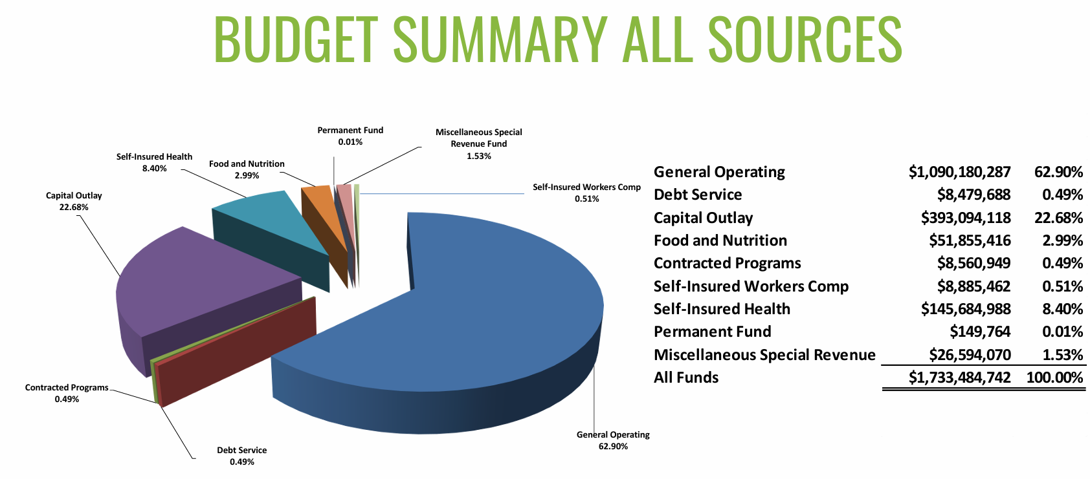

Slide 7
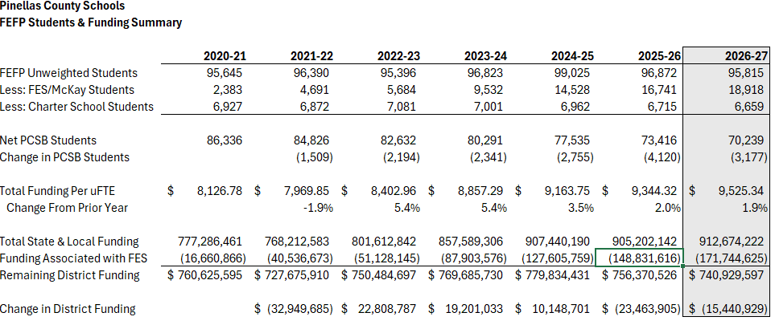

Slide 8
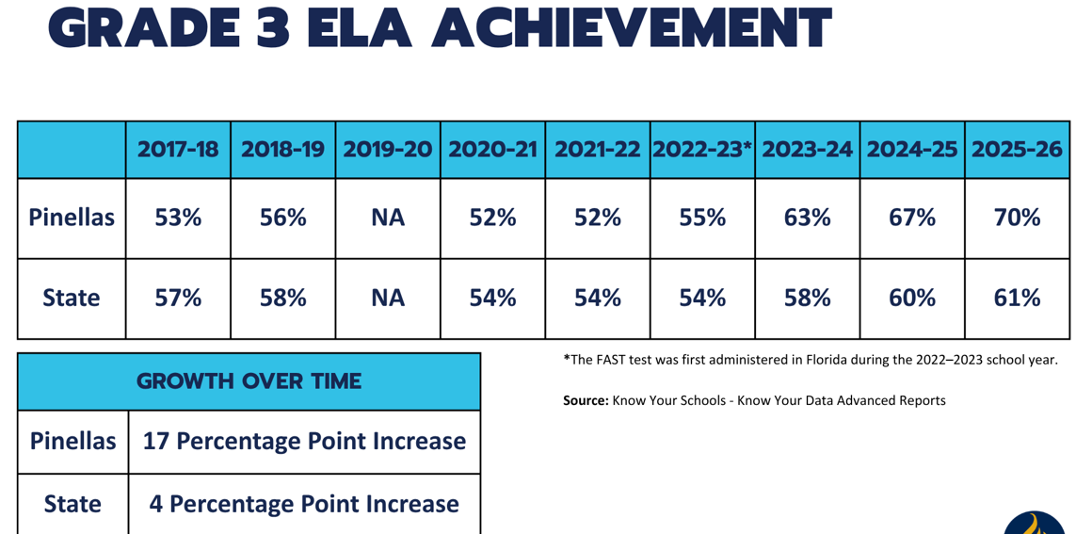

Slide 9
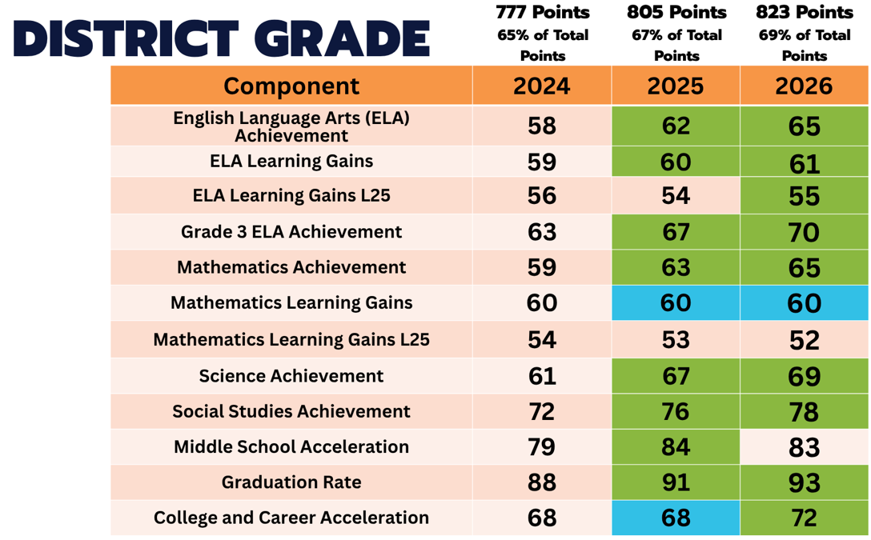

Slide 10
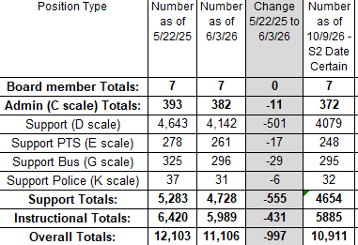
Employee Counts​

Slide 11
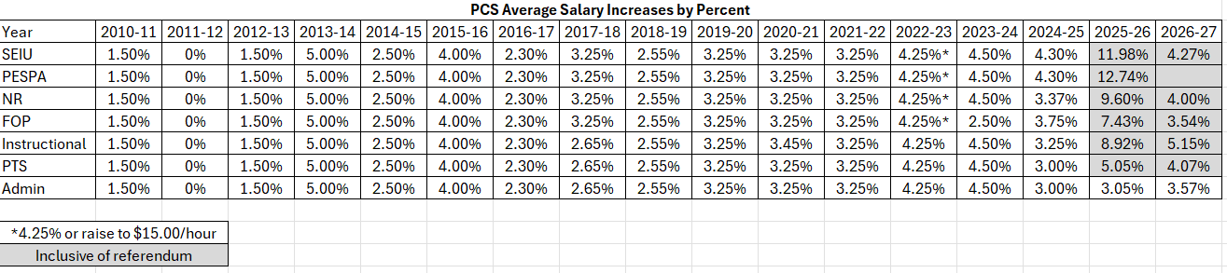
Salary Increases by Percent by Group​

Slide 12
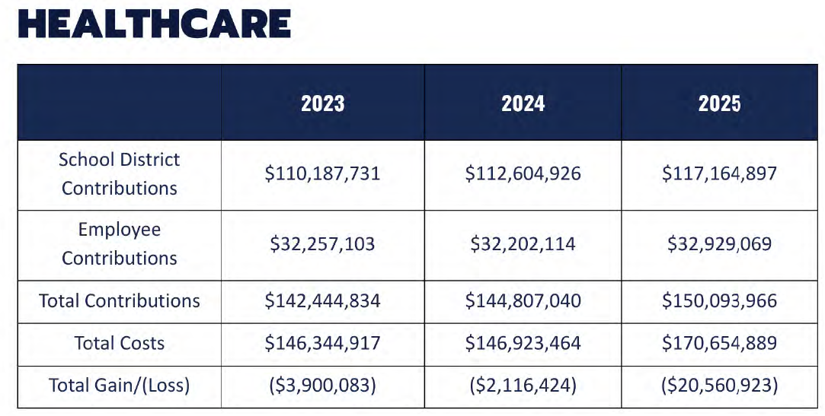

Slide 13
Planning for Progress:
Strategy, Timelines, and Processes
Florida’s 10 Largest Districts
January 2026 Recommendations
Fall 2026 Recommendations
  Portfolio Review – School Data Sample
  Timeline
Cross-departmental Work
Communication
  Approaches
  Timelines
  Community Resources
Ongoing and Upcoming Work

Slide 14
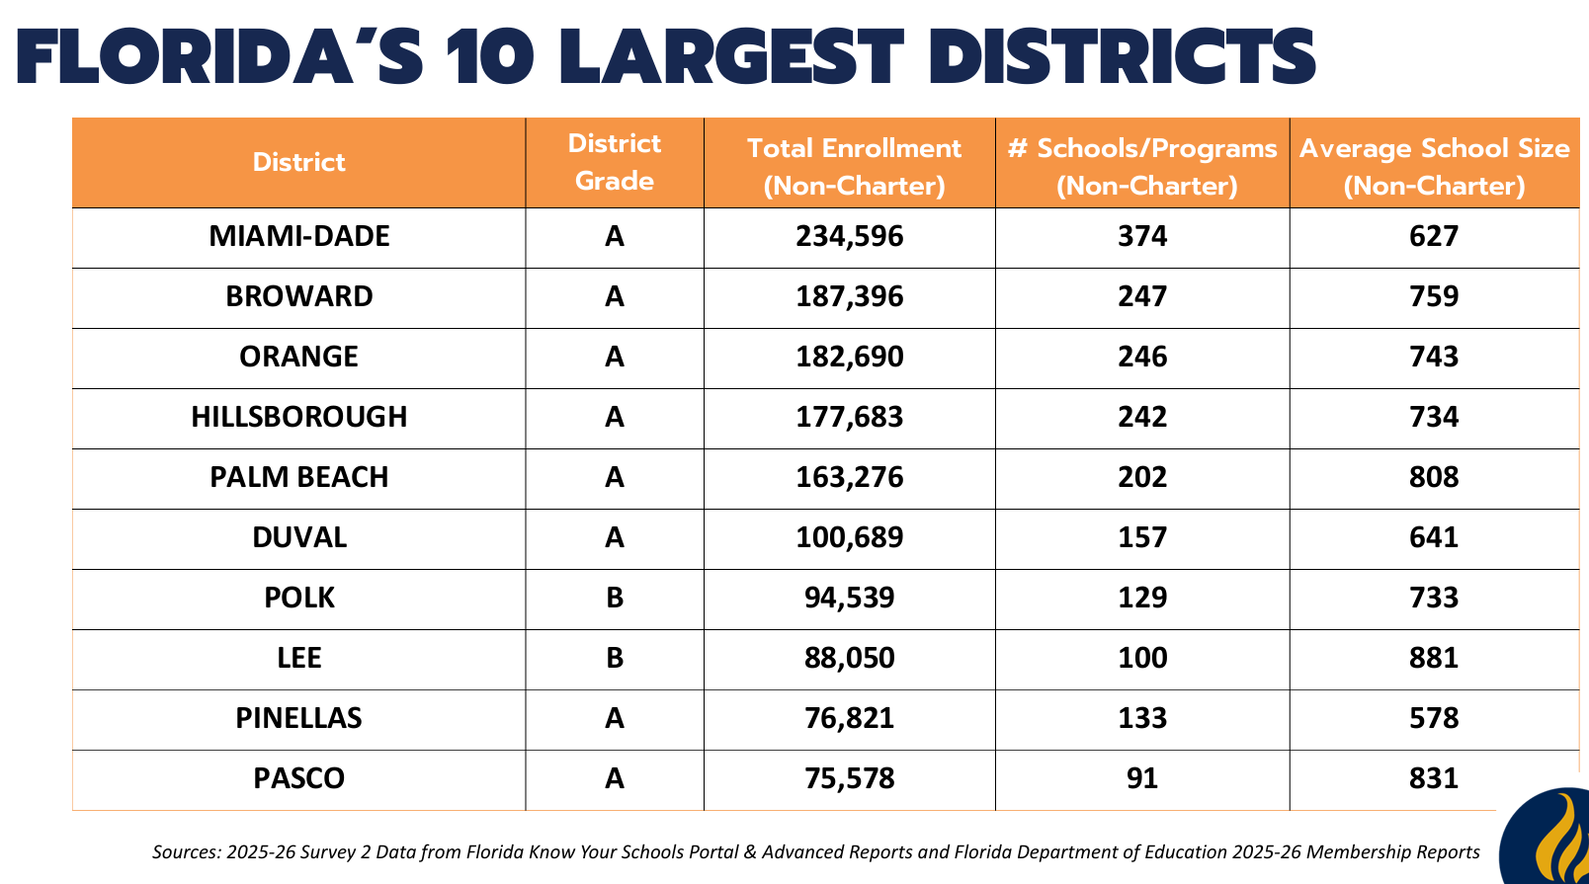

Slide 15
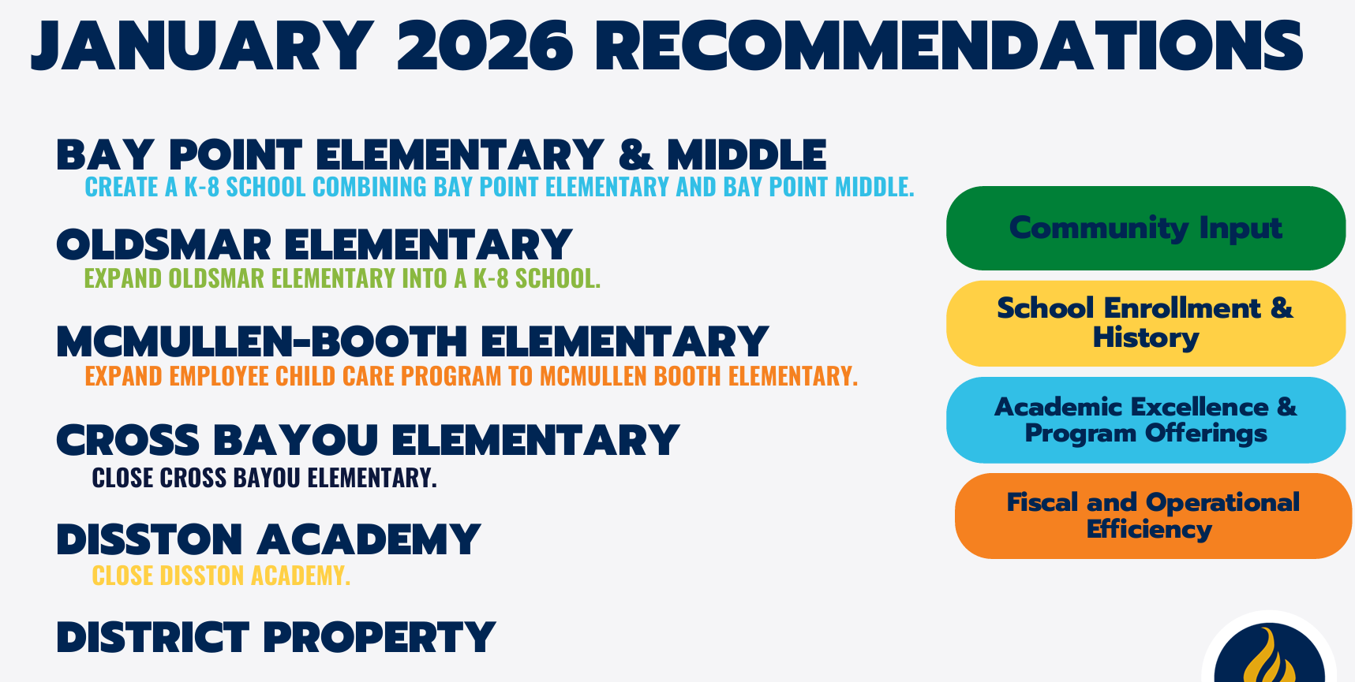

Slide 16
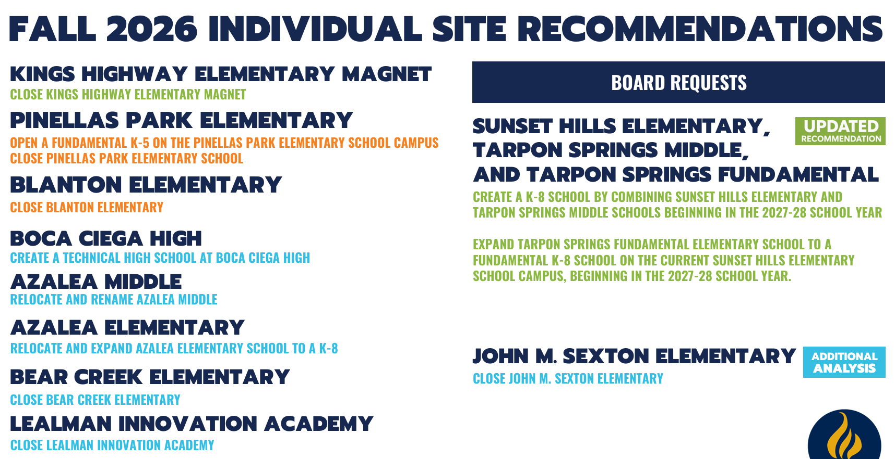

Slide 17
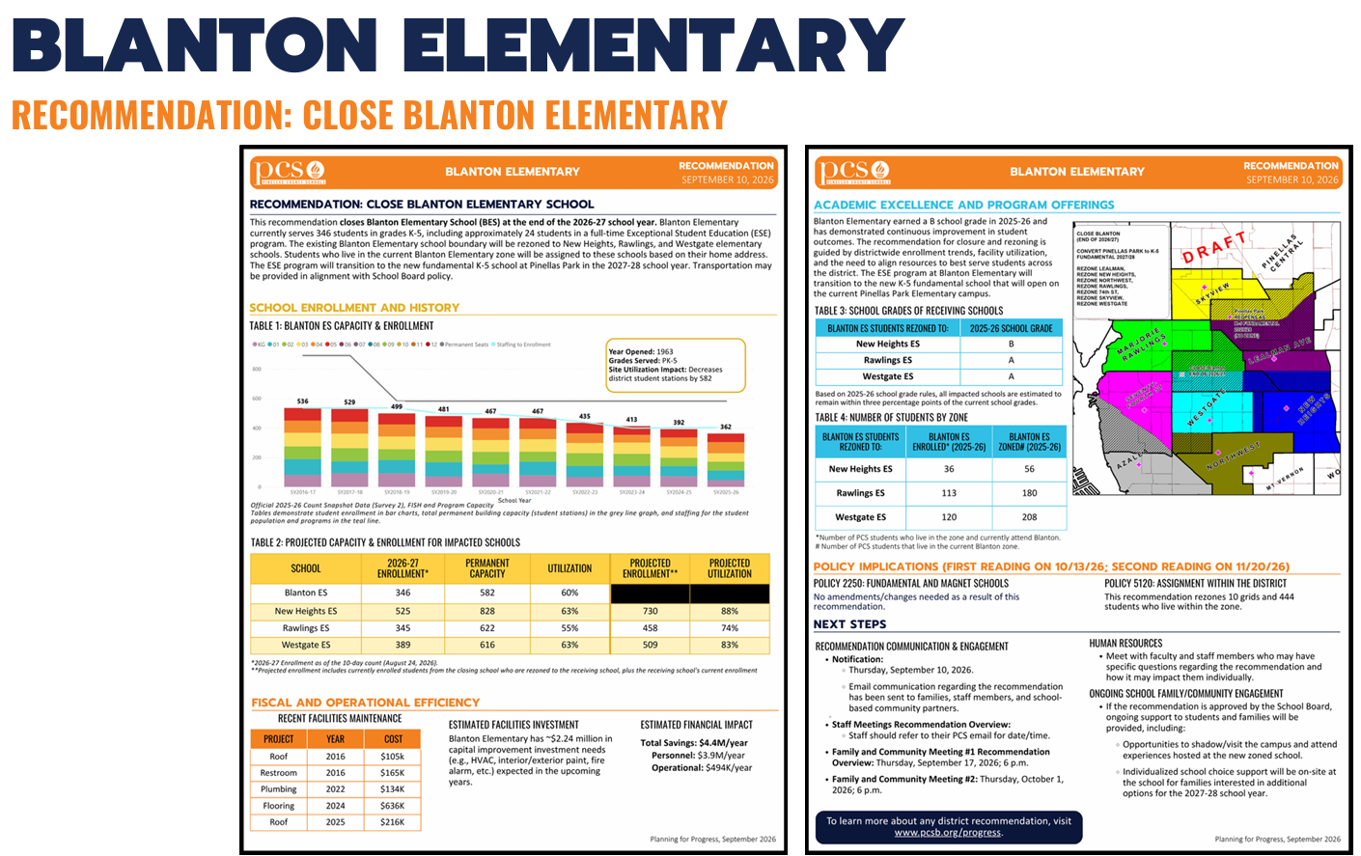

Slide 18
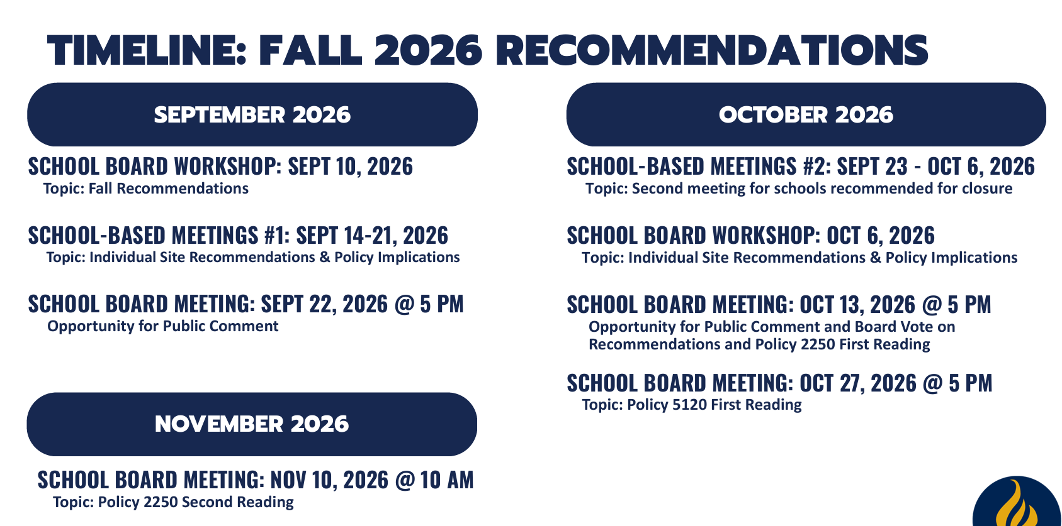

Slide 19
Cross-departmental Work​
Portfolio Reviews led by Operations and Demographer
Alignment to District Strategic Plan
Community and Municipality Partnerships
Recommendations
Project Management Assignments
PCSB Policy Updates for Zoning and Choice Programs
Executive Updates
School Support Working Groups with Assigned Project Managers

Slide 20
Communications Approaches & Timeline​
Listen and Learn (2022 – 2025)
Recurring Board Member and Board Updates
Impacted School Community Meetings (Winter 2026)
Geographical Community Input Opportunities (Summer 2026)
Recommendations at PCSB Workshop (Fall 2026)
Staff Meeting at each Impacted Site
Two Additional Community Meetings Per Impacted Site – Inclusive of Receiving Schools
PCSB Meetings Moved to Evenings (Sept/Oct 2026)

Slide 21


Slide 22
Ongoing and Upcoming Work​
School Naming Process and PCSB Approvals
Facility Upgrades and Renovations (Winter – Summer 2027)
Relocation of Specialized Service Units
Family Support and Preferential Opportunities for Student Special Attendance Permits
Project Manager Led Working Groups – Minimize Impact on Current Principal/Team
District Application Program Support for Applications (January 2027)
Continue Community and Municipality Partnership Development
Continue Development of Early Childhood Programs
Monitor Student Enrollments for 27-28 Unit Allocations and Staffing Models
Use Current Decisions to Guide Future Decisions

Slide 23
Human Resources: Employees and Unions
Personnel Impact by Site
Impact Bargaining for Transfer Process
Next Steps

Slide 24
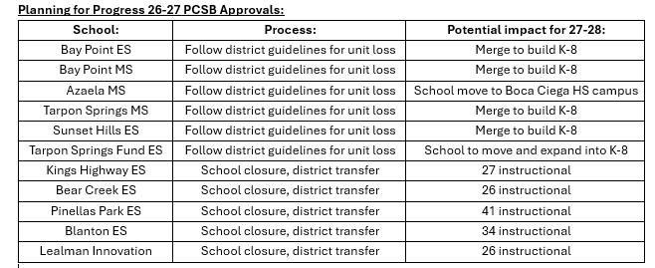
Personnel Impact by Site​

Slide 25
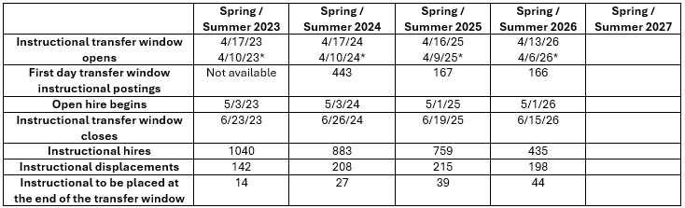
Impact Bargaining for Transfer Process
​*Legacy Schools Only

Slide 26
Human Resources Next Steps ​
HR Partner Assignments
Principal Hiring Process
Union Leaders (SEIU, PESPA, FOP) Updates
PCTA Impact Bargaining Process
District Transfer (vs. Reduction in Force)
Additional School Visits (Whole Staff and Individual Employees)
Support for Resume Updates and Application
Instructional Hiring Process (January – May 2027)
Ongoing Support Employee Hiring and Transfers (Now vs. Spring 2027)
Unit Allocation Meetings (March 2027)
Instructional Transfer Process (Voluntary and District Transfers)
June and July Placements Based on PCON

Slide 27
Feel free to reach out to us.
Dena Collins – Executive Director, HR
collinsden@pcsb.org
Allison Hearn – Staff Attorney
hearna@pcsb.org
Gary Jeppesen – Chief Financial Officer
jeppeseng@pcsb.org
Michael Vigue – Chief Human Resources Officer
viguem@pcsb.org
Tonya Womack – Director, Risk Management and Insurance
womackt@pcsb.org

