Slide 1


SB 1296 - Public Employees Relations Commission - 2026
FLORIDA SCHOOL
LABOR RELATIONS SERVICE &
FLORIDA EDUCATIONAL NEGOTIATORS

Slide 2
Objectives
Context and Potential Legal Challenges | Legislative Appropriations and Financial Urgency
The New Thresholds | Paid Union Leave
Employer Responsibility | Summary & Questions
Notes:
I want to urge you to consider this a safe space where we can talk freely – HR, collective bargaining, and all the associated topics are a significant aspect of district work – it is up to 4/5 of your district budget. You have questions, experiences, and stories. Let’s share those stories that advance us all.

Slide 3
Constitution and Statute Foundation
Article I, Section 6, Florida Constitution
  Florida public employees have the constitutional right to bargain.
  Right-to-work state.
  No striking by public employees.
Chapter 447, Part II, Florida Statutes (sections 447.201-.609, F.S.)
  Statutes describing public sector bargaining process and related issues.
Notes:
The Florida experience is unique in that the right to bargain collectively is in our constitution.
Article I, section 6 provides: The right of persons to work shall not be denied or abridged on account of membership or non-membership in any labor union or labor organization. The right of employees, by and through a labor organization, to bargain collectively shall not be denied or abridged. Public employees shall not have the right to strike.’
Denial and Abridgment may soon be before a court again.

Slide 4
Statement of Policy
The public policy of this state...with respect to public employees; to promote harmonious and cooperative relationships between government and its employees, both collectively and individually; and to protect the public by assuring...the orderly and uninterrupted operations and functions of government.
Neutrality Principle - Nothing herein shall be construed either to encourage or discourage organization of public employees.
[see 447.201, FS]
Notes:
How we achieve the goal of the constitutional mandate matters. In the statement of policy, the legislature recognized that the purpose of the Act was to implement Art. I, §6, with respect to public employees as well as “to promote harmonious and cooperative relationships between government and its employees, both collectively and individually; and to protect the public by assuring, at all times, the orderly and uninterrupted operations and functions of government.”
As I am reminded that as senior leaders in your districts, your role is to implement this policy through fair, transparent, and effective bargaining practices that ultimately benefit students, employees, and the community. You are charged with a difficult task to avoid where possible adversarial approaches in favor of problem-solving that addresses both district needs and employee concerns.
The statutes include a statement of neutrality: Nothing herein shall be construed either to encourage or discourage organization of public employees. § 447.201, Fla. Stat. This policy statement establishes the legislature's intent to create a balanced framework that serves multiple stakeholders. Our climate, difficult negotiations, infuriating asks make this a difficult position to maintain.
This is contrasted with the private sector; in the National Labor Relations Act, which specifically states that “[I]t is hereby declared to be the policy of the United States to ... encourage[e] the practice and procedure of collective bargaining”
Further, public sector collective bargaining is acknowledged to be a political process: [C]ourts and commentators uniformly agree that public bargaining is inherently different from private bargaining. Courts have addressed the necessity of political activities by public union representatives in order to achieve what private sector unions can achieve solely at the bargaining table. Public employment collective bargaining is influenced primarily by political forces, as opposed to private employment collective bargaining, which is essentially shaped by the market.

Slide 5

(Potential) Legal Challenges
Collective bargaining rights. That the higher certification, recert-
ification, and decertification thresholds burden the constitutional right to
bargain collectively.
Equal protection. Concerning the different treatment of public safety and non-public-safety bargaining units.
Free speech. To the limits on paid leave for certain union-related activities, including political and organizing activity.
Single subject. That the bill includes multiple subjects or provisions that may not be sufficiently connected.
Delegation / standards. That the bargaining-unit clarification process does not provide enough standards to guide the commission’s decisions.
Implementation. That some provisions may require rulemaking or further administrative action before they can be fully implemented.
  [see Senate Staff Analysis]
Notes:
Last Thursday the bill was sent to the Gov
On Friday - in a highly scripted press conference with a handful of speakers with prepared comments the bill was signed.
Many of you watched and I’ll leave to any comments you want to make about what was said.
As reminder, in SB 256, the federal judge was willing to block SB 256 where it overrode existing contract rights, but he was less receptive to challenges aimed at the new union-qualification rules themselves. So we might think that challenges to new certification rules, membership documentation, and recertification standards may be hard to win on unless they clearly impair existing agreements but my legal experts remind me that there may be a new judge and new case made about whether these provisions burden constitutional rights in a way the court views as too intrusive.
Overall, the bill presents several points that could be raised in litigation, even if some are ultimately upheld.

Slide 6

Effective when?
Approved by Governor, 05/01/26; Chapter No. 2026-58, Effective Date: 7/1/2026.
SB 1296 has been signed by the Governor, is now a Law of Florida
and is largely self-executing, with an operative date of July 1, 2026.
PERC may issue rulemaking to address implementation details,
but the statutory language appears to be effective.
Notes:
Last Thursday the bill was sent to the Gov
On Friday - in a highly scripted press conference with a handful of speakers with prepared comments the bill was signed.
Many of you watched and I’ll leave to any comments you want to make about what was said.
As reminder, in SB 256, the federal judge was willing to block SB 256 where it overrode existing contract rights, but he was less receptive to challenges aimed at the new union-qualification rules themselves. So we might think that challenges to new certification rules, membership documentation, and recertification standards may be hard to win on unless they clearly impair existing agreements but my legal experts remind me that there may be a new judge and new case made about whether these provisions burden constitutional rights in a way the court views as too intrusive.
Overall, the bill presents several points that could be raised in litigation, even if some are ultimately upheld.

Slide 7
The Bill – new thresholds.
Under the previous law, elections were decided by a majority of participating employees. The new language creates a two-part test:
At least 50% of all eligible employees in the unit must participate in the election (a turnout threshold), and at least 50% of those voting must support the union (a support threshold).
These requirements are in addition to the existing 60% dues-paying membership requirement and the 30% showing of interest threshold to trigger an election. Public safety units retain the simple majority-of-voters standard.
Notes:
The legislature took note of the very low election turnouts we have experienced. A majority of voters is no longer enough — affected unions will need to meet a turnout threshold and a support threshold. This is in addition to the existing requirements which triggers the election process… which is 60% dues paying membership and then filing of cards showing an interest in showing of interest a union from 30% of the eligible bargaining unit. A showing of interest is a written statement that is signed and dated by an appropriate employee who wishes to be, or to no longer be, represented by the bargaining agent for purposes of collective bargaining.
Those unions who show 60% or greater dues payers can avoid these requirements.

Slide 8
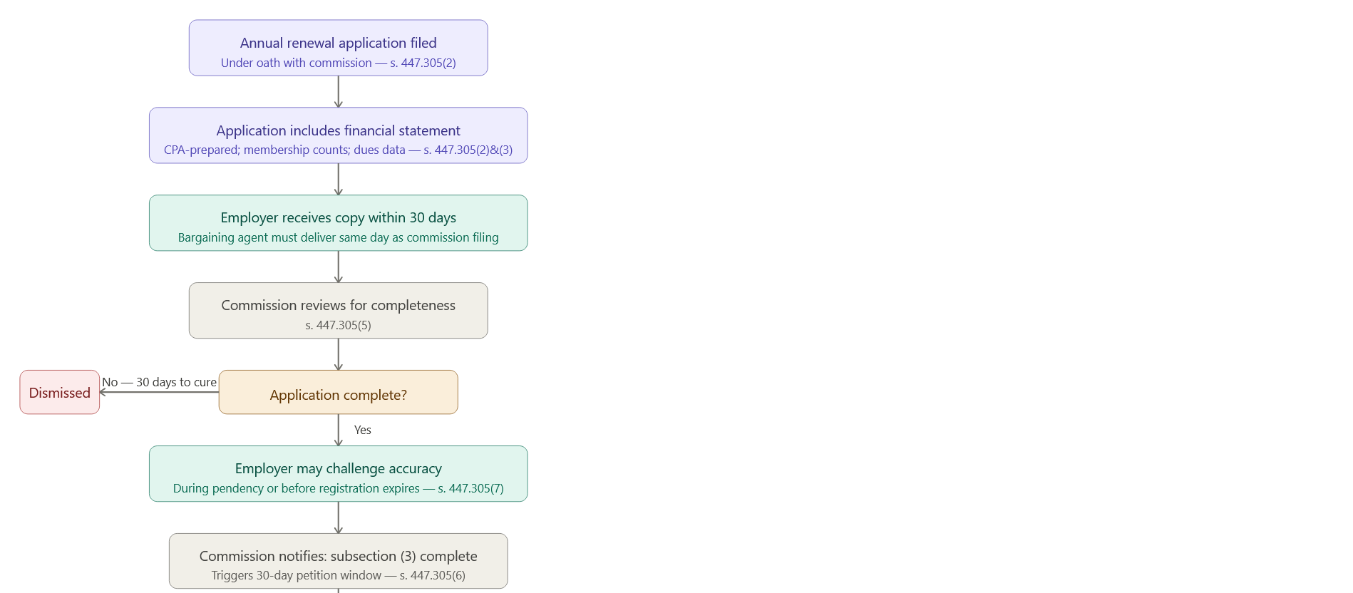
The Process
Flowchart
1
Notes:
I was really jealous of Leonard’s one page impasse flow chart. I remain envious because mine is long! Those of you with ongoing relationships with a favored Ai may be able to chart something better that this but it may serve as a springboard to your thinking and planning for your work.
I put this key moments in FEN green.

Slide 9
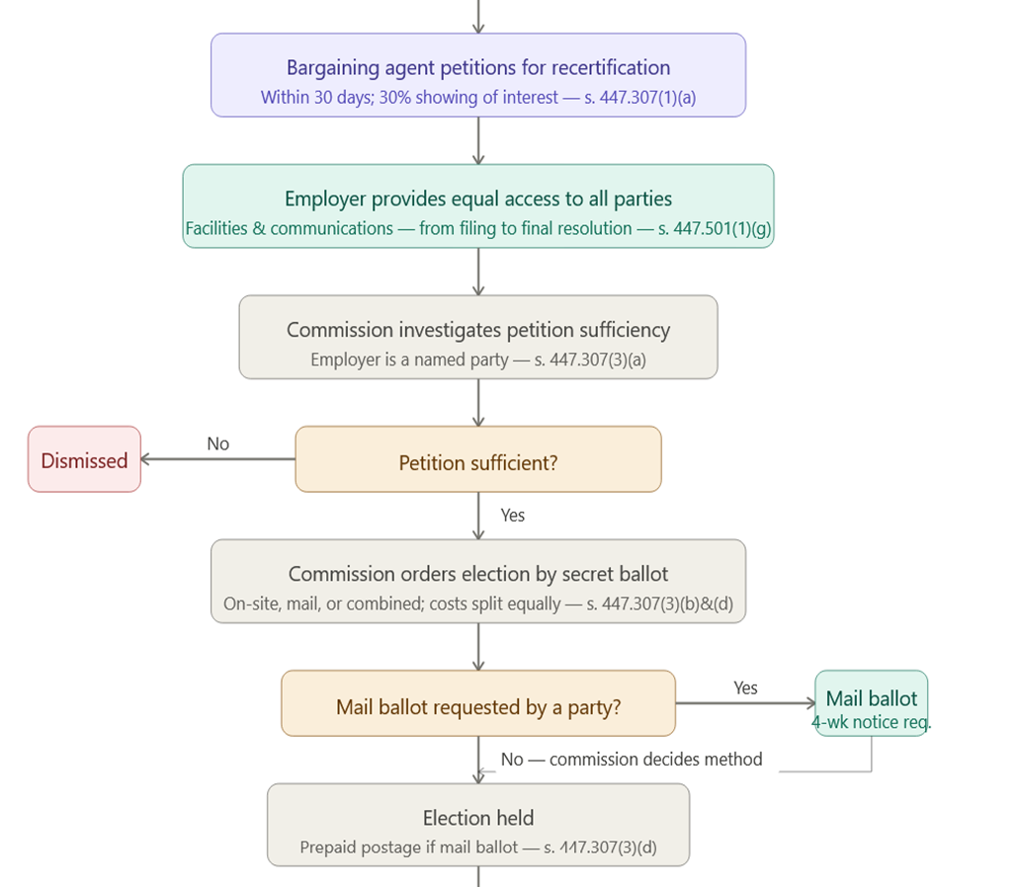
The Process
Flowchart
2

Slide 10
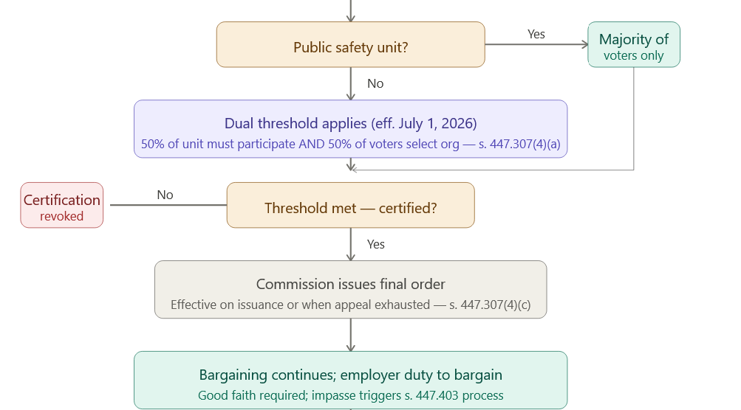
The Process
Flowchart
3
Notes:
Collective Bargaining Continues Until Final Order
Certification, recertification, or revocation is not effective until the commission issues a final order — or, if appealed, until the appeal is exhausted or any stay is vacated. The employer's obligation to bargain collectively with the existing bargaining agent continues uninterrupted until that final order is issued or the appeal is resolved.

Slide 11
Employers - Recertification
For each certification, the number of public employees in the bargaining unit. This number, of course comes from you, the employer.
Registration Renewal Notification to Employer. Within 30 days of filing its renewal application with the commission, the bargaining agent must provide a copy to the public employer. The employer receives this as a passive recipient but should review it for accuracy.
Challenging Inaccurate Renewal Applications The public employer may challenge an employee organization's application for renewal of registration if it believes the application is materially inaccurate — either during the pendency of the application or before the current registration expires.
Cooperation with Commission Investigation. If the commission or a designated agent conducts an investigation into the validity of submitted registration information, the employer is an implicit participant in confirming accuracy of bargaining unit membership data.
Notes:
And I detail some key point on the following slides.
As aside, You might the bill is requiring a less neutral position ….a shift to a more "Active Verification“ mode. That will be something you and your team will consider.
As with SB 256, you are the provider of key information. The numerators in many of these calculations. But similar to your current role, you are to be provided information as well including a copy of their renewal registration within 30 days.
The statute speaks to an authority to challenge registration renewals based on 'material inaccuracies.' This is a role where a challenge is possible while an application is still pending or even after it is granted, provided the current registration hasn’t expired.
If PERC or an intervenor investigates anything, you are not on the sidelines either. Your records will likely be used to verify the accuracy of a union’s reported membership.
Removes the ability to voluntarily recognize an employee organization,

Slide 12
Employers - Decertification
Equal Access to Facilities and Communications. The public employer must provide equal access to its facilities and internal means of communication to any registered employee organization or petitioning public employee seeking to support, oppose, or intervene in the decertification proceeding.
Participation in Commission Investigation. The commission investigates sufficiency. The employer is identified as a party and must cooperate with that process.
Election Cost Sharing. The public employer must bear an equal share of the cost of a decertification election ordered by the commission, unless the commission provides otherwise by rule.
New Participation Threshold (July 1, 2026). Decertification now requires at least 50% of bargaining unit employees to participate in the election AND at least 50% of those voting to select decertification . Public safety units retain the simple majority-of-voters standard.
Notes:
A significant new provisions concerns intervenors.
The new language amends s. 447.501, F.S., to require a public employer to allow any registered employee organization or any petitioning public employee who is seeking to support, oppose, or intervene in the certification, recertification, or decertification of a bargaining agent be granted access to its facilities and internal means of communications. Failure to provide access is classified as an unfair labor practice.

Slide 13
Employers – Unit Clarification
Receiving Service of Petition. The public employer must be served a copy of the petition. This is a mandatory notice requirement.
Notifying Unrepresented Affected Employees. The public employer must provide a copy of the petition to those employees not represented by a bargaining agent within 10 days after the petition is filed.
Filing Eligibility. The public employer itself may file a unit clarification petition.
25% Growth Cap. Any clarification that would increase bargaining unit size by more than 25% converts the matter into a representation question and the petition must be dismissed — relevant when the employer is assessing whether to file or oppose a clarification.
Notes:
s. 447.3076, F.S., which creates the clarification of a bargaining unit process. The bargaining agent of an affected bargaining unit, or the public employer of the public
employees in that unit may file such a petition with the commission when a significant change occurs.
• Created or substantially changed after the unit was initially defined by the commission;
• Retitled with no substantial change in job duties; or
• Included or excluded through the commission’s mistake or misunderstanding.
The bill establishes notice requirements for unit clarification petitions, including requiring service of the petition on (1) the public employer; and (2) any bargaining agent certified to represent employees or other employee classifications that may be substantially affected by the proposed clarification. If substantially affected employees are not represented by a bargaining agent, the public employer must provide notice of the petition to those employees within 10 days after the petition is filed.

Slide 14

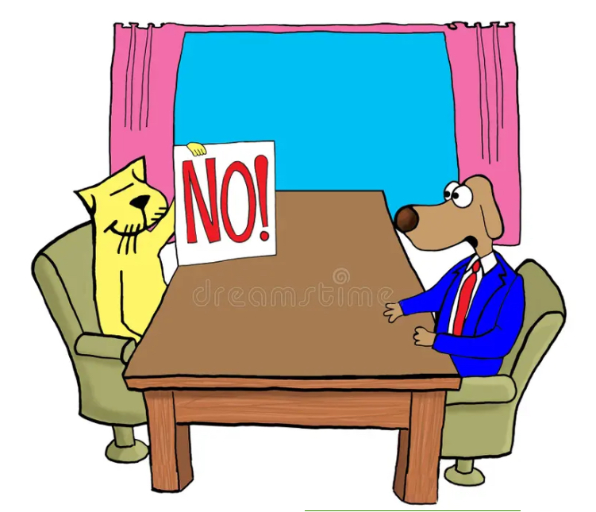
OFFER
Notes:
It is not always cats and dogs but it may be.

Slide 15
Impasse and Financial Urgency
Legislature-Directed Salary Appropriations. Funds designated for salaries, the appropriation are deemed a statutory financial urgency. The employer's chief executive officer or representative must meet with the bargaining agent within 15 calendar days of the appropriation…
Impasse Declaration Deadline Under Financial Urgency. If a dispute still exists 30 calendar days after the effective date of a salary appropriation, either party must declare impasse in writing within 2 business days — notifying both the other party and the commission.
Prohibition on Unfair Labor Practice Charges. Neither party may file an unfair labor practice charge during the 30-day negotiation period or while any resulting impasse process is ongoing.
Notes:
No mediation is allowed.
Does the infixation neutral statutory language reflect what you believe will actually be the case given the political dynamics in the state.

Slide 16
Legislature-Directed Salary Appropriations
Funds designated for salaries, the appropriation are deemed a statutory financial urgency.
The employer's chief executive officer or representative must meet with the bargaining agent within 15 calendar days of the appropriation…
Settle the entire contract
Agree to an MOU on appropriated salary
“Expedited” Impasse under §447.4095
Notes:
Discuss the MOU
****Based on actual teachers not estimates…in July.
What missing for the draft MOU? That have served you district well?

Slide 17
Impasse and Financial Urgency
Expedited Timeframe - 447.4095(2) Impasse
The overall timeline from the July 1 appropriation to the calculated December 5 ratification submission spans approximately five months, assuming every step takes the maximum time allowed, includes a one-day hearing, and has no delays.
In practice, the steps could be completed sooner if the parties move faster than the statutory deadlines require.
It is rough idea of the process timeline.
Notes:
No unfair labor practice charges and the reasonable period of negotiations window is prescribed. 30 days
While the other timeframes are compressed it is time a lengthy process.

Slide 18

Public Employer Payments for Employee Organization Activities
This language limits when a public employer may pay public employees for time spent on employee organization activities, and it broadly prohibits using public funds to compensate employees for union-related activities unless a specific exception applies.
A public employer, or anyone acting on its behalf, may not provide compensation or paid leave to a public employee for the purpose of engaging in employee organization activities. The prohibition applies to direct and indirect payments and is aimed at preventing the use of public funds to support union-related activity.

Slide 19
What Counts as Employee Organization Activities
Supporting or opposing candidates.
Influencing legislation, regulations, or ballot measures.
Promoting union membership or financial support.
Seeking certification as a bargaining agent.
Participating in union governance or administration.
Attending union events, conferences, meetings, or trainings, unless the training is directly related to the employee’s job duties.
Distributing union communications.
Speaking on behalf of the union where the public employer is not a participant.
Preparing or pursuing grievances or unfair labor practice charges.
Representing employees in investigatory, disciplinary, or legal proceedings.
Bargaining, mediation, factfinding, arbitration, administering contracts, and labor-management committee work.

Slide 20
What Employers May Do
A public employee may take unpaid time off to engage in employee organization activities if the public employer and bargaining agent agree. In addition, an employee organization may pay the employee for that time itself.
The bill also allows a public employee to use accrued leave, including donated leave, for employee organization activities.
Public employees can perform representational employee organization activities while in duty status without loss of pay or benefits if the public employer and bargaining agent agree.

Slide 21
What Public Employers Cannot Do
Pay employees for union-related activities.
Give paid leave for those activities.
Provide indirect compensation for those activities.
Use public resources to finance employee organization activity unless a statutory exception applies.
A major exception applies where the collective bargaining agreement authorizes the payment and the employee organization fully reimburses the public employer. In that case, compensation and benefits may be provided for the purpose of employee organization activities.

Slide 22
Employer Responsibilities
Receiving the Renewal Application
Challenging Inaccurate Renewal Applications
Cooperation with Commission Investigation
Equal Access to Facilities and Communications Once a Petition is Filed
Participation as a Named Party in the Commission Investigation of the Petition
Notifying Unrepresented Employees in a Unit Clarification
Election Cost Sharing
Collective Bargaining Continues Until Final Order
Declaration of Impasse if Negotiations Break Down
Legislative Salary Appropriation — Mandatory Meeting
Formal Impasse Declaration Under Salary Appropriation
Special Magistrate Agreement and Submission
Submission of Recommendations to the Legislative Body
Legislative Body Public Hearing and Action Deadlines
Reducing the Agreement to Writing and Ratification
Prohibition on Unfair Labor Practice Charges During the Process
Notes:
No unfair labor practice charges and the reasonable period of negotiations window is prescribed. 30 days
While the other timeframes are compressed it is time a lengthy process.

Slide 23


Questions
Notes:
Trainings like this don’t eliminate issues: You will have issues
Never enough money , Little control over external factors, Uncertainty of funding stability, Community emotion, Complex legal procedures , Risk of unfair labor practices, Risk of adverse publicity, Additional time commitments... The list is long
But good relationships and bargaining can help ameliorate the easier issues, the own goals...and improve others to include that statement of policy I started with.
labor harmony, building community support, advancing skills achieve agreement on your vision and more.

