Slide 1

A Bird’s-Eye View of School Funding
Notes:
I wanted to help you understand the funding from a bird’s eye view. If I get caught in the weeds with Lingo as I work in this everyday stop me.

Slide 2
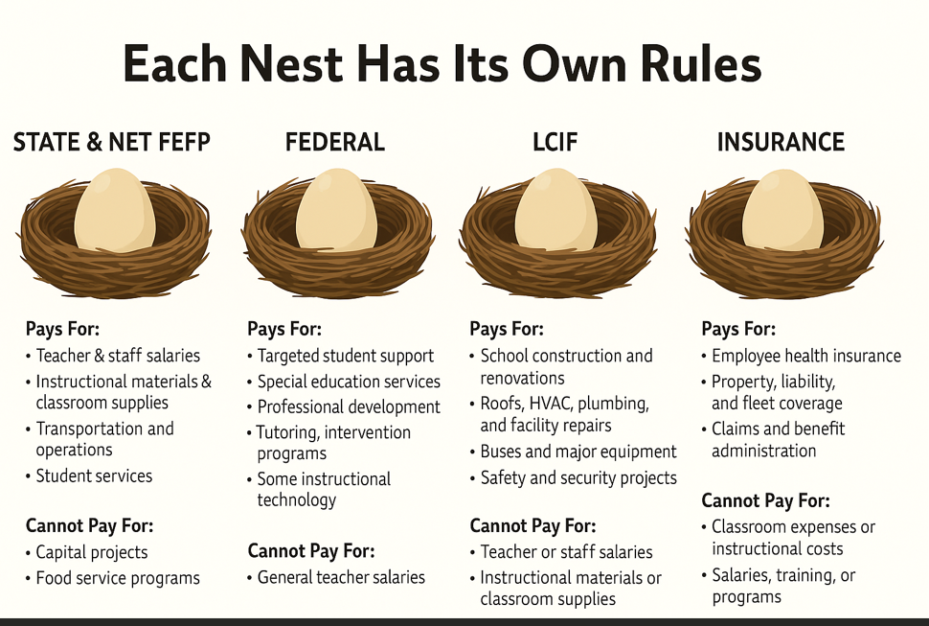
Funding Sources:
Notes:
What do you see from this chart? Where do teachers salaries come from ? General Fund.

Slide 3
Budget
Fund Source | Type of Funding | Estimated Total
🟩 General Fund | State + Local | $69,629,390
🟦 Special Revenue Fund | Federal (Perkins, Title, etc.) | $12,446,613
🟥 Debt Service Fund | Dedicated Debt Payments | $125,000
🟨 Capital Projects Fund | PECO, Local Capital Outlay | $12,765,429
🟧 Internal Service Fund | Insurance, Self-Funded | $17,279,246
➡️ Total All Funds | Combined District Revenue | $112,245,677
Notes:
Do you even know what the school district's budget is?

Slide 4
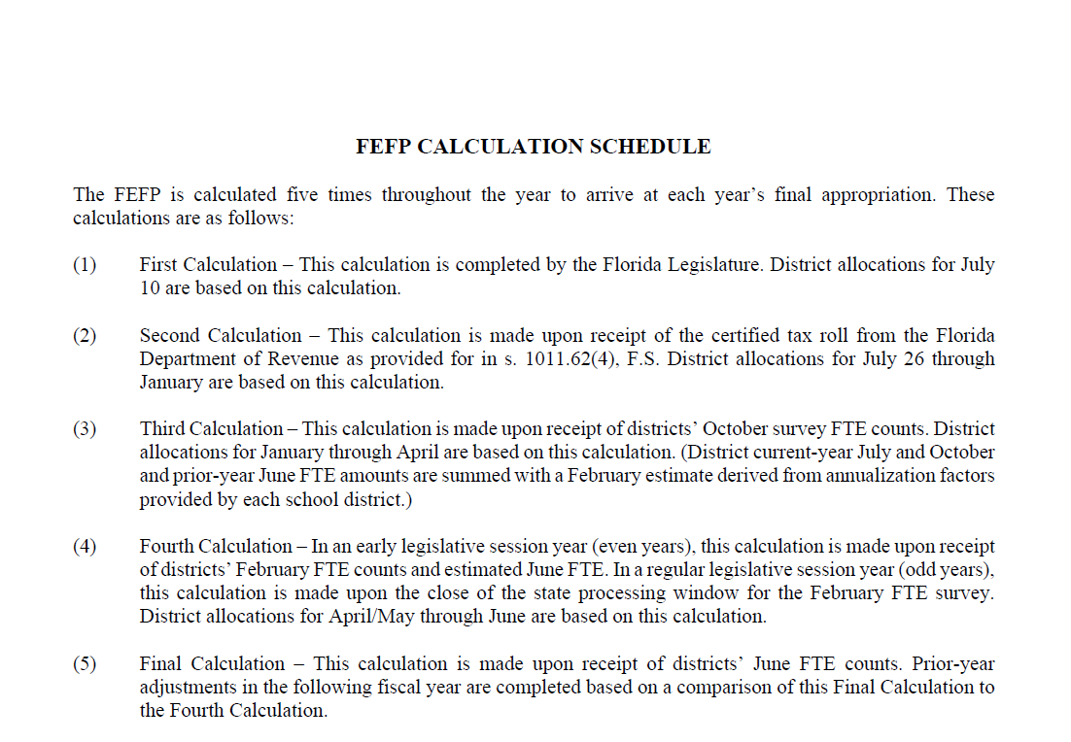
Notes:
Everything we do is a projection then an adjust to actual as you can see from here. We project the student enrollment and hope that we hit the target. 3rd calculation decrease ( explain this to them).

Slide 5

Family Empowerment Scholarships
How much does that remove from our district to fund teacher salaries?
Notes:
Plain Explanation:
The Family Empowerment Scholarship (FES) is money the state gives to families so they can choose where their child goes to school — public, private, or other approved options.
The funding for it comes from the same pot of state money that supports public schools, called the FEFP (Florida Education Finance Program). So when a student takes a Family Empowerment Scholarship and leaves a public school, the dollars that would’ve gone to that public school follow the student to pay for their new school instead.
In short:
The FEFP is the main source of school funding in Florida.
The FES pulls from that same source.
When students use the scholarship, public schools receive less funding because those students (and their FEFP dollars) are no longer counted in the district’s enrollment.

Slide 6
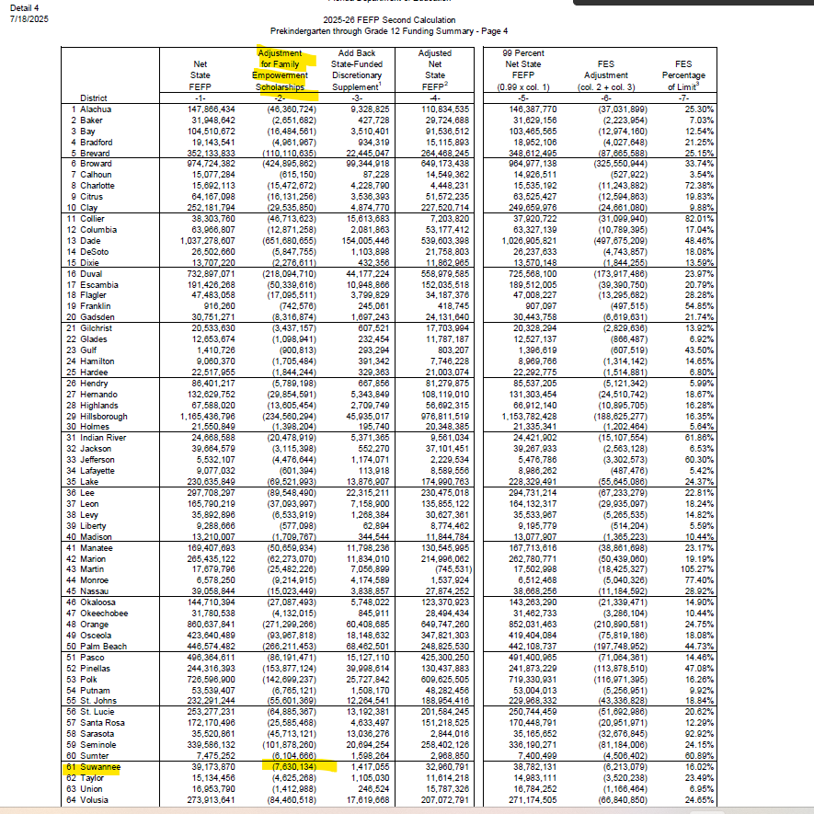

Notes:
Do you know when you are in the community and say anything negative? Do you know the cost of negativity? For us $7,630,134 ! Think about the cost to your paychecks as this money flows out. Remember “ the cost of negativity”

Slide 7
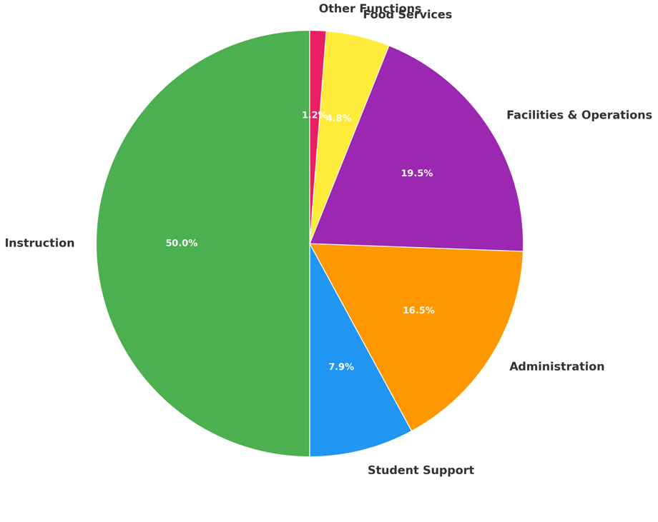
Notes:
All monies- all funding sources- The green represents the amount spent on instruction.

Slide 8
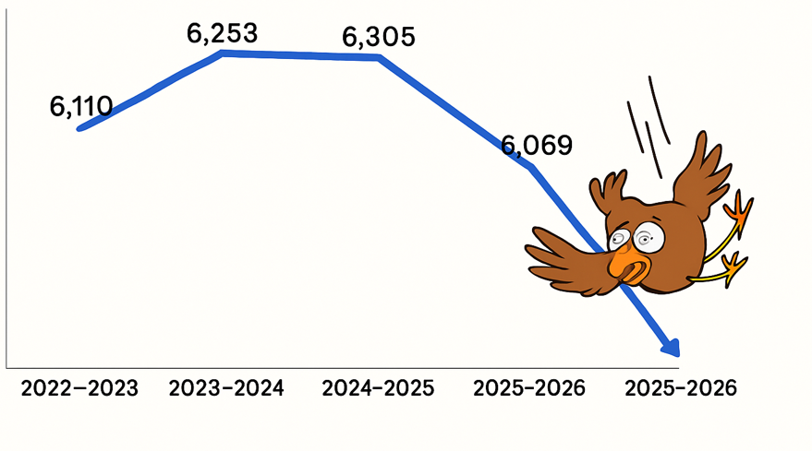
Declining Enrollment
Notes:
Every student we lose impacts our ability to fund teaching positions, programs, and resources —
while the cost of maintaining buildings, staff oversight, and compliance stays the same. Enrollment drives funding — but not all costs are flexible

Slide 9
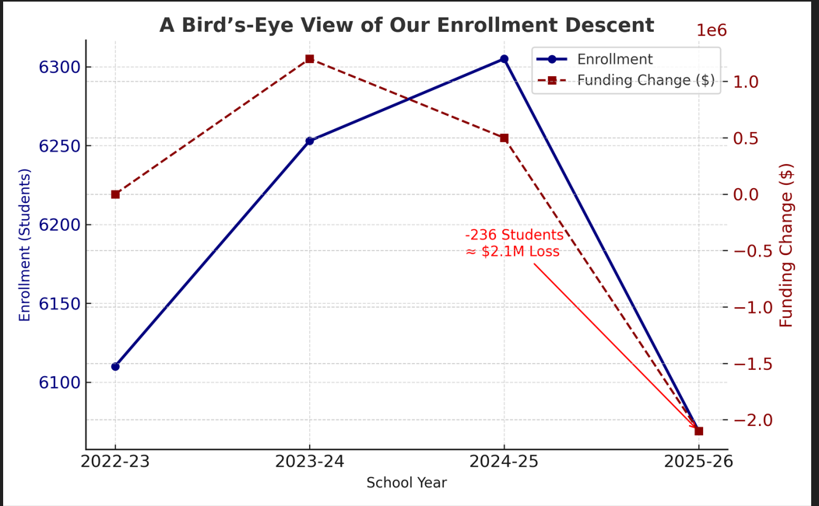

Slide 10
School | 2024–25 Enrollment | 2025–26 Enrollment | Change | % Change
Branford Elementary | 718 | 645 | −73 | −10.2%
Branford High | 806 | 829 | +23 | +2.9%
RIVEROAK Technical College | 537 | 442 | −95 | −17.7%
Suwannee High | 1,196 | 1,182 | −14 | −1.2%
Suwannee Middle | 970 | 915 | −55 | −5.7%
Suwannee Opportunity | 62 | 54 | −8 | −12.9%
Suwannee Pineview Elementary | 663 | 624 | −39 | −5.9%
Suwannee Riverside Elementary | 901 | 881 | −20 | −2.2%
Suwannee Springcrest Elementary | 608 | 594 | −14 | −2.3%
Total | 6,305 | 6,069 | −236 | −3.7%
Notes:
Visual chart- what do you see here? All negatives- Declining enrollment- without “cheeks in the seat” we do not get funded. Surveys- student counts are important for us.

Slide 11
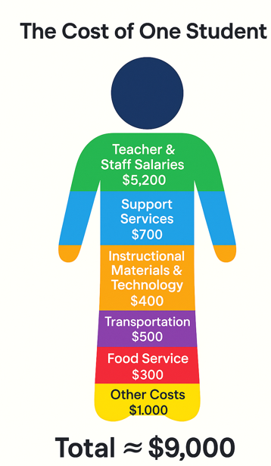
Category | Approximate Cost per Student
Teacher & Staff Salaries | $5,200
Transportation | $500
Facilities & Utilities | $600
Instructional Materials & Technology | $400
Support Services (counselors, aides, nurses) | $700
Administration | $300
Food Service | $300
Other Costs (insurance, supplies, maintenance) | $1,000
Total | ≈ $9,000
Notes:
I wanted to give you a visual of costs to help you understand the approximate cost of one student.

Slide 12
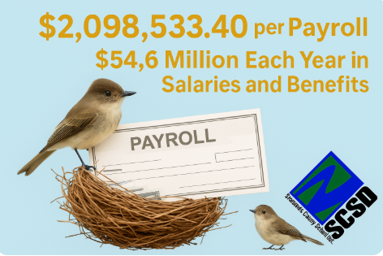
Notes:
Can anyone guess how much it cost Suwannee County schools across ALL FUNDS to run one payroll?

Slide 13
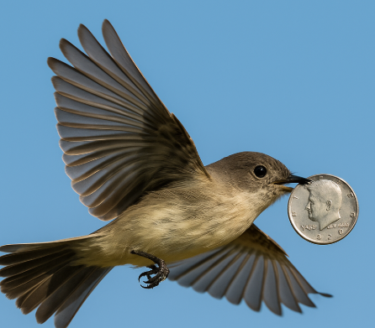
Nearly half of every dollar supports the people who make learning possible:
Teacher Salary Increase: $2,802,597
Substitute Costs (24/25): $877,785.90
Instructional Materials: $1,760,000
Insurance Contributions & HSA: $3,600,000
Supplements $680,165.49
Notes:
Did you know what the district pays to support you and our students? It looks different when you see it in black and white. This is the information I want you to spread in the community- factual information.

Slide 14

From the Ground It Looks One Way… From Above, We See More
RTC Nursing Expansion- PECO funding
Teacher Academy- Perkins Grant (Federal)
Storage for the district- Local Capital Outlay
Branford Women’s Club- Local Capital Outlay

Slide 15

vision and mission
Suwannee County School District will be a system of excellence ensuring all students are prepared for personal success. Suwannee County Schools will educate all students in a safe and supportive learning environment that will develop life-long learners and productive citizens.
Notes:
I am an advocate for public school funding because I know what we offer. I also know what it cost to run the day to day operations. Just because enrollment declines the amount of buildings we have to maintain, buses that need to room, and administrative oversight do not decline – only the funding. Day to Day operations cost the district. When you look at the children you see sweet Sally- I see approximately $9000. I have to look at numbers not people as we move through these unprecedented funding times.

Slide 16

Being Good Stewards of Public Funds
As we look ahead, our commitment remains the same, to be transparent, responsible, and good stewards of the tax dollars entrusted to us.
Our job is to ensure everyone employed receives a paycheck.
If you have any questions or would like to learn more, please don’t hesitate to reach out. We’re always here to help you see the full picture.
Notes:
I will be sending this or I can present to your staff or send someone from our Finance dept.

