Slide 2

Impasse Is War!
Leonard J. Dietzen
Prepared by Leonard J. Dietzen, III, Esquire © 2026 Rumberger, Kirk & Caldwell, P.A.

Slide 3
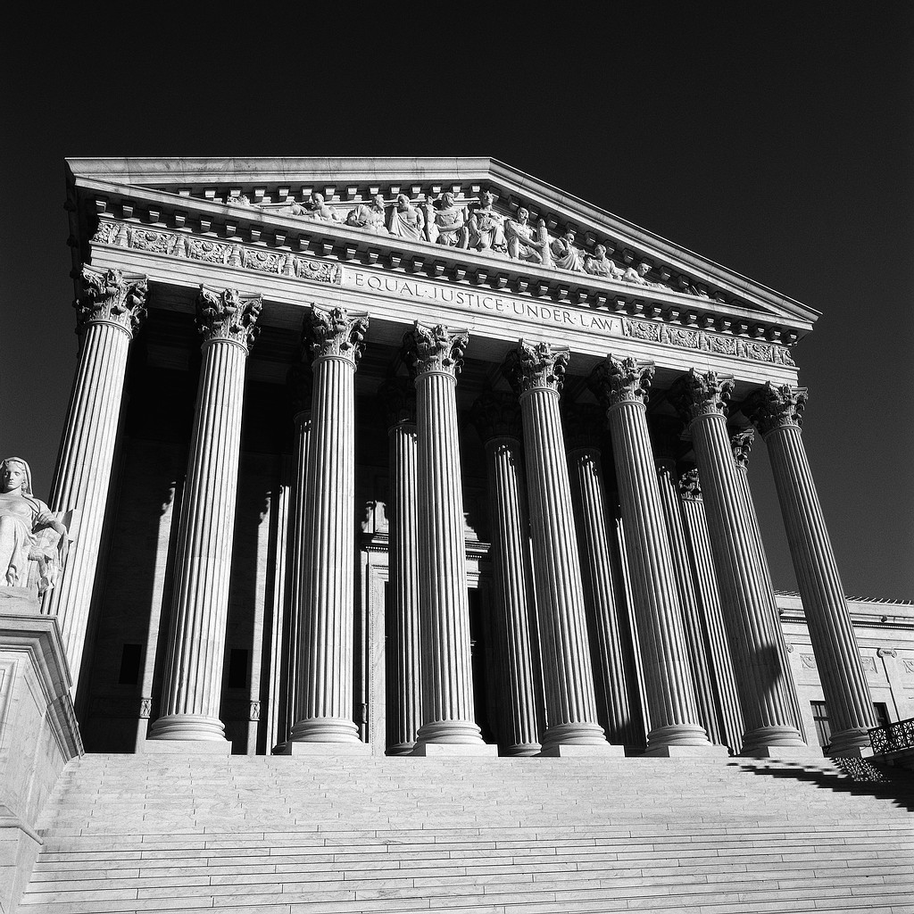
Impasse Process
Public Employees –
Resolution of Impasses
Sec. 447.403, Florida Statutes (2025)
© 2026 Rumberger, Kirk & Caldwell, P.A.
Notes:
Impasse is not a four-letter word; it’s a seven-letter word.

Slide 4

Union or Board Declares Impasse
If after a reasonable period of negotiations…an impasse shall be deemed to have occurred when one of the parties so declares in writing to the other party and to the commission.
Sec. 447.403(1), F.S.
© 2026 Rumberger, Kirk & Caldwell, P.A.

Slide 5

Parties May Appoint Mediator
When an impasse occurs, the public employer or the bargaining agent, or both parties acting jointly, may appoint, or secure the appointment of, a mediator to assist in the resolution of the impasse.
Sec. 447.403(1), F.S.
© 2026 Rumberger, Kirk & Caldwell, P.A.

Slide 6

Special Magistrate Appointed
If no mediator is appointed, or upon the request of either party, the commission shall appoint, and submit all unresolved issues to, a special magistrate acceptable to both parties.
Sec. 447.403(2)(a), F.S.
© 2026 Rumberger, Kirk & Caldwell, P.A.

Slide 7

Resolution by Legislative Body
However, if the parties agree in writing to waive the appointment of a special magistrate, the parties may proceed directly to resolution of the impasse by the legislative body pursuant to paragraph (4)(d). Sec. 447.403(2)(a) and (4)(d), F.S.
If waive Special Magistrate, the insulation period begins. (No Executive Sessions allowed.)
© 2026 Rumberger, Kirk & Caldwell, P.A.

Slide 8

Resolution by Legislative Body
The legislative body shall take such action as it deems to be in the public interest, including the interest of the public employees involved.
© 2026 Rumberger, Kirk & Caldwell, P.A.

Slide 9

Hearings before Special Magistrate
The special magistrate shall hold hearings in order to define the area or areas of dispute, to determine the facts relating to the dispute, and to render a decision on any and all unresolved contract issues.
Sec. 447.403(3), F.S.
© 2026 Rumberger, Kirk & Caldwell, P.A.

Slide 10
What to Do
Prepare for hearing like you want to win, and you are at war.
Research the Special Magistrate’s prior recommendations and reports on PERC’s website.
Follow blueprint set forth in § 447.405, F.S. “Factors to be considered by special magistrate.”
Organize presentation so Special Magistrate knows what you want.
Make sure you understand exactly what the issues at impasse are.
Know your opposing counsel’s style.
© 2026 Rumberger, Kirk & Caldwell, P.A.

Slide 11
Factors to Consider
Section 447.405, Florida Statutes, requires the Special Magistrate to consider certain factors.
Comparisons of annual income in local area in similar work;
Comparisons of annual income in similar public employment of comparable size throughout the state;
Interest and welfare of the public;
Comparisons to other trades or professions; and
Availability of funds; trends are relevant even if FCR is above 5%.
© 2026 Rumberger, Kirk & Caldwell, P.A.

Slide 12
What Not to Do
Do not assume preparation is unnecessary because the Board makes the final decision.
  This may be true but a strongly worded recommendation from the special magistrate has political power for the union.
  Preparation leads to better data for the special magistrate.
Fail to cost out the union’s proposals and demonstrate why they are not reasonable.
Fail to show impact on next year’s budget.
© 2026 Rumberger, Kirk & Caldwell, P.A.

Slide 13

Special Magistrate’s Recommendation
Within 15 calendar days after the close of the final hearing, the special magistrate shall transmit his or her recommended decision to the commission and to the representatives of both parties by registered mail, return receipt requested. Sec. 447.403(3), F.S.
(Is this recommendation a public record?)
© 2026 Rumberger, Kirk & Caldwell, P.A.

Slide 14
Parties Accept or Reject
Such recommended decision shall be discussed by the parties, and each recommendation of the special magistrate shall be deemed approved by both parties unless specifically rejected by either party by written notice filed with the commission within 20 calendar days after the date the party received the special magistrate’s recommended decision. The written notice shall include a statement of the cause for each rejection and shall be served upon the other party.
Sec. 447.403(3), F.S.
© 2026 Rumberger, Kirk & Caldwell, P.A.

Slide 15
If Either Party Rejects…
The Chief Executive Officer (CEO) of the governmental entity involved shall, within 10 days after rejection of a recommendation of the special magistrate, submit to the legislative body of the governmental entity involved a copy of the findings of fact and recommended decision of the special magistrate, together with the CEO’s recommendations for settling the disputed impasse issues. The CEO shall also transmit his or her recommendations to the employee organization.
Sec. 447.403(4)(a), F.S.
© 2026 Rumberger, Kirk & Caldwell, P.A.
Notes:
Who is CEO for impasse for a Charter School? (no one – no union)

Slide 16

If Either Party Rejects…
The employee organization shall submit its recommendations for settling the disputed impasse issues to such legislative body and to the CEO.
Sec. 447.403(4)(b), F.S.
© 2026 Rumberger, Kirk & Caldwell, P.A.

Slide 17
Public Hearing
The legislative body or a duly authorized committee thereof shall forthwith conduct a public hearing at which the parties shall be required to explain their positions with respect to the rejected recommendations of the special magistrate.
© 2026 Rumberger, Kirk & Caldwell, P.A.

Slide 18
Public Hearing
Who determines the format of the hearing?
Time allotted for each side to present
Oral argument or evidentiary hearing with witnesses
© 2026 Rumberger, Kirk & Caldwell, P.A.

Slide 19
Public Hearing
Thereafter, the legislative body shall take such action as it deems to be in the public interest, including the interest of the public employees involved, to resolve all disputed impasse issues.
Sec. 447.403(4)(c)(d), F.S.
© 2026 Rumberger, Kirk & Caldwell, P.A.

Slide 20
Citizen Input During Hearing
(2) Members of the public shall be given a reasonable opportunity to be heard on a proposition before a board or commission.
(3) The requirements in subsection (2) do not apply to:
(d) A meeting during which the board or commission is acting in a quasi-judicial capacity.
Sec. 286.0114(2), (3) and (3)(d), F.S.
© 2026 Rumberger, Kirk & Caldwell, P.A.

Slide 21
Agreement
Following the resolution of the disputed impasse issues by the legislative body, the parties shall reduce to writing an agreement which includes those issues agreed to by the parties and those disputed impasse issues resolved by the legislative body’s action.
The agreement shall be signed by the CEO and the bargaining agent and shall be submitted to the public employer and to the public employees who are members of the bargaining unit for ratification.
What happens to the other tentative agreements during the impasse process?
Sec. 447.403(4)(e), F.S.
© 2026 Rumberger, Kirk & Caldwell, P.A.

Slide 22
Executive Sessions
Permitted until special magistrate’s recommended settlement is rejected or until parties mutually agree in writing to waive the special master procedure. This is known as the “insulation period.”
After that time, the Board becomes a neutral body for the purposes of the impasse process.
© 2026 Rumberger, Kirk & Caldwell, P.A.

Slide 23
Disclaimer
The information provided during this presentation is not intended for legal advice. The presentation, and any handouts which may accompany it, provide general information on the impasse process and answers to common questions about this issue. Please consult an attorney to assure that this information, and your interpretation of it, is appropriate to your particular situation.
© 2026 Rumberger, Kirk & Caldwell, P.A.

Slide 24

Thank you! Applause optional…
Leonard J. Dietzen, III, Esquire
Rumberger, Kirk & Caldwell, P.A.
P.O. Box 10507
Tallahassee, FL 32302-2507
(850) 222-6550
ldietzen@rumberger.com
© 2026 Rumberger, Kirk & Caldwell, P.A.

