Slide 1
Best Practices for Strengthening Employee Voice Post-Union Decertification
Law, Process and Impact (Post 2023)
John Boyd, Osceola County
Mark West, Semi-retired

Slide 2
What Is Union Decertification?
Removal of a union as exclusive representative
Ends collective bargaining authority
Employees lose union representation
Notes:
Move quickly through these first three slides.

Slide 3
Legal Framework in Florida
Governed by Florida Public Employees Relations Act
Overseen by Florida Public Employees Relations Commission
Applies to most public-sector workers

Slide 4
Traditional Decertification (Pre-2023)
Employee-driven process
Petition required (~30% of workers)
Secret-ballot election
Majority vote determines outcome

Slide 5
2023 Law: SB 256
Introduced major changes to union requirements
Focus on membership levels and accountability
Key Provision: 60% Membership Rule
Unions must maintain ≥60% dues-paying membership
Applies to most public-sector unions
Verified by PERC
Notes:
John, I think this is where you insert your documents from SB 1296

Slide 6
Perspective of Supporters and Critics
Supporters
Critics
Promotes accountability
Prevents “inactive” unions
Ensures majority support
Weakens unions
Removes worker voting step
Unequal treatment due to exemptions
Administrative burden on unions
Notes:
Decide whether we want to keep these next two slides or not. I can go through them quickly.

Slide 7
Real World Effects
For Unions
For Districts
Increased membership drives
Some unions decertified
Ongoing legal and political debate
More recertification elections
Requirement to review policies and procedures
Communication with all employees
Coordination with Administrative teams and representative groups

Slide 8
Practical application
Volusia example of ASCFME decertification:
  Jan 24 – Failed to comply with 60% rule
  Chose not to recertify
  Did not respond to show cause order
Result – Decertification of ASCFME union
Next steps
  Communication
  Good Leadership
  Anticipate timeline
Final – You are the most important part of this process.
Notes:
The president at the time said we will not recertify. Had other factions apply for certification – IUPAC for security, bus drivers tried to unionize
They failed 60% - had less than 20% at the time. PERC gave them the opportunity to show cause, they didn’t respond and were decertified.
Communication - We knew this ahead of time and started meeting with each representative group individually. I met with bus drivers/mechanics by area, custodians by area, maintenance workers as a group, student nutrition by area, and security officers by going out to each area and set up town hall meetings. Specifically addressed what happens when the union is decertified. Listened to what they wanted to have happen and any additional wants. Most items revolved around money – Agreed to uphold incentives in the contract; ie – attendance incentives, longevity bonuses, uniform allowance. Agreed to look at areas of critical need ( bus drivers and mechanics) – eventually raised hourly rate to 23.00 per hour for drivers to be competitive. Find any way for a win. Make sure they felt heard. Find someone who will listen.
Good leadership makes for a smoother transition. Met with supervisors and mid level managers to inform them that contract processes and procedures would continue as usual. Any grievances would continue to be handled in the same fashion – with level 1 at the supervisor level first, then move to HR for next level, then so forth as spelled out in contract. This aligned with board policy anyway.
Anticipate – Look the specific date when your unions recertify. They may buy an additional year depending on certification date. Anticipate them not meeting recertification. Don’t wait to meet about potential decertification. Work with your union on this.
Final – We’ve always been the glue that has held the district together. We’ve always been the union whisperers, the board whisperers, the principal whisperers, the superintendent whisperers, and the lawyer whisperers. We will continue to be, but now we not only have to represent the district, we have to represent our own employees. Just like we always have.

Slide 9
What does this mean for you… potentially
Town hall meetings
Review of alignment of CBA with current policies and procedures
Political Implications
Legal Implications
Convincing administrative team that current processes remain
  Fairness
  Representation
  Appeal process for grievances
Notes:
Review of policies – Compare to current CBA. Identify any potential gaps in policy
Political – Will board support union or district decisions due to political pressure from individual teachers
Legal – cannot individually bargain with employees; coaching supplements
Practical questions – employee status – should support employees remain as continuous contract or annual?
How will this affect representation? – Will splinter unions want to jump into the fray?

Slide 10
Senate Bill 1296
Overview of Current versus New State Law

Slide 11
Comparative Summary: Existing Law versus SB 1296 Changes …
Topic | Existing State Law | New Law Under SB 1296
Union Recertification Elections | Majority of votes cast by participating employees | Majority (50% + 1) of all bargaining unit employees must vote; and Majority (50% + 1) of participating employees must vote in favor
Membership Authorization | Authorization valid until revoked; limited timing requirements | Organizations must revoke membership and dues collection within a specified timeframe upon withdrawal or ineligibility
PERC Subpoena Service | Primarily personal service | Service authorized by: certified mail or personal service
Registration and Renewal | Standard registration with limited waiver authority | Expanded requirements for: application, annual renewal, and waiver authority

Slide 12
… Comparative Summary: Existing Law versus SB 1296 Changes
Topic | Existing State Law | New Law Under SB 1296
Impasse Resolution | More limited criteria for financial urgency | Legislatively directed salary appropriations are now deemed a financial urgency.
Appeals & Final Orders | Mixed statutory standards | Conformed to Chapter 120, Florida Statutes
Paid Leave Restrictions | No such prior restrictions | Limits paid leave for union activities unless the union reimburses the employer per contract. Permits paid leave for representational work per contract: Bargaining meetings Grievance proceedings

Slide 13
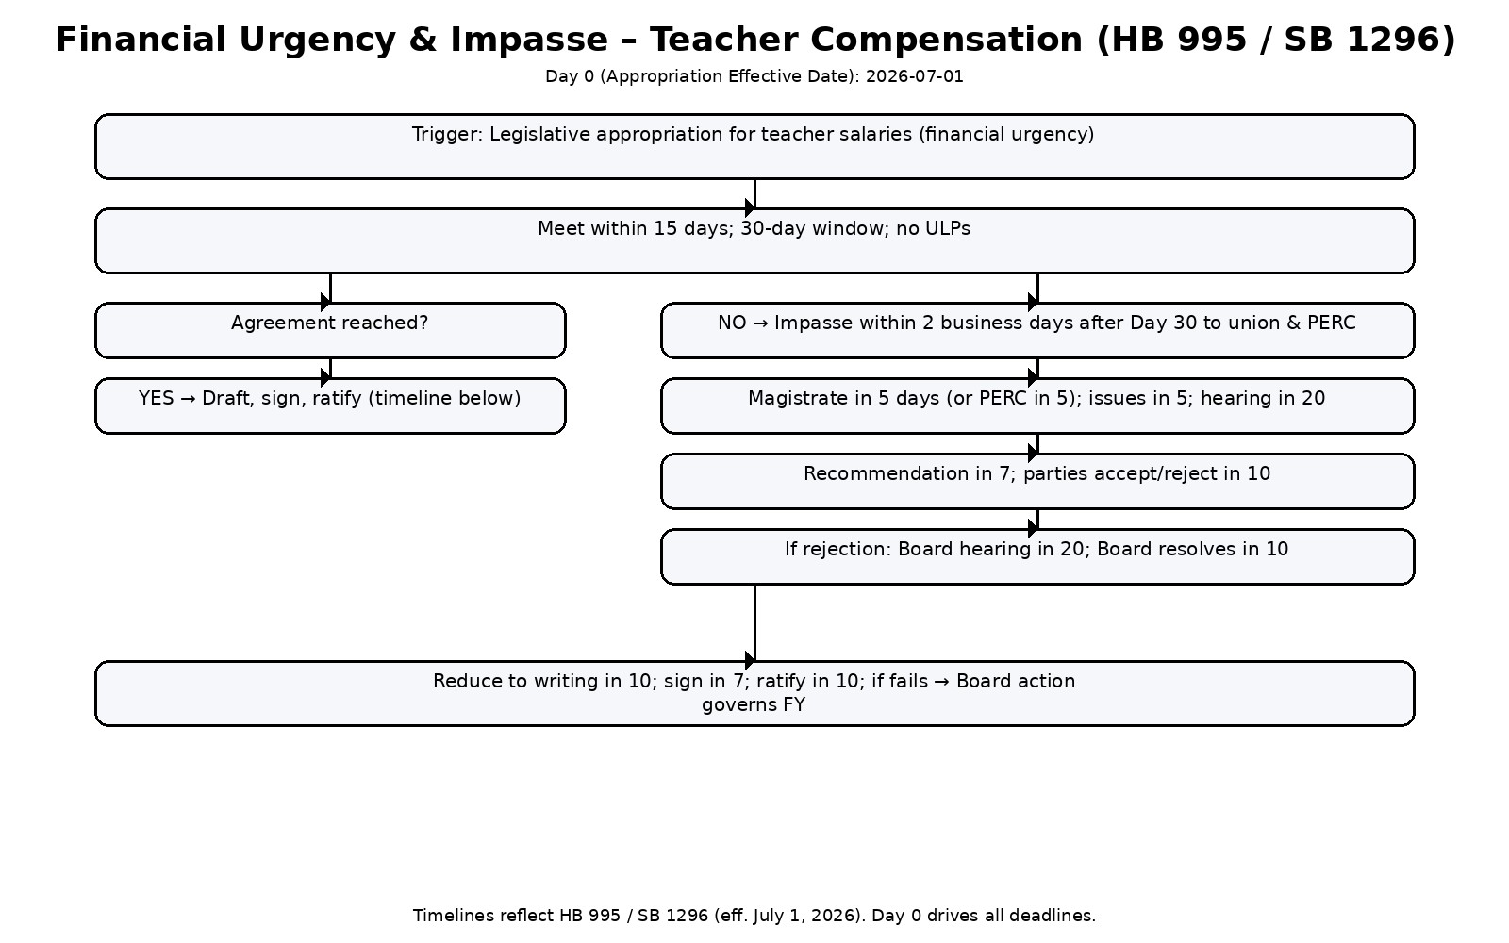

Slide 14
Senate Bill 1296
Immediate Communication and Next Steps

Slide 15
Tools for Changes: SB 1296
One-Page School Board Briefing: Senate Bill 1296
Sample School Board Agenda Item
Sample School Board Resolution
Principal’s One‑Pager: Senate Bill 1296 and Next Steps
Staff FAQ: Senate Bill 1296 and Next Steps
Sample District-Specific Implementation Timeline

Slide 16
Post Union-Decertification
Immediate Communication and Next Steps

Slide 17
Tools for Changes:
Post-Union Decertification Communications
Post-Union Decertification: Now What?
Post-Union Decertification Risk‑Mitigation Strategies
Post-Union Decertification Implementation Checklist
Neutral Employee Communication Template

Slide 18
Post Union-Decertification
Strategies to Operationalize Employee Voice

Slide 19
Tools for Changes:
Post-Union Decertification Strategies
How to Operationalize Teacher Voice Without a Bargaining Agent
Research-Based Strategies for Teacher Voice
Related Sample Policy Drafts
  DRAFT POLICY: Employee Communications
  DRAFT POLICY: Teacher Voice Framework

