Slide 1
Compete to Win: Rethinking How We Market Our Schools
Broward County Public Schools
Farrah Wilson
Office of Communications
Director, Marketing & Strategic Communications

Slide 2
Current Reality: Expected Five-Year Enrollment Outlook
2025-26
2026-27
2030-31
187,847
182,841
162,062
What This Means for Families and Staff
A multi-year enrollment decline translates into a multi-year budget challenge. That is why discussions about staffing, school footprint, and efficiency are happening in parallel.

Slide 3
What is Contributing to the Decline in Enrollment
Lower Birth Rates
Changes in Immigration Patterns
Less School-Aged
Children Moving to Broward
County births have trended down. Fewer births today result in smaller kindergarten classes in future years.
Recent immigrant enrollment fell sharply from current feeder countries, contributing to lower new student counts.
Broward is highly built out. New housing, especially single-family housing, is lower than peer counties, limiting family growth.
More School Choice
Options
Fewer Students Entering Than Graduating
Fewer Students Replacing Those Who Leave
Voucher-supported private and home education options expanded rapidly. Family Empowerment Scholarship (FES) participation reached 35,491 in 2025-26 in Broward.
More students are graduating than entering in kindergarten, putting pressure on enrollment before withdrawals are even counted.
Every year, students graduate from BCPS, but fewer new students enroll to replace them, leading to an overall enrollment decline.

Slide 4
A Key Reality: Enrollment Has Fallen Faster Than Staffing
Enrollment Level 2015-16 through 2025-26
Loss of (38,648) students since 2017-18 = ($352,169,852)
as of 2025-26
[at $9,112.24 per student]
230,000
220,000
210,000
200,000
190,000
/ / /
District-managed student enrollment fell from 221,227 in 2017-18 to 182,579 in 2025-26
That is a loss of 38,648 students, equal to roughly $352.2 million at the current per student funding
Minimal change in staffing levels, which is why one-time savings are not enough
The District is spending more than it receives in funding
($80.1M)
(8,789)
Break in scale
Student Enrollment
Staffing Levels (Filled Positions in the General Fund)
Notes:
[Sources]
Chart image taken from slide 2 of Budget_Presentation_-__REVISED.pdf, which the user specifically asked to retain.
Numeric claims on UFTE and revenue-equivalent loss are taken from that same slide.

Slide 5
Competing Starts at the School Level

Slide 6
School leaders went to school to educate students, not be marketers, yet we expect them to compete in a crowded marketplace.
Today’s enrollment environment requires storytelling, branding, targeting, and consistency.
Competing effectively means providing schools with professional marketing strategy, tools, and support, not asking leaders to become something they were never trained to be.

Slide 7
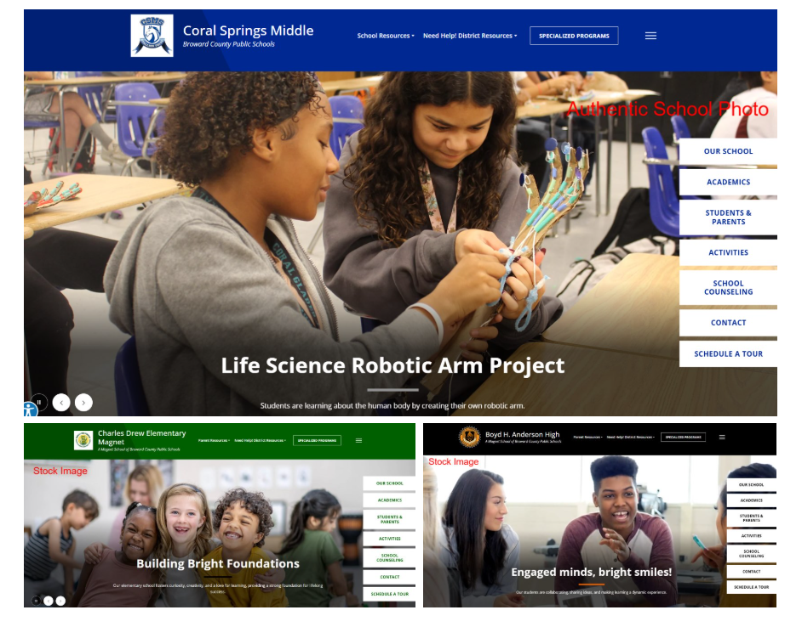
Connecting the Dots for School Leaders
School
Websites
Social Media
Enrollment Inquiries & School Tours
Marketing & Branding

Slide 8

Social Media
School
Websites
Social Media
Enrollment Inquiries & School Tours
Marketing & Branding

Slide 9
Selecting the Right Platform
Facebook
Primary Audience: Current parents and caregivers
Typical Age Range: 30–65+
Best Used For:
School announcements and reminders
Event information and schedules
Family resources and updates
Photo albums from school activities
Collaboration with PTA account
Why It Works:
Facebook remains the most widely used platform for adult and family communication.
Instagram
Primary Audience: Prospective parents, students and the school community
Typical Age Range: 13–44
Best Used For:
School culture and campus life
Student voice, feedback and involvement
Student celebrations and achievements
Collaboration with school clubs and programs
Photos, reels and short videos
Visual storytelling that builds school pride
Why It Works:
Strong visuals help families connect emotionally with your school’s story.
X
Primary Audience: District Staff, community members, municipalities, partners, organizations, media and engaged parents
Typical Age Range: 25–54
Best Used For:
Real-time updates and announcements
Weather, safety and emergency information
Event reminders and live coverage
Public-facing highlights and District messaging
Why It Works:
X supports timely communication and broad community visibility.

Slide 10


Follow Us Moment/Testimonial Tuesdays
Each school posts a customized “Follow Us” message on its social media channel(s) using the District template at the scheduled date/time (all schools posting simultaneously)

Slide 11
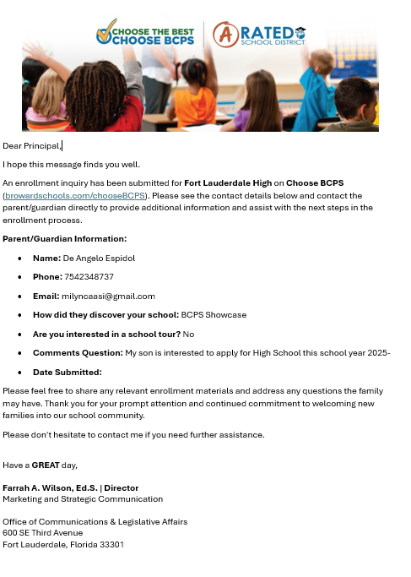

Enrollment Inquiries & School Tours
School
Websites
Social Media
Enrollment Inquiries & School Tours
Marketing & Branding

Slide 12
Enrollment Inquiries
12,200
Enrollment Inquiries
12/24 -6/25 (6 months)
11,000
Enrollment Inquiries
7/25 – 5/26 (10 months)
1200
Total to date (5/26)

Slide 13
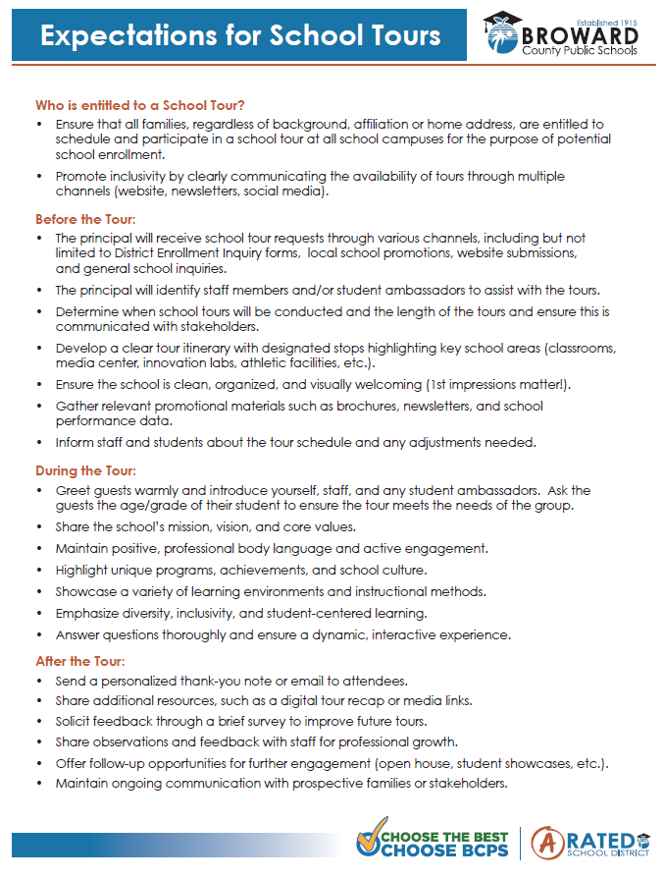
School Tours

Slide 14
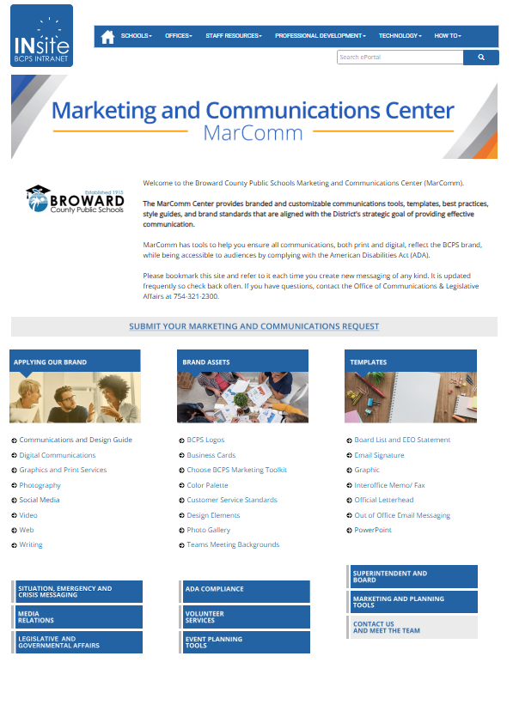
Marketing and Branding
School
Websites
Social Media
Enrollment Inquiries & School Tours
Marketing & Branding

Slide 15
Marketing and Branding Templates
School Communications Blueprint: School Story, Strengths and Key Messages Worksheet
Next Steps to Close Marketing/Branding
Mission & Vision
Identify School’s Core Strengths
Identify Stakeholder Groups
AI Prompts (Tell School Story, Create Value Proposition, Principal Annual Message, etc.)
Submit the following to your Director for review and approval:
• Completed school story
• One-sentence Key Message (School Promise)
• Principal’s Message

