Slide 1

Current School District Insurance Risk Environment
A presentation for
The Florida Educational Negotiators
February 27, 2026

Slide 2
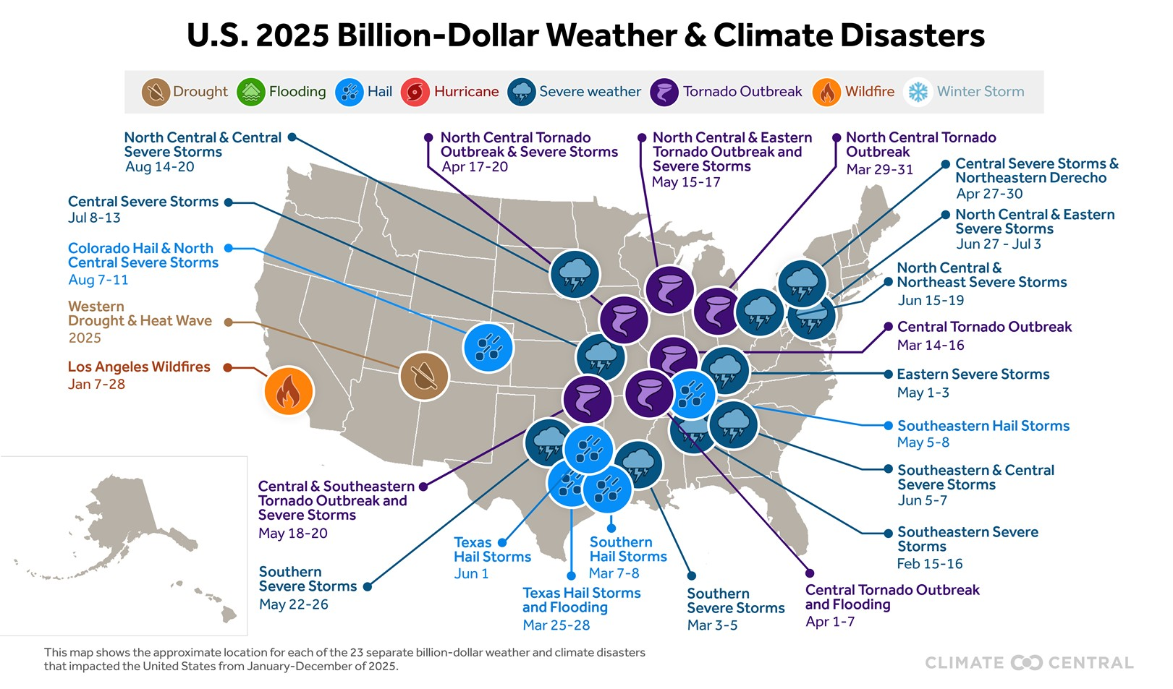


Major U.S Losses in 2025
Quantity of U.S. Billion-Dollar Weather & Climate Disasters (2020 - 2025):
  2025 - 23
  2024 - 27
  2023 - 28
  2022 - 18
  2021 - 20
  2020 - 22
Average # of US Billion-Dollar Weather & Climate Disasters from 1980-2025 – 9 events
Types & Quantity of U.S. Billion-Dollar Weather & Climate Disasters in 2025:
  Severe Storm - 10
  Tornado Outbreak - 6
  Hailstorm - 5
  Wildfire - 1
  Drought - 1
  Total - 23
Source: Climate Central
https://www.climatecentral.org/climate-services/billion-dollar-disasters

Slide 3

Property
Capacity
Coverage
Retentions
Pricing
Capacity exceeds demand.
Shared and layered programs are frequently seeing subscription levels above 150%
The combination is putting downward pressure on rates.
The underwriting emphasis on valuations is here to stay.
Ongoing uncertainty in global trade relations has further heightened carrier sensitivity to construction cost volatility.
In the absence of a compelling valuation narrative or adequate supporting data, underwriters are continuing to rely on provisions such as Occurrence Limit of Liability (OLLE) or Margin Clauses.
Overall, Insureds that have addressed their retentions and deductibles since the onset of the increased inflationary environment (2020) should experience minimal pressure on retention levels.
Two consecutive years of profitability has allowed for increased competition. Pricing and rate outcomes will continue to depend on a range of factors, including individual risk profile, loss history, industry class, the carriers’ view of rate adequacy, and any improvements implemented at the account level.

Slide 4
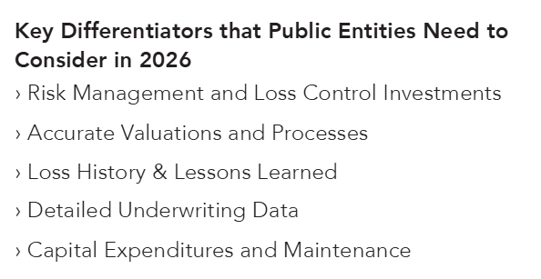
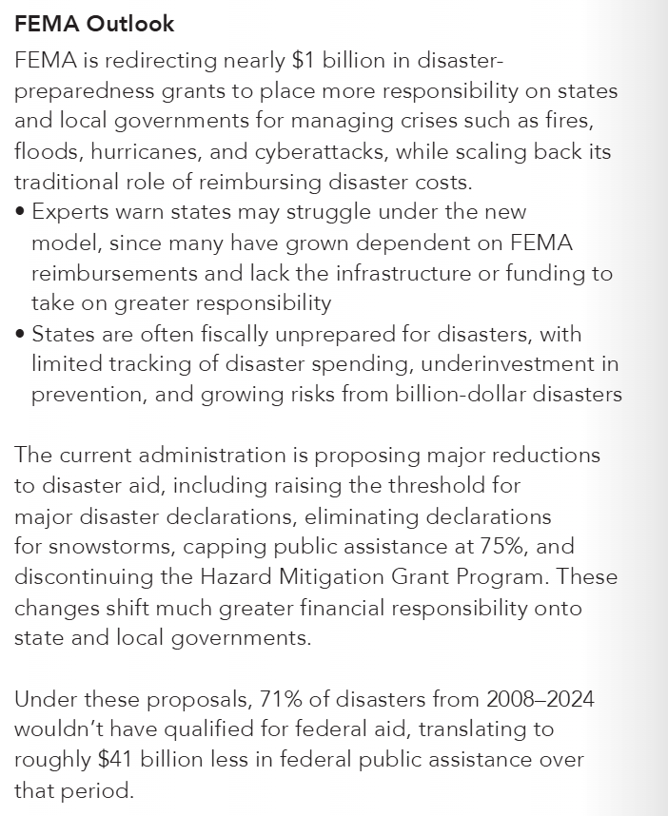
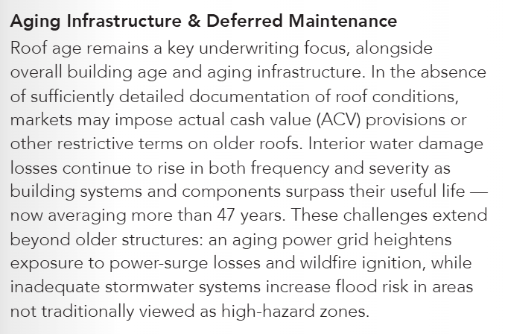
Property
Conditions

Slide 5
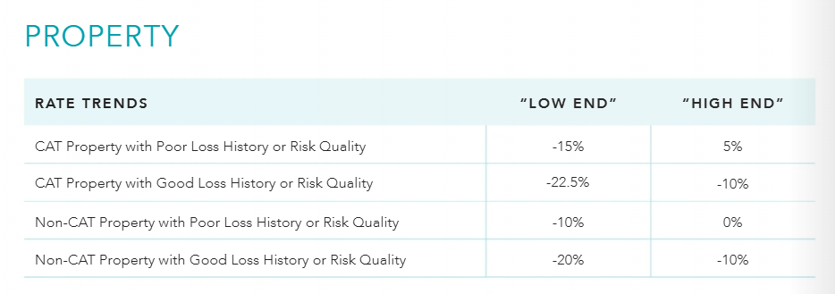

Slide 6
Property
Considerations
Where is your capacity compared to your 100 year event or PML?
Does your TIV match true replacement costs or are you limited by a margin clause?
What is your disaster recovery plan?
How much did you save this year for your future NWS deductible?
Is insurance a part of your deferred maintenance plan?
Watch for alternate offers designed maintain premium such as buy down of deductible or increased capacity.

Slide 7
Casualty Lines – GL, AL, WC, Excess & PL
Capacity
Coverage
Retentions
Pricing
Capacity is readily available for less complex risks.
Some insurers have pulled out of certain classes of business and market sizes all together.
Auto liability capacity continues to be limited due to rising claim frequency & severity, and an uptick in Hired and Non-owned losses.
PFOS and PFAS exclusions are generally non-negotiable.
Biometric data collection related underwriting questions and exclusions are increasing at a rapid pace due to tort law concerns.
Seeing increased use of Abuse & Molestation, Assault & Battery, Wildfire and Traumatic Brain Injury exclusions.
Emerging concerns regarding reliance on Artificial Intelligence (AI) and its implications.
Pressure remains on retentions. Attachment points should be analyzed and adjusted depending on risk appetite, with data, analytics and modeling tools utilized to make informed decisions. Alternative solutions, such as corridor deductibles and buffer layers, are becoming more common.
Auto repair costs (labor, parts and materials) keep rising, as does attorney representation in auto losses, and are contributing factors to the continued distressed auto market and continued significant rate increases.
Workers Compensation remains the most consistent profit generator for insurers.
Legal system abuse (social inflation) and third-party litigation funding (TPLF) are driving an increase in the frequency of severity losses.
State and federal lawmakers need to be more aggressive in tackling these abuses which are producing runaway jury verdicts and negatively impacting insureds.

Slide 8

Social Inflation: Legal System Abuse
Nuclear verdicts
2024
Number of reported thermonuclear verdicts over $100 million increased to 49 in 2024
135
$31.1 billion
$51 million
Number of nuclear verdicts that surpassed $10M,
a 52% increase over 2023
Total sum of nuclear verdicts
Median nuclear verdict
Insurance claim costs
Increasing Propensity to Sue
Size of Jury Awards
Courts/Juries Favoring Plaintiffs
Growing Distrust of Large Corps.
Litigation Financing
Aggressive Plaintiff Bar Ads
Changes in Regulatory and Legal Environment
Source: Marathon Strategies: Corporate Verdicts Go Thermonuclear 2025 Edition

Slide 9
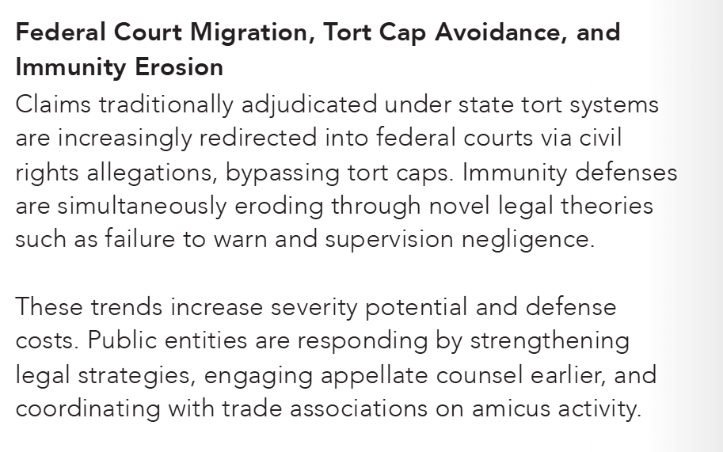
General Liability & Excess Liability
Increase in Catastrophic Losses
  Sexual Misconduct
  Law Enforcement Liability
  Lifetime Care Costs
  Punitive Damage Awards
Organized Plaintiff Bar
  Litigation Financing
  Settlement pressure driven by
  Nuclear Verdict Potential
  Erosion of Tort Reform
Inflationary Pressure
  Social Inflation
Aging Infrastructure

Slide 10



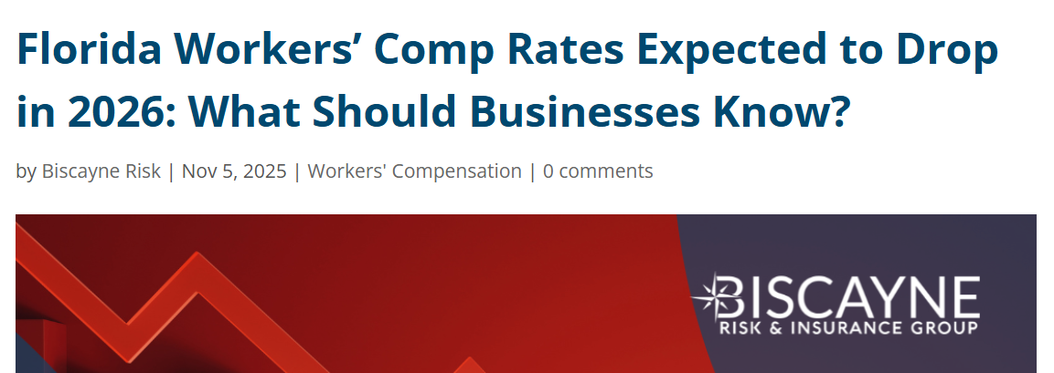
Worker’s Compensation
The “relatively” stable line of coverage in recent years
Accident frequency has been steady or slightly down
However, severity continues
to trend upward and there
are some disturbing trends
to keep an eye on

Slide 11
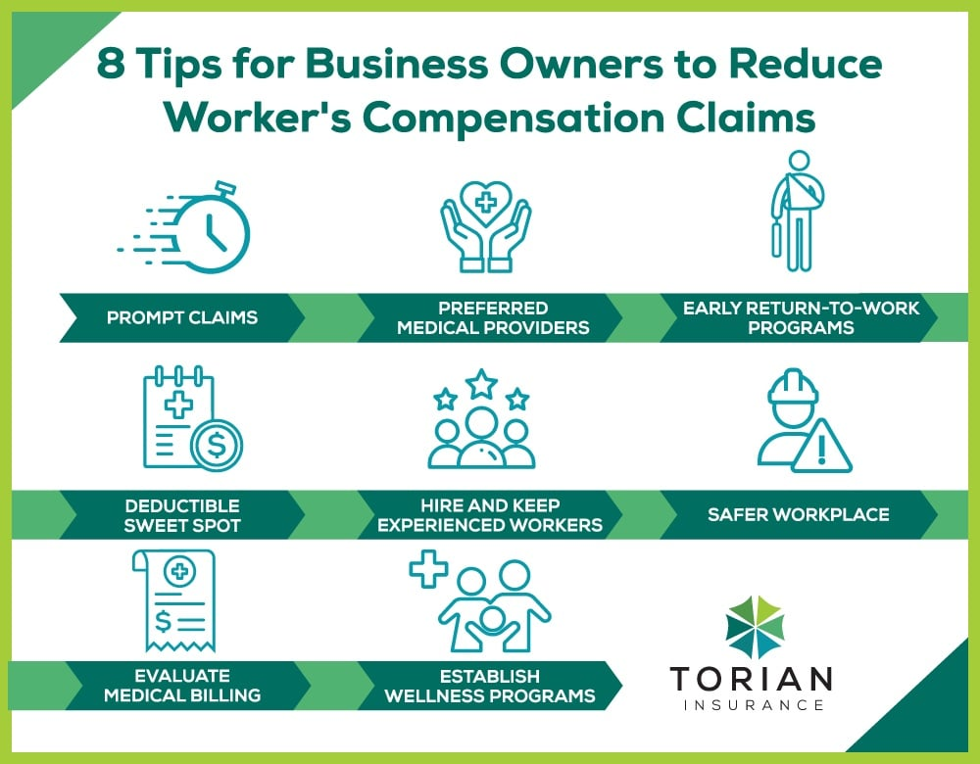
Worker’s Compensation Trends to Watch
Rising medical costs for catastrophic claims:
  Accident survivability
  Increased life expectancy for catastrophically injured workers
  Higher costs for medical care technology
  30% increase in claims incurred over $10M
Enhanced care with AI tools
Inflation, tariffs and stress on our medical system
The risk and needs of an aging workforce
Legal claim costs
Uptick in cumulative trauma claims
Mental health claims
Return to office

Slide 12
Auto Liability
Cost of Vehicle (inflation)
Cost to Repair (technology)
Fatality Trends
Distracted Driving- - Cell Phones
Rising Medical Costs
Rapid Rise in Litigation Costs
Use of Autonomous Driving
Increased fleet use of
Electric Vehicles
Automobile Liability Large Case Average Settlement Amount by Disposition Year
Wider Spread
Narrower Spread
Source: Zywave Casualty Data
NOTES:
Analysis considers US only Automobile Liability cases with recorded settlement or award value greater than $15M
Dollar amounts are unadjusted for inflation and economic trends

Slide 13


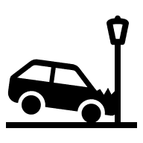
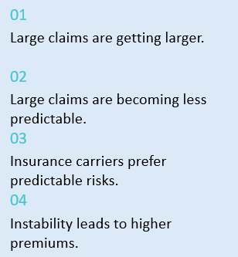
Auto Liability
Considerations
Fleet Policy Updates
Training – Stale or Refreshed?
Use of Telematics or Dash Cams
Collision Management
Theft and Vandalism Prevention and Protocol
Maintenance and Replacement Schedules
Routing, Scheduling, and Bus Stop Reviews

Slide 14
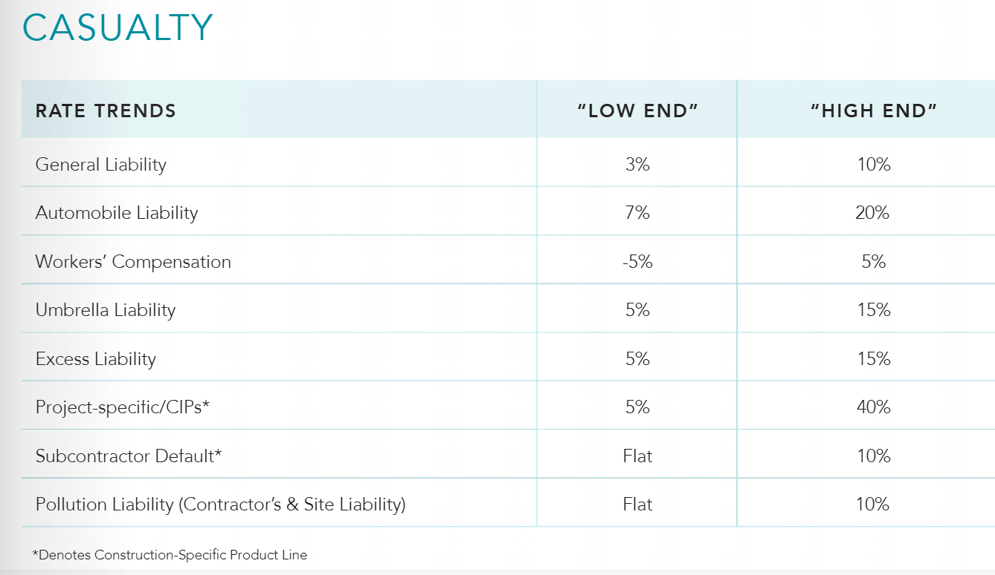

Slide 15
Cyber
Capacity
Coverage
Retentions
Pricing
Capacity has remained stable over the past year.
The markets for reinsurance, catastrophe bonds and insurance-linked securities are favorable and have allowed insurers to dilute their risk.
US insurers will now participate on large primary quota share layers, previously exclusive to the London market.
Broad coverage is available, as insurers compete for business via favorable terms and conditions.
Dependent Business Interruption can be provided at full limits, with losses tied to Non-IT Providers typically sublimited for System Failure Losses.
Sub-limits and restrictions for widespread events are rare and have not been adopted by the broader marketplace, although limitations on social engineering funds theft have emerged.
Systemic risk, such as the CrowdStrike and AWS remains the industry’s top concern.
Ransomware payments totaled $814M in 2024, down 35% from the record-setting $1.25B in 2023.
The reduction was driven by increased law enforcement actions, improved international collaboration, and a growing refusal by victims to pay.
Global cyber premiums were $15.3B in 2024, up nominally from ~$15B in 2023.
US cyber premiums declined by 2.3% in 2024, from $7.24B to $7.08B, due largely to premium reductions.
Despite ongoing claims activity, premiums continue to decline, however, we are beginning to see those decreases taper off, particularly for Healthcare and Public Entity with carriers looking to push flat to 10% increases.
Retentions have been reduced at a select few renewals in the past 12 months but have broadly remained unchanged.

Slide 16



Artificial Intelligence: Impact to Public Entity Risks
As Artificial Intelligence makes its way into governance
Key Risk Exposures for Agencies
Civil rights & due process
Decision errors
Data & IP
Cybersecurity
Procurement/ vendor risk
Potential bias in policing, benefits, hiring, housing decisions
Hallucinations, automation mistakes → liability, action reversals
Training-data ownership, copyright claims, public records obligations
Prompt injection, data leakage, model theft
Third-party AI tools expose agencies
to contractual
and liability gaps
Notes:
Cyber security prompt injection is a type of attack where malicious actors trick AI systems. These attacks can cause various threats, including sensitive data exfiltration, manipulation of AI-powered workflows, unauthorized command execution, and generation of harmful content. Defenders can use techniques like input validation, prompt layering, anomaly detection, and human oversight to mitigate these risks.

Slide 17
Cyber
    Requirement to evidence security posture:
      Multifactor Authentication (MFA) in place for all remote, email, backup and domain admin access;
      email security policies that automatically quarantine incoming email that fail basic security checks (e.g. SPF, DMARC, DKIM);
      a fully deployed Endpoint Detection Response (EDR) tool;
      at least annual employee cyber security awareness training including phishing simulations;
      patching of critical vulnerabilities within 7 days;
      local admin access denied to users and/or use of a local admin password solution (LAPS);
      backups encrypted and immutable/offline and tested at least annually.

Slide 18
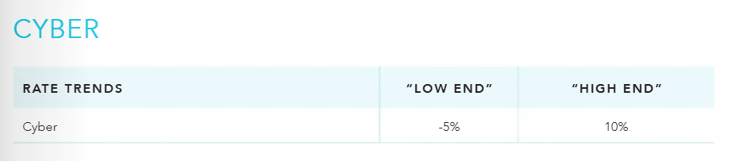

Slide 19
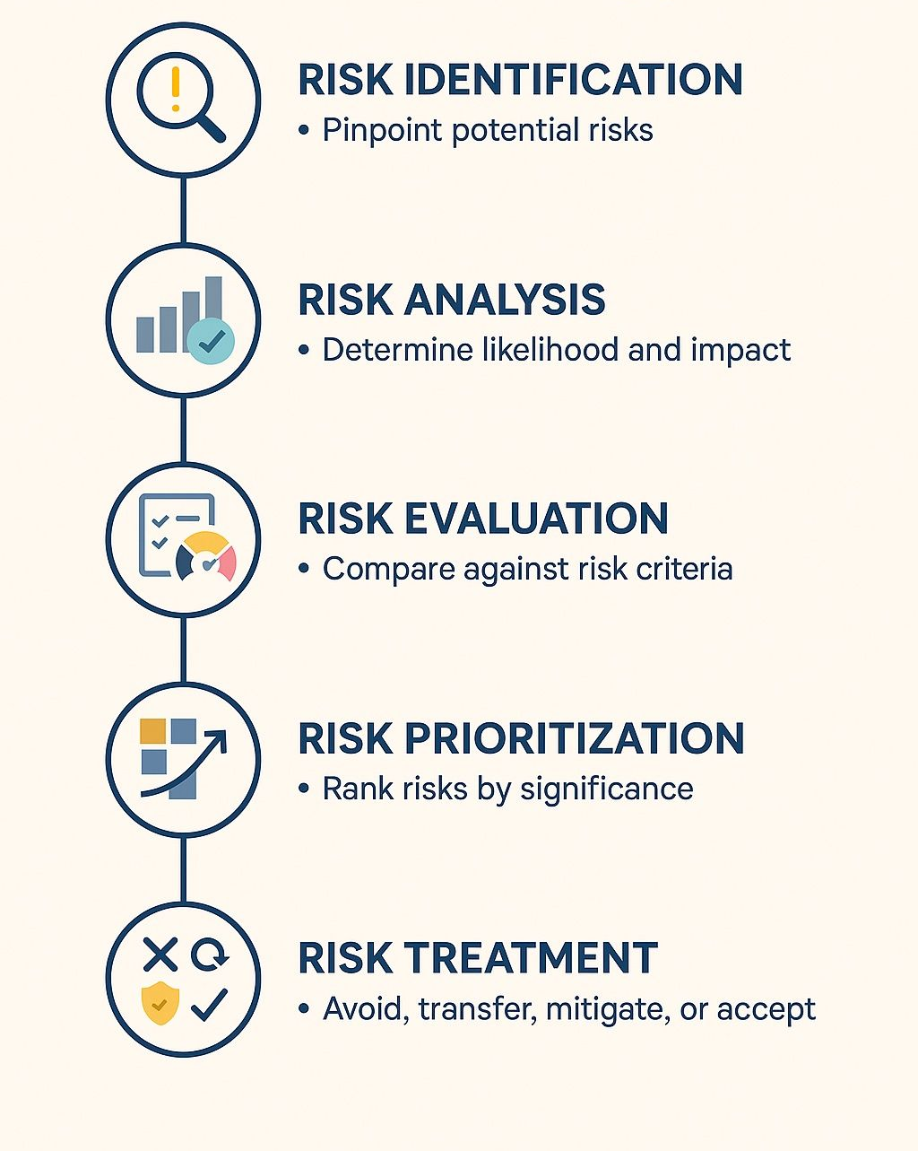
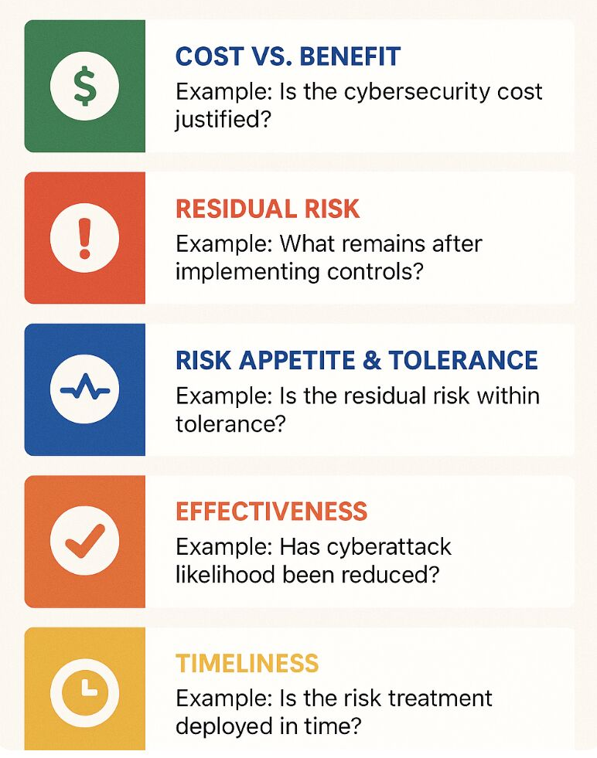
Enterprise Risk Management

Slide 20
Questions?

