Slide 1
Negotiating Through Budget Uncertainty
Florida Educational Negotiators
Rosen Centre - Orlando
January 30, 2026
Michael Degutis
Retired Florida School District CFO

Slide 2
AGENDA
Introductions
Defining the Problem (History & Trends)
Current Financial Impact on School Districts
Key Considerations for the Future
Strategies for Considertion
Process and Timelines
Communication Plan
Leadership Traits for Tough Times
Questions and Comments

Slide 3
Introductions
My Background
34 years of experience in Florida K-12 finance and operations
Brevard (16 years), Indian River (5 years) and St. Johns (13 years)
Experienced in all facets of school district operations and the issues surrounding them
Positions held include CFO, Deputy Superintendent and Chief of Staff
Credit and Disclaimer on Material Presented
All data is from Legislative Final Conference Reports for years presented, unless otherwise noted
Based on my experience and opinion

Slide 4
Defining the Problem (History & Trends)
FTE Growth / Decline
Funding per FTE
Base Student Allocation (BSA) and Total State & Local
Required Local Effort (RLE)
Taxable Assessed Valuation (TAV)
State and Local Funds
State Education Funding Review
2016/17 vs. 2025/26

Slide 5
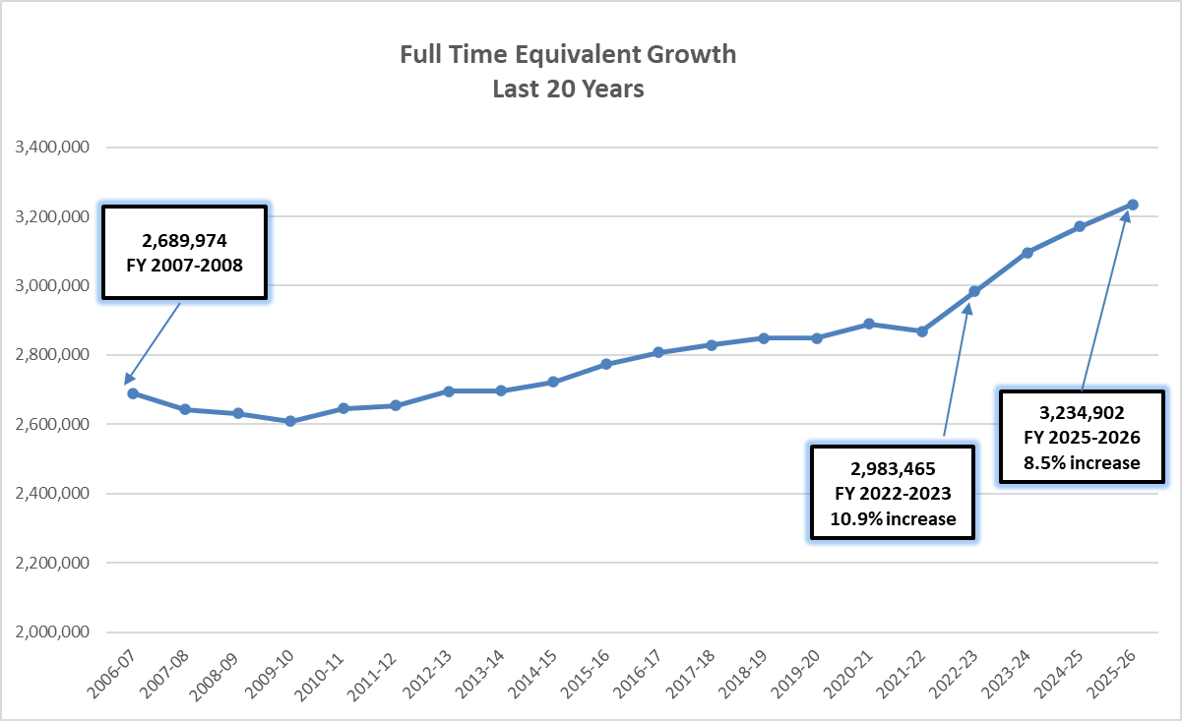
Defining the Problem (History & Trends)

Slide 6
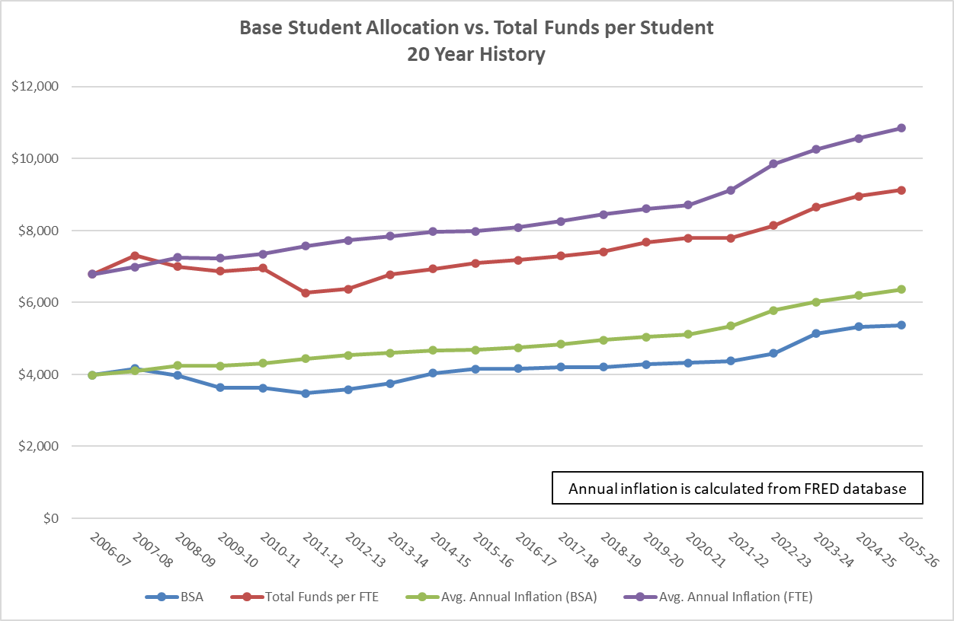

Slide 7
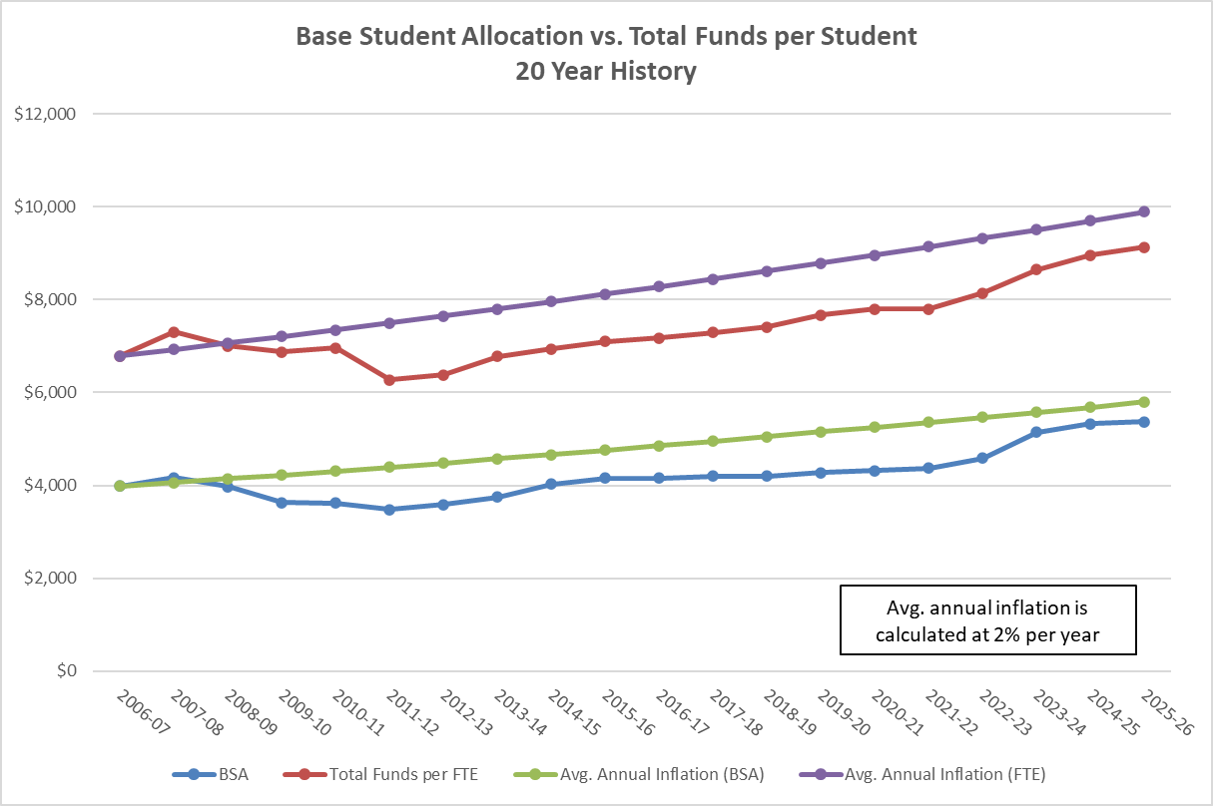
Avg. annual inflation is calculated at 2% per year

Slide 8
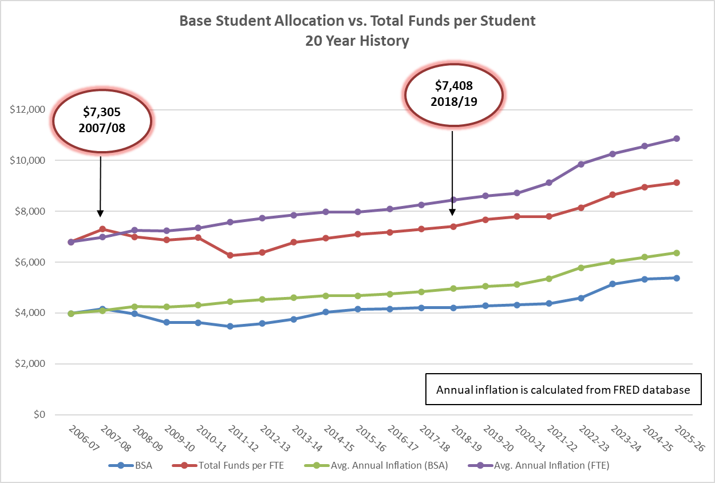

Slide 9
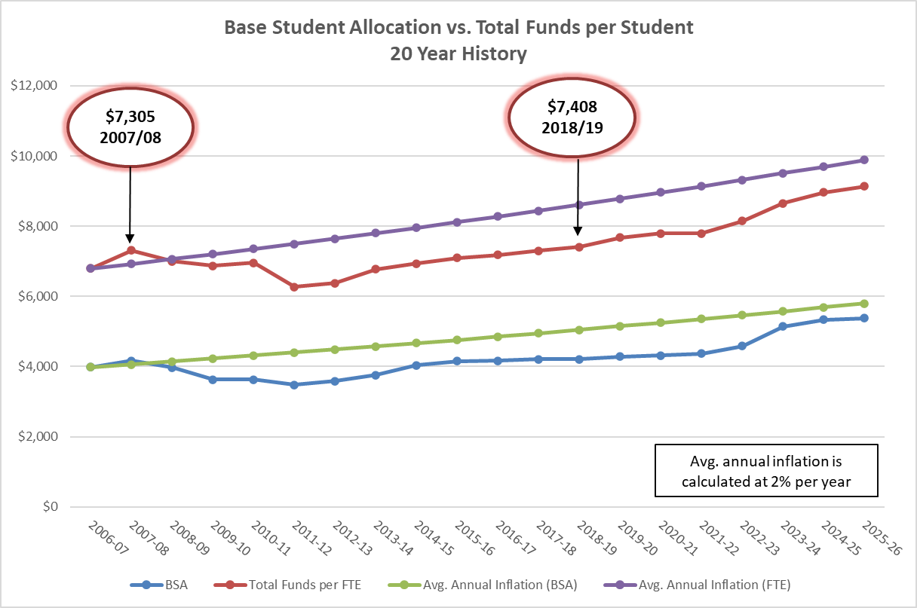

Slide 10
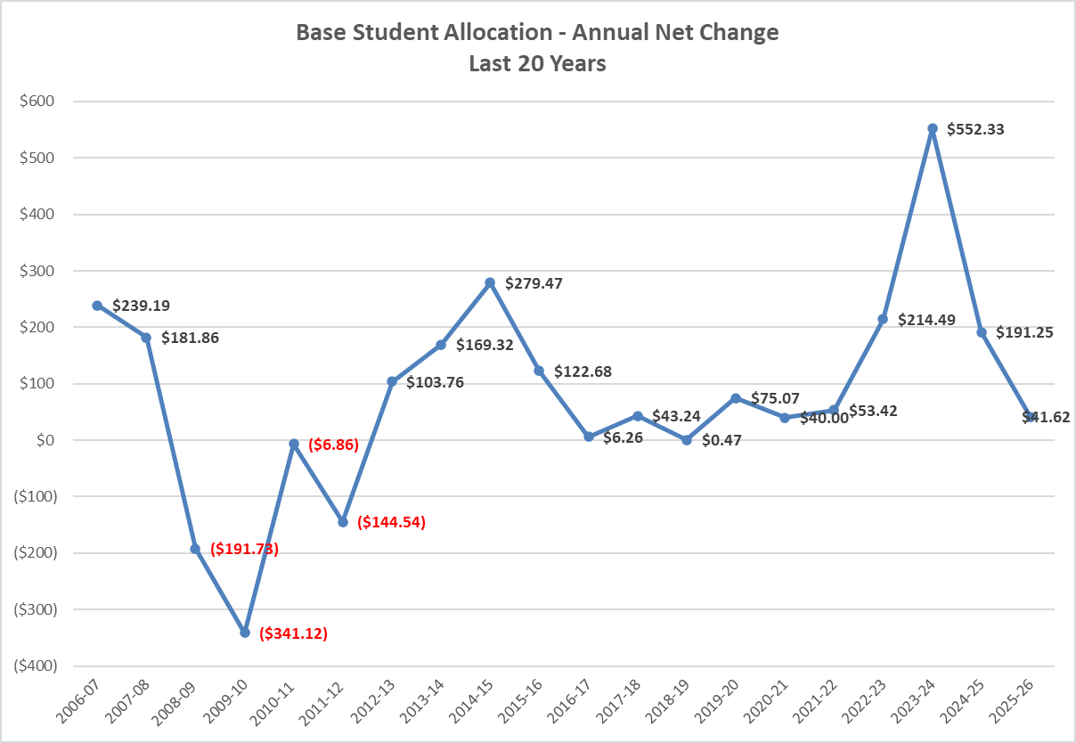

Slide 11
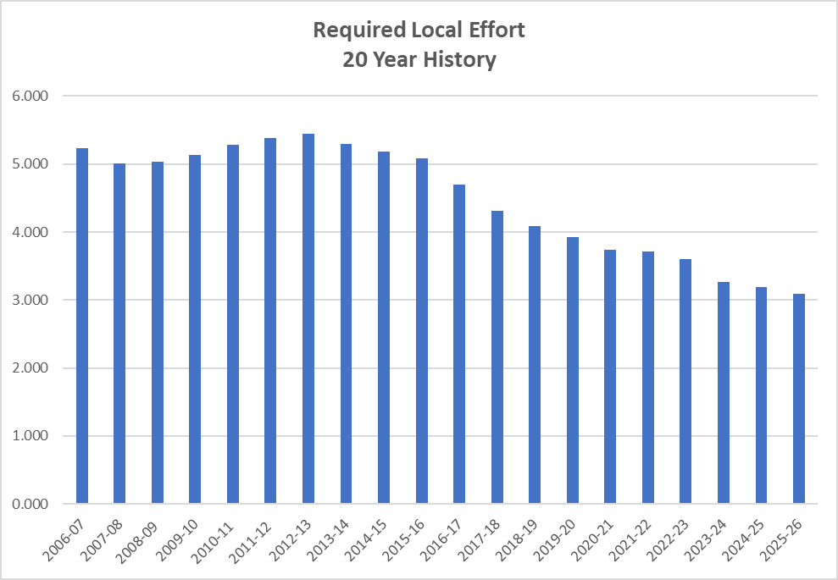
In 2008/09 and 2009/10 Capital Outlay Millage of .25 mills was transferred from the Capital Fund to the Required Local Effort to help out the General Revenue Fund.
Total Capital Outlay allowable by law decreased from 2.0 mills to 1.5 mills, where it has been ever since.

Slide 12
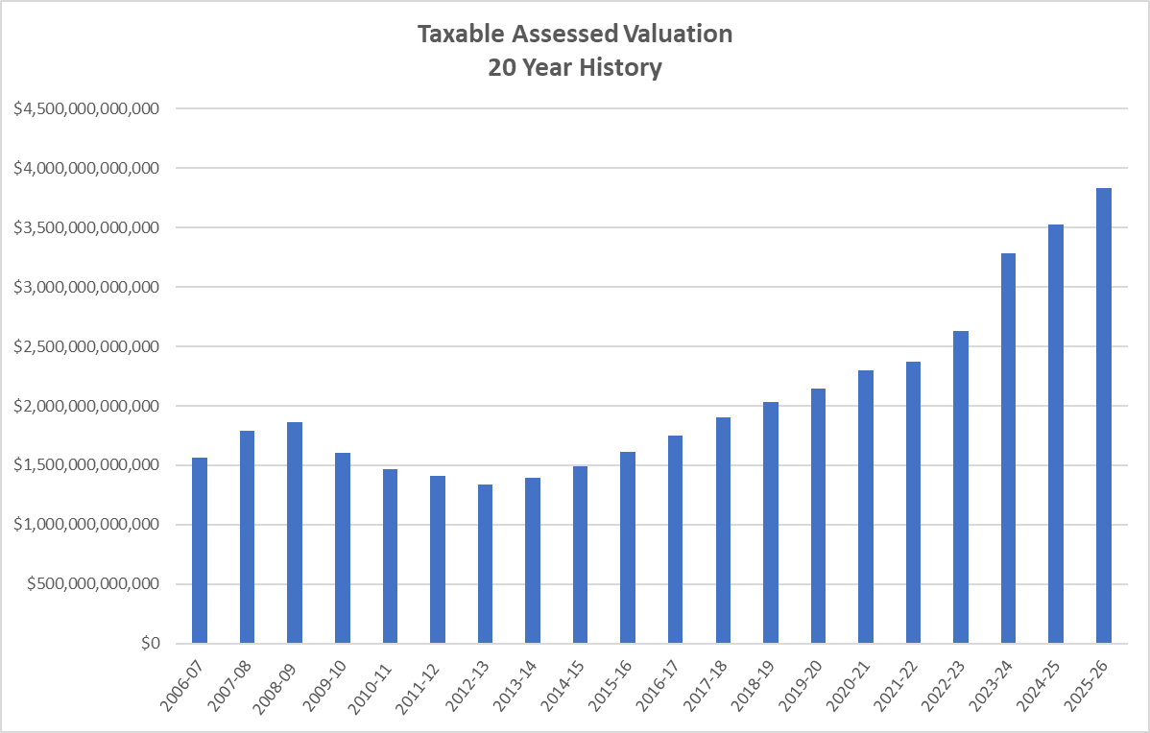

Slide 13
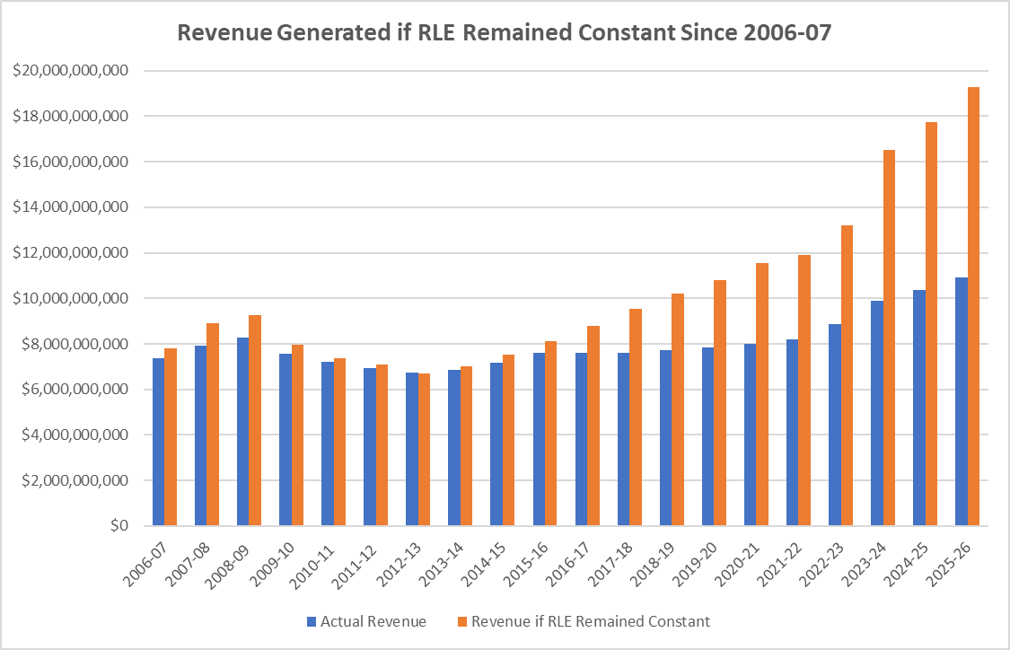

Slide 14
State Education Funding Trends
Total state budget increased by $32.5 billion, or 39%
Education’s portion increased by $ 7.6 billion, or 32%
Education’s 2025-26 slice is only 27% when it used to be 29% in 2016-17
Education is getting a smaller piece of a larger pie
Notes:
In the end it’s about what the Legislature has chosen to prioritize

Slide 15
Key Considerations for the Future
We are no longer the “only game in town.”
Realize that we need to “reinvent”, “reimagine” or “reconfigure” ourselves.
We need to become more competitive in the education marketplace.
This is not a traditional budget reduction exercise – it is figuring out a new way of doing business.
Now is the time to be creative and innovative.
Our old way of being funded is gone and we are now in a new revenue allocation environment.

Slide 16
Key Considerations for the Future
Family Empowerment Scholarships have opened up funding to students who have never been part of the formula before.
We need to not only understand where we have been but also where we are headed.
HB1 (2023) and revamping of the FEFP formula
Universal school choice
“Rolled” several line items into the BSA including Instructional Materials, TSIA, Teacher Classroom Supply, Compression, Sparsity Supplement and Reading Allocation
State-wide roughly $1.4 billion

Slide 17
Example of Voucher Impact on Districts
 | Pre Vouchers | Post Vouchers (2,000 outside vouchers) | Delta
Number of Students | 50,000 | 52,000 | 2,000
Total Funds per Student | $9,000 | $8,653.85 | ($346.15)
Total Available Funding (constant) | $450,000,000 | $450,000,000
Total Loss of District Funding |  |  | ($17,307,500)
What about students who leave the system?
What happens to “their” funding?
What happens to those students?

Slide 18
Strategies to Consider
Maximize / prioritize use of capital outlay funds (1.5 mills)
Maintenance costs at school sites and district facilities
Equipment purchases (new and replacement)
Computers, software systems (ERP), vehicles
Review refresh cycles
Infrastructure as a Service (IaaS)
Property insurance
Casualty insurance
Liability insurance
Seven period day vs. Six period day
MS/HS from 5 core & 2 electives to 4 core & 3 electives
Transportation
Staffing constraints
Sign-on bonuses
Equipment purchases (general fund vs. capital fund)

Slide 19
Strategies to Consider
Create a slow-fill process for “non-critical” personnel
Review your staffing models under the new way of being funded
Can we adjust our “tipping points”
What do our non-core / elective classes look like
What do our resource classes look like
Elementary level vs. middle & high school
All Schools of Excellence shall utilize Class-size Averaging
Consider moving to one 12-month AP per school and all others 11 month
“We can no longer be everything to everybody”
“We need to look at every position that is not covering a class roster”

Slide 20
Strategies to Consider
Consider the “Associate Teacher” model
Review programs that have a longevity to them
District-wide allocations for the same position in every school
Is it a Shall / Should / Would Like To?
Are resources still necessary on a 1:1 basis
School nurses (i.e. - high acuity students)
Tech Support Specialists
Conference attendance
Consider instituting a “train the trainer” model
Medical plans
Fully insured vs. self-insured
Plan design changes
Dependent eligibility audits
Hospital Indemnity Programs – do we still need them?

Slide 21
Strategies to Consider
Consider asking the voters to support the additional operating millage under §1011.71(9), F.S. and §1011.73(2), F.S.
FY 2004 --- one district
FY 2014 --- 12 districts
FY 2024 --- 25 districts
Review your collective bargaining agreements (CBA) for any reduction in force (RIF) language, just in case. §1012.33(5), F.S. outlines the procedures to be taken.
Notice requirements to union leaders as well as impacted employees.
There are rules relative to the selection criteria employed (seniority, teacher certifications, performance, etc.).
The Board, as management, must ensure compliance with all statutory requirements, CBA language and any/all procedures.

Slide 22
Strategies to Consider
Be familiar with what the “financial urgency” law is all about - §447.4095, F.S. outlines the procedures to follow in such a situation.
What is a “financial urgency”?
It is not defined in Florida Statutes.
It’s a serious and immediate financial condition that justifies expedited negotiations.
It must be urgent, unforeseen, and substantial enough to warrant bypassing normal bargaining timelines.
How is it triggered?
When it is identified, the Board and the Union must meet to bargain its impact within 14 days of identification.
What do we do?
Timeline is to bargain for 14 days
If no agreement after that time, an impasse is deemed to have occurred and either party may move under that section of law.

Slide 23
Process and Timelines
Identify the problem and possible solutions as a team
Revenue shortfall
Over extension of appropriations
Both
Use your school district’s historical trends
5 years of history should be sufficient
Current year projections without any changes vs. projections
Produce a target amount (“how much”)

Slide 24
Process and Timelines
Gather input
Staff knows your budget better than anyone else
Principals, SAC, PTO, Unions, etc. (use “role-a-likes” if that helps)
Community groups
School board workshops
Note of caution here…

Slide 25
Process and Timelines
Review All New, Creative and Innovative Ideas
Who, What, Where, When and Why
How much it will save / redirect
“You never know where a good idea comes from”
Recap
Never be afraid to prognosticate
“The FEFP for our schools included $55 million for the FES program this current year, however, our projections for next year show a 5 percent increase to this year’s level”
Growth / declining enrollment
Charter schools / private schools / home school
Medical costs
FRS costs

Slide 26
Communication Plan
Two Main Points to Include in Your Plan
“The Four Ts” (Point No. 1)
“Tell Them the Truth”
Economy vs. Legislature vs. FEFP Funding
Impact of vouchers on your district operations
Struggles with re-balancing the new vs. veteran teacher compensation
Struggles with the post-COVID employment market
Inflation and other cost increases
Non-academic side of a student's day
Always be transparent – in the final analysis, it will never hurt you

Slide 27
Communication Plan
Go Tell Everyone Who Will Listen (Point No. 2)
“No group too big or too small”
School Faculty meetings
SAC, PTO and other school related organizations
Civic Groups
Rotary, Moose, Elks, Kiwanis, etc.
Political Groups
County Commission
Chamber of Commerce
Realtor Groups
Contractor Groups
Executive committees
Stay on Message, Keep the Faith and Never Give Up!

Slide 28


Slide 29
Leadership Traits
Tough Times Require Gutsy Leadership
Drs. Kevin & Jackie Freiberg
Let’s Be a Game Changer!

Slide 30
Leadership Trait No. 1
What We Know
Our financial world has been turned upside down and uncertainty can distract and derail us.
Be a Game Changer!
Are we focusing on things we can control or are we obsessing over things we cannot?
Let’s have laser-like focus.

Slide 31
Leadership Trait No. 2
What We Know
Panic and fear will hinder critical and rational thinking.
Be a Game Changer!
We need to step through the fear!
Let's have the courage to lead with clear heads.

Slide 32
Leadership Trait No. 3
What We Know
In the absence of truth and valid data, people will make assumptions and draw their own conclusions.
Be a Game Changer!
We need to communicate much more than we think we should!
Let's communicate like we are changing the world… because we are!

Slide 33
Leadership Trait No. 4
What We Know
People are angry and hurt.
Be a Game Changer!
We need to find something or someone for which to be grateful.
Let's show people all around us just how truly grateful we all need to be!

Slide 34
Leadership Trait No. 5
What We Know
Attitudes are contagious.
Be a Game Changer!
We need to make sure our attitudes are positive and worth catching!
Let's show folks around us how positive attitudes can change their own attitudes for their benefit!

Slide 35
Leading Negotiations Through Budget Uncertainty
Contact Information
Michael Degutis
Email: Lmdegutis@gmail.com
Cell: (904) 315-8556

Slide 36
Questions and Discussions Thank you!

