Slide 1

TIME TO SHOW WHAT YOU KNOW!
Your Game Show Host: Bonnie Penner and Scott Ward

Slide 2
TRUE OR FALSE
The Florida Legislators approved a record investment in education by providing a historic $15.9 billion in funding for the K-12 public school system.

Slide 3

FALSE
The $15.9 billion in funding from the State includes the portion funded for the FES Scholarships
When comparing the State’s contribution to the FEFP for Public Education, excluding the FES Scholarships, the State’s contribution to the K-12 public school system declined $669 million.

Slide 4
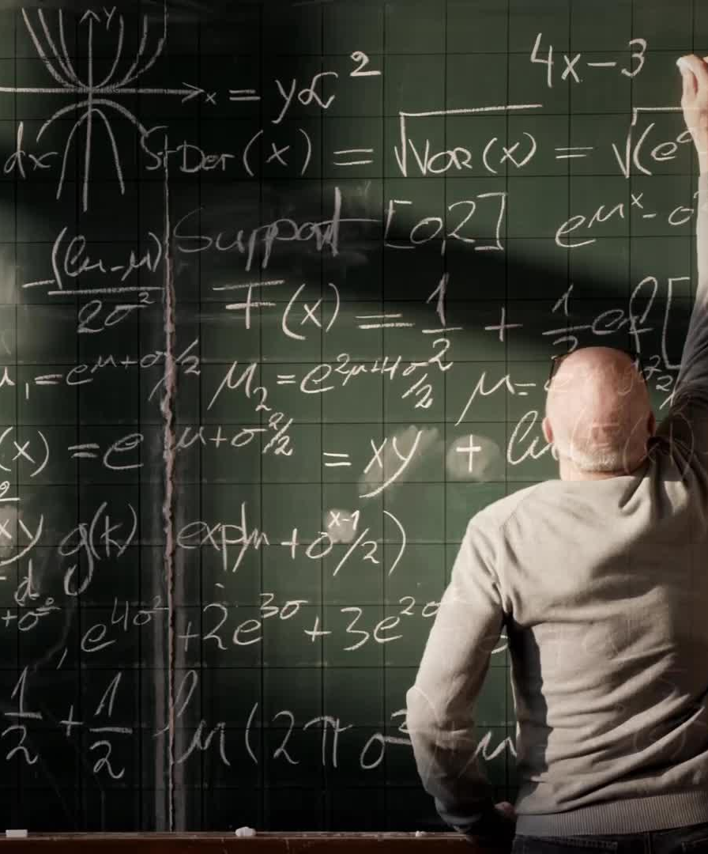
TRUE OR FALSE
The FEFP Formula earmarks $102 million of the Base Allocation to fund salary increases for teachers in the 2025-26 fiscal year.

Slide 5

FALSE
The FEFP Formula earmarks and allocates each FEFP component based on Total FTE, including the FTE for FES Scholarships.
Although not reflected in the Calculations, when the State deducts for payments made to the Scholarship Funding Organizations for the FES Scholarships, proportionate shares of the earmarks and allocations are reduced.

Slide 6
TRUE OR FALSE
The $143 increase per student included in the budget is available for salary increases.

Slide 7
FALSE
The $143 increase in per-student funding included increases for categorical allocations, which are restricted in their use.
The Base Student Allocation and the .748 Mill Discretionary Compression are unrestricted and increased $41.62 and $52.58 per student, respectively.
The increase in unrestricted funding must cover the increase in all costs, not just salary increases.

Slide 8
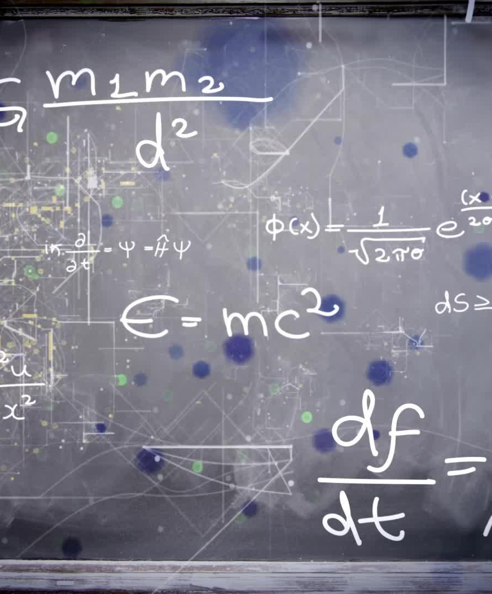
TRUE OR FALSE
The Base Student Amount (BSA) in the FEFP formula will remain consistent throughout the year, and variations in property values and FTE will not affect it.

Slide 9

FALSE
Variations between Estimated and Actual Property Values can cause an increase in the State Funded Discretionary Contribution, resulting in a proration of funding in the Second Calculation.
Increases in WFTE over the State-wide projections will result in a proration in the Third, Fourth, and Final FEFP Calculations.
A proration results in a reduction in funding, which is typically absorbed by the BSA.

Slide 10
FIVE FEFP Calculations
Calc 1 - AKA Conference Report. Uses Estimated Property Values and Projected FTE
Calc 2 - Updates Calc 1 with Certified Property Values
Calc 3 - Updates Calc 2 with October FTE, and uses factors to project February FTE
Calc 4 – AKA 2025 Ghost Calculation. Updates Calc 3 with February FTE, and Virtual Course Completions
Calc 5 - Updates Calc4 with June FTE for ESE and DJJ

Slide 11
TRUE OR FALSE
School Enrollment equals FTE for purposes of funding through the FEFP.

Slide 12

FALSE
Students enrolled in virtual courses outside of regular school hours receive approximately 12.5% less funding.
High school students often accumulate enough credits to graduate early or attend only part of the school day.
Students with a Florida Empowerment Scholarship will have their scholarship payment deducted from the district’s FEFP even if the student is enrolled and attending a public school

Slide 13
True or False
The State fully funds FES Scholarships without impacting the school districts.

Slide 14
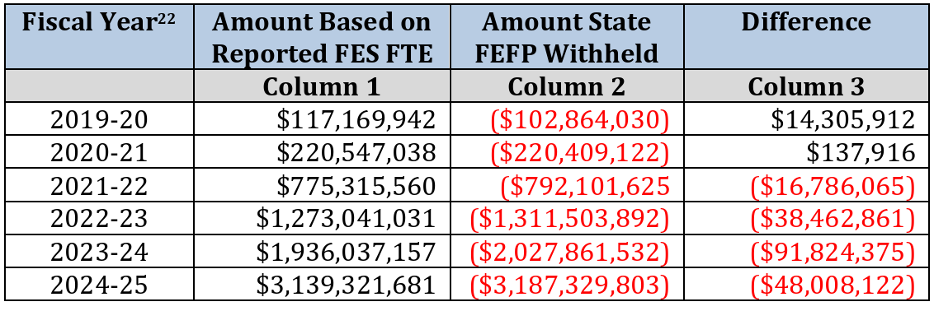
False

