Slide 1
Florida Public Records Law: Keeping It Legal (and Organized!)
Seminole County Public Schools
Carolyn Bedsole, Records Custodian & IS Project Manager
Seminole County Public Schools – Florida Public Records Law
Notes:
Today we are going to discuss Florida Public Records Law

Slide 2
Introduction
Quick personal intro
Why this topic matters
Seminole County Public Schools – Florida Public Records Law
Notes:
Introduce yourself
Explain why public records are important in your role.
Legal obligations under Florida’s Public Records Law (Sunshine Law)

Slide 3
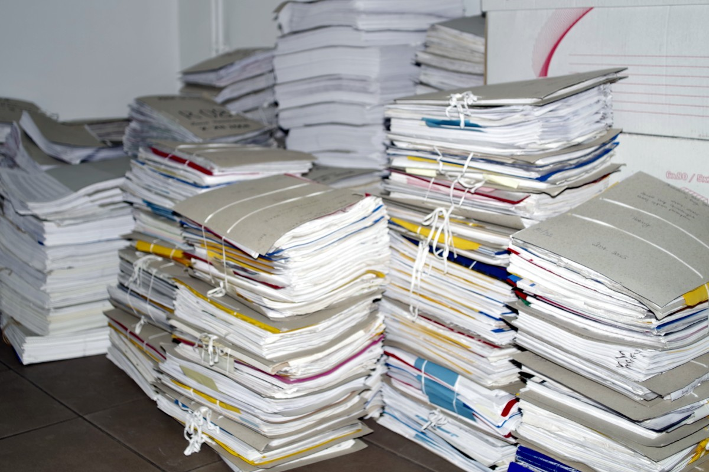
Opening
Public records are more than paperwork—they're part of every organizations accountability.
Seminole County Public Schools – Florida Public Records Law
Notes:
Ask the audience if they’ve ever been buried in file folders or have lost an email.

Slide 4
Legal Foundation
Florida Statute Chapter 119
Florida Constitution Article I, Section 24
Sunshine Laws and open government
Seminole County Public Schools – Florida Public Records Law
Notes:
The Florida Constitution's open records provisions guarantees the public's right to inspect and copy public records. This right is further defined by Chapter 119 of the Florida Statutes, which outlines the specific duties and requirements for custodians of public records.

Slide 5
What is a Public Record?
Definition under Florida Statutes Chapter 119
Includes documents, emails, texts, social media, and more
Anything made or received in connection with official business
Seminole County Public Schools – Florida Public Records Law
Notes:
Chapter 119.01 states that it is the policy of this state that all state, county, and municipal records are open for personal inspection and copying by any person. Providing access to public records is a duty of each agency..
It’s not just paper—digital counts too. Phone logs and messages can be included here. Why do Public Records matter? Public Trust, Legal Compliance, and Institutional History.

Slide 6
Who is Covered by the Law?
SCPS staff, board members, contractors
Anyone acting 'on behalf of' the district
Seminole County Public Schools – Florida Public Records Law
Notes:
It’s not just central office staff—teachers and even contractors can fall under this.

Slide 7
Purpose of the Law
Transparency
Public trust
Institutional history
Legal compliance (Florida Sunshine Law)
Seminole County Public Schools – Florida Public Records Law
Notes:
Reinforce transparency and public accountability. People have the right to know how their tax dollars are spent.
Public records help build public trust, comply with the Florida Sunshine Law, and keep an institutional history of our decisions and actions.
“Not keeping records is like deleting your kid’s baby pictures—just don’t.”]

Slide 8
What is a Public Record
Maintenance work orders
Bids and Contracts
Emails, texts, meeting minutes, audio/video, files
Anything made or received in connection with official business
Seminole County Public Schools – Florida Public Records Law
Notes:
Use high-profile cases to show how public records are used in the real world. Mention education-specific ones if possible.

Slide 9
Records That Might Surprise You
Whiteboard notes? Sticky notes? Calendar invites?
Yes, maybe, or no?
Reminder – a draft of the project plan is due tomorrow
5/07/2025
10:30 AM
Called Carolyn’s parents and discussed a plan of action.
Seminole County Public Schools – Florida Public Records Law
Notes:
Use this to engage. Ask the audience what they think counts as a public record.

Slide 10
What ISN’T a Public Record?
Personal emails (non-business)
Drafts not circulated
Sticky notes with grocery lists
Seminole County Public Schools – Florida Public Records Law

Slide 11
Not All Records Are Public
Student educational records (FERPA), medical (HIPAA)
Social Security numbers and financial info
Attorney-client communications
Employee Garnishments
Ongoing investigations
Security-related data
Surveillance videos (including bus videos) are confidential and exempt from release as a public record as part of the District’s security system plan pursuant to ss. 119.071(3)(a) and 281.301, F. S.
Seminole County Public Schools – Florida Public Records Law
Notes:
Caution about sensitive student and medical records. Highlight FERPA and HIPAA.

Slide 12
Redacting PII (Personally Identifiable Information)
PII includes names, SSNs, student IDs, addresses, etc.
Always review documents before release
Use software tools or manual review for redactions
Seminole County Public Schools – Florida Public Records Law

Slide 13
Common Pitfalls
Using personal devices for public work
Ignoring requests
Work
Personal
Seminole County Public Schools – Florida Public Records Law
Notes:
Inappropriate relationships and comments from past principals and even board members have been found though email searches and the pulling of text messages.
I advised the schools to develop innocent sounding code words for situations where a quick meeting is warranted verses using text to describe the behavior of a child or even a co-worker.
Once, I was reported to the State department for failing to respond to a request and I was investigated by the States Attorney’s office. Also, there was a time prior to my taking over Public Records, where the School Board was fined $50K for not responding to a subpoena.

Slide 14
Public Records vs. Discovery
Not just for lawsuits
Public’s right to know
Seminole County Public Schools – Florida Public Records Law
Notes:
Point out that records requests happen outside of lawsuits—they’re part of daily transparency.

Slide 15
Access and Response Time
No delay permitted
‘Reasonable’ time explained
Redaction rules
Seminole County Public Schools – Florida Public Records Law
Notes:
Who can define a 'reasonable time'.
In Florida, public records must be released within a "reasonable time," which is not defined by a specific time limit in the Public Records Act. The exact timeframe depends on the complexity and volume of the request, as well as any redaction needs for exempt information. While there's no fixed timeline, agencies should acknowledge requests promptly and work to fulfill them efficiently.

Slide 16
Request Process
How to submit a request
Who to contact
How SCPS tracks them
Seminole County Public Schools – Florida Public Records Law
Notes:
Explain how requests come in and what the district does next. Highlight your office’s role.

Slide 17
Seminole County’s Approach
Internal workflows
Staff roles and responsibilities
Fees for staff time and materials
Is your organization using software and tracking tools?
Seminole County Public Schools – Florida Public Records Law
Notes:
Show off your systems. Talk about workflow improvements and digital tools.

Slide 18
Records Retention
Follow retention schedules (GS1-SL, GS7)
Timely responses to public requests
Retention ≠ storage forever
Seminole County Public Schools – Florida Public Records Law
Notes:
Explain retention schedules. Emphasize that deleting something too early can be a problem.

Slide 19
Technology and Records
Email archiving
Cloud storage
Document tracking software
Seminole County Public Schools – Florida Public Records Law
Notes:
Link to how SCPS uses Microsoft 365. Mention email archiving and retention policies.

Slide 20
Humor Break
Seminole County Public Schools – Florida Public Records Law
Notes:
Insert something funny here to keep the audience awake. Make a light-hearted comment.

Slide 21
How We Educate Our Staff
Annual training
Policies and Procedural documents
All FAQs and guidance docs stored in one place
Real-time support
Seminole County Public Schools – Florida Public Records Law
Notes:
Talk about training, guides, and support you provide to ensure compliance.

Slide 22
Tips for Staff
Use work devices
Think before sending
Avoid premature deletion
Seminole County Public Schools – Public Records Training
Notes:
“When in doubt, keep it. Or call the records wizard.”]

Slide 23
FAQs
Can records request be anonymous?
Can I say 'no' to a request?
Do I need to print emails?
What if I make a mistake?
Seminole County Public Schools – Florida Public Records Law
Notes:
Answer common staff questions. Take some questions from the audience.

Slide 24
Final Thoughts
Seminole County Public Schools – Florida Public Records Law
Notes:
Summarize key takeaways. Reassure them this isn’t scary—it’s about trust.
Add as much as possible to your website to reduce the number of tasks.

Slide 25
Resources
FL Dept of State – Records Management
PublicRecords@DOS.fl.gov
850-245-6507 - Office
Carolyn Bedsole
carolyn_bedsole@scps.k12.fl.us
407-320-0466
SCPS internal tools and forms
Seminole County Public Schools – Florida Public Records Law
Notes:
Point people to where they can get help—state websites, SCPS internal documents, you!
Invoice that we can share.

Slide 26
Questions & Contact Info
Q&A session
Thank you!
Seminole County Public Schools – Florida Public Records Law
Notes:
Open it up for questions. Give your info. Thank them warmly for their time.

