Slide 1
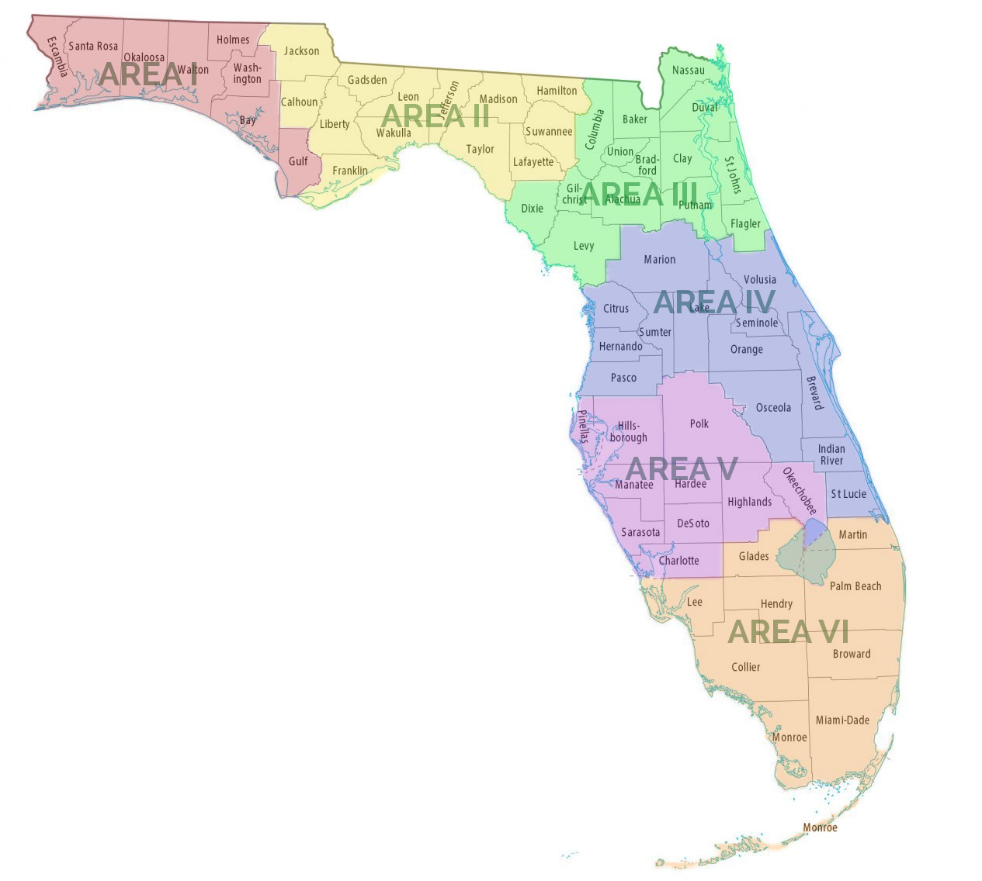
Proposed Slate: Officers and Area Directors 2025-26
President - Dr. Adrienne McElroy, Charlotte
President-Elect - LeighAnn Blackmore, Orange
Secretary - Tim Kubrick, Palm Beach
Past President - Dr. Dawn M. Baglos, Miami Dade
Area I - Candy Bodie, Walton
Area II - Lori Sangren, Wakulla
Area III - Kim Lake, Levy
Area IV - Dawn Bontz, Seminole
Area V - Danielle Shotwell, Hillsborough
Area VI - Kim Lucas, Miami-Dade

