Slide 1
Collective Bargaining 101
Presented by:

Slide 2
The Law
Article I, Section 6 of the Florida Constitution
The right of persons to work shall not be denied or abridged on account of membership or non-membership in any labor union or labor organization. The right of employees, by and through a labor organization, to bargain collectively shall not be denied or abridged. Public employees shall not have the right to strike.
Notes:
1946: The Florida Supreme Court ruled that public employees did not have the right to bargain collectively, picket, or strike.
1959: The legislature prohibited government employment for those who participated in strikes or advocated for the right to strike.
1968: Florida teachers went on strike statewide, demanding higher pay, which was the nation's first statewide teacher strike.
1969: President Nixon issued Executive Order 11491, establishing a framework for labor-management relations in the federal government.
1972: The Florida Supreme Court warned the legislature that it would create its own guidelines if no legislation protecting collective bargaining rights was passed.
1974: The Florida Public Employees Relations Act (PERA) was enacted, granting public employees the right to organize and collectively bargain, but not to strike. Florida became the first Southern state to adopt a comprehensive labor relations act for public employees.

Slide 3
The Law
Chapter 447, Part II, Florida Statutes
Regulates all public sector unionization in Florida
Jurisdiction over all public entities
Provides general rules for public employers and unions in Florida
Establishes the Florida Public Employees Relations Commission (“PERC”)
Notes:
Part 1, 1943, Part 2, 1974, Part 3

Slide 4
What Is PERC?
Quasi-judicial entity
Three full time members
Four year staggered terms
In theory, one representative of labor, one representative of management, and one neutral
Employs their own hearing officers
Establishes law through:
Administrative code rule (Chapters 28, 60CC)
Case law

Slide 5
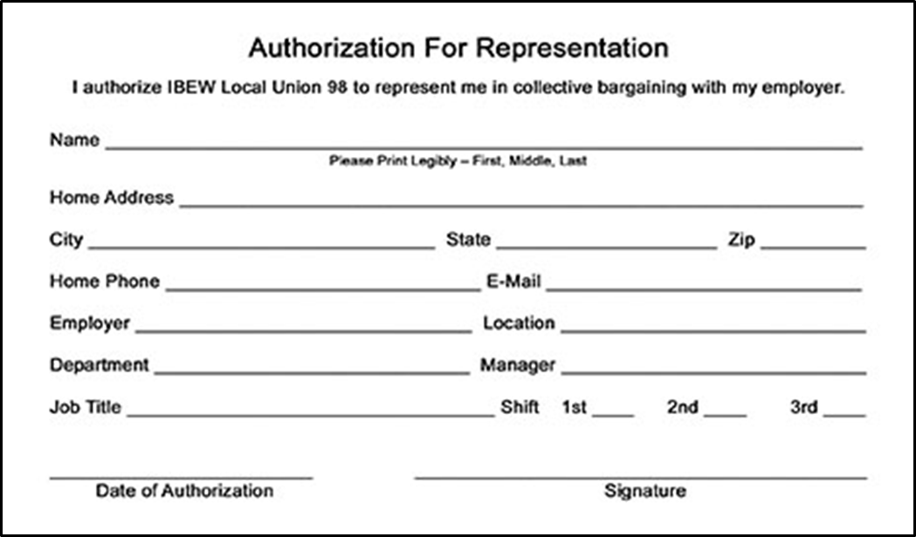
The Representation Process
Identification
Solicitation
Showing of Interest (SOI) Cards
Petition

Slide 6
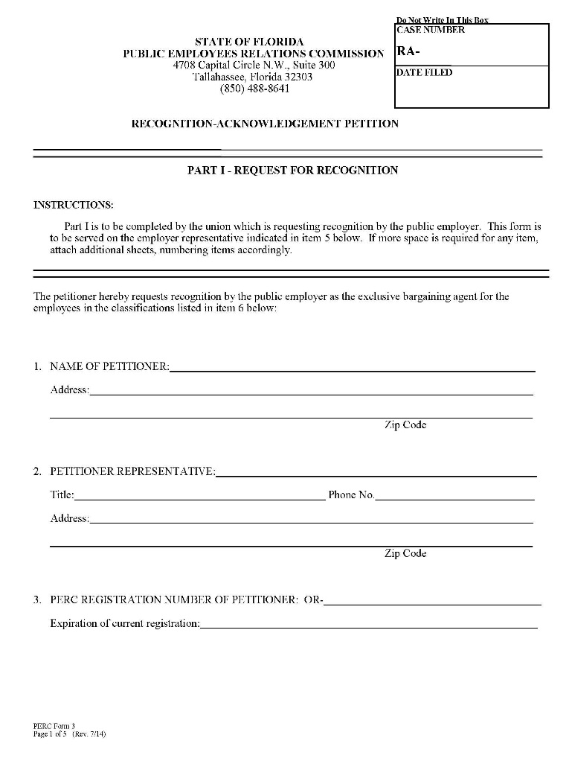
Petitions
Representation - Acknowledgement (“RA”)
50% plus 1 SOI
Approval by legislative body
Review by PERC
Certification without election

Slide 7
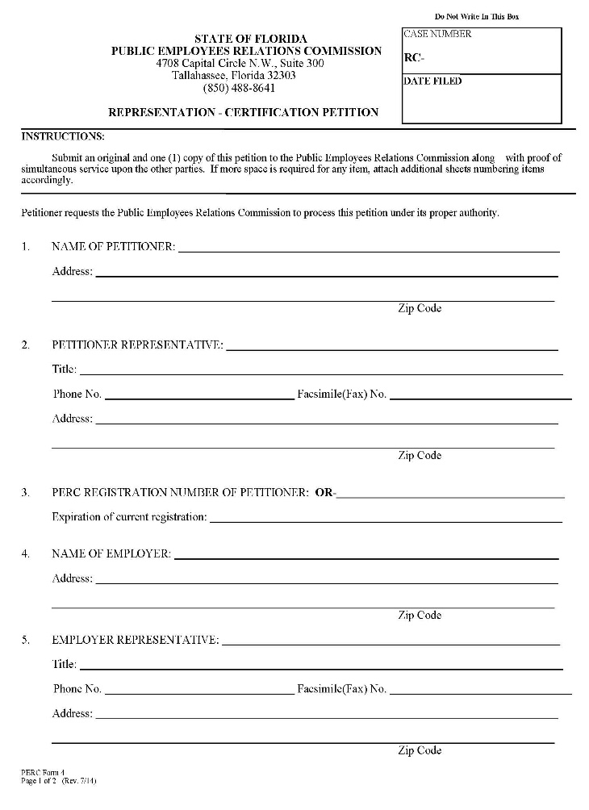
Petitions
Representation - Certification (“RC”)
30% Petitioner SOI
10% Intervenor SOI
PERC sufficiency review
Consent Election Agreement
Contested process

Slide 8
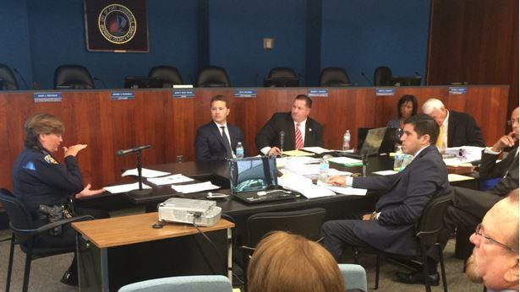
The Contested Process
Hearing
Bargaining unit composition
Sufficiency of SOI
Other defenses
HORO
Order Directing Election
Election
Appeal
Notes:
What is HORO – Hearing Officer recommended Order , What are the exceptions, What is the appeal process?

Slide 9
Types Of Bargaining Units
Wall-to-Wall
White Collar
Blue Collar
Professional
Public Safety
Departmental
Over-fragmentation

Slide 10
Who’s In
An appropriate unit v. most appropriate unit
Community of Interest
Similarity of wages, hours, terms and conditions
Common pay plan
Common personnel rules
Interchangeability
Common supervision
Similar hazards

Slide 11
Who’s Out
Managerial
Confidential
Supervisory
Professional
Casual/Temporary
Notes:
Is this statutory?

Slide 12
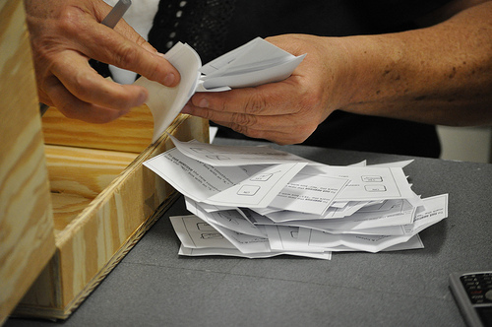
Elections
Types
Outcome
50% plus 1
Tie goes to “no union”
Run-off
Top 2 vote getters
Only voters eligible to vote in 1st election
Election objections

Slide 13
The Laboratory Conditions
Campaigning
Captive audience speeches
Electioneering near polls
Limitations on Speech
Free speech proviso
Changing wages, benefits
Notes:
What is the Laboratory Conditions? If you do this perfectly. TIPS?

Slide 14
Certification
Once a union is certified, it becomes the exclusive bargaining representative for all employees in classifications covered by the certification.
Doesn’t matter whether they voted against
Doesn’t matter if they even voted
Bound by whatever the union does
Bargaining unit versus dues-paying member

Slide 15
Recent changes to Chapter 447
Recent changes to Florida Statutes Chapter 447, which governs public employee collective bargaining, include provisions related to public employee unions and their dues and membership information. Specifically, SB 256 mandates that civilian unions are prohibited from receiving dues and assessments via salary deduction from the members' public employer. Additionally, employee organizations must provide detailed information about their bargaining unit members, including membership status, dues payment, and independent accountant verification

Slide 16
Decertification
Similar petition/election process
30% support
Tie goes to the union
Timing
Election bar
Contract bar
Management taint
Notes:
What is management taint?
Election bar? Cannot refile for one year.
Contract bar? Cannot dissolve the contract for one year. Maintains stability.

Slide 17
Duty To Bargain
Section 447.301, Florida Statutes:
After a … [Union] has been certified pursuant to the … [FPERA], the bargaining agent for the … [Union] and the chief executive officer of the … public employer …, jointly, shall bargain collectively in the determination of the wages, hours, and terms and conditions of employment of the public employees within the bargaining unit.
The duty to bargain attaches on certification.

Slide 18
Duty To Bargain
Collective bargaining rights are broader than negotiating a collective bargaining agreement.
Bargaining obligation applies to any changes to the status quo in the areas of employee wages, hours, or other terms and conditions of employment.
Status quo that must be maintained
Established past practices

Slide 19
Established Past Practice
Existed substantially unvaried for a significant period of time such that the employees can reasonably expect that they will continue in the future.
Unvaried
Significant period of time
Is it in writing?

Slide 20
Prohibited Unilateral Change
With limited exception, modifying an established past practice without giving notice and an opportunity to bargain = prohibited unilateral change.
As much a ULP to unilaterally increase as it is to unilaterally decrease
Notes:
Orange County Choosing instrument to evaluate – had to bargain the impact – unilateral change to contract. Effect

Slide 21
Unilateral Change
Exceptions to unilateral changes
Management rights
Waiver
By action/inaction
By contract
Legislative body action
Exigent circumstances
Notes:
Exigent conditions - COVID

Slide 22
Bargaining — The Basics
The chief executive officer or his or her representative and the bargaining agent or its representative shall meet at reasonable times and bargain in good faith.
What is Good Faith Bargaining?

Slide 23
Good Faith
Section 447.203(17), Florida Statutes:
“Good faith bargaining” shall mean, but not be limited to, the willingness of both parties to meet at reasonable times and places, as mutually agreed upon, in order to discuss issues which are proper subjects of bargaining, with the intent of reaching a common accord. It shall include an obligation for both parties to participate actively in the negotiations with an open mind and a sincere desire, as well as making a sincere effort, to resolve differences and come to an agreement.

Slide 24
Good Faith
According to PERC:
Good faith is a matter of intent; it is a state of mind.
Whether a party has failed to bargain in good faith is a factual determination based on the totality of the circumstances.
In practice, good faith bargaining is any bargaining that is not in bad faith.
Notes:
What is the definition of Immaterial

Slide 25
Bad Faith
Incidents indicative of bad faith shall include, but not be limited to, the following occurrences:
(a) Failure to meet at reasonable times and places with representatives of the other party for the purpose of negotiations.
(b) Placing unreasonable restrictions on the other party as a prerequisite to meeting.
(c) Failure to discuss bargainable issues.

Slide 26
Bad Faith
(d) Refusing, upon reasonable written request, to provide public information, excluding work products as defined in s. 447.605.
(e) Refusing to negotiate because of an unwanted person on the opposing negotiating team.
(f) Negotiating directly with employees rather than with their certified bargaining agent.
(g) Refusing to reduce a total agreement to writing.
Notes:
Unwanted persons - three officers not even employees of the district
Directly with employees - Board members wanting to give one group a raise
Total agreement to writing - union sometimes doesn’t want to

Slide 27
Collective Bargaining Process
Legislative Body
Is the public employer
Constitutional officers?
Chief Executive Officer
Negotiates on behalf of the public employer
Notes:
Constitutional officers - Board

Slide 28
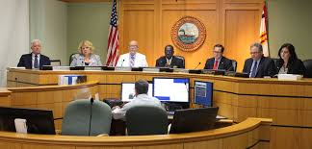
Role Of The Players
In conducting negotiations with the bargaining agent, the chief executive officer or his or her representative shall consult with, and attempt to represent the views of, the legislative body of the public employer.

Slide 29
The Executive Session
Section 447.605, Florida Statutes provides:
All discussions between the chief executive officer of the public employer, or his or her representative, and the legislative body or the public employer relative to collective bargaining shall be closed and exempt from the provisions of s. 286.011.
Only pure exemption from the sunshine
Must be limited to collective bargaining
Confidential

Slide 30
Bargaining Process Overview
Parties meet in bargaining sessions
Public meeting under Chapter 286
Proposals are exchanged
Public records once exchanged
Can communicate with the employees about them
Tentative agreements (“TAs”) reached subject to full and final agreement
Ideal result
Everyone holds hands and sings “Kumbaya”
Notes:
Communication with employees - Ways to communication without getting in trouble
Kumbaya - neither side is fully satisfied, both give

Slide 31
Subjects Of Bargaining
Mandatory Subjects
Permissive Subjects
Illegal Subjects

Slide 32
Mandatory Subjects
Wages, hours, and terms and conditions of employment
Not defined by statute
PERC has determined to be expansive
trade-off for no right to strike
going to grocery store on duty
TVs in fire station
Exception
management rights

Slide 33
Management Rights
Section 447.209, Florida Statutes:
It is the right of the public employer to determine unilaterally the purpose of each of its constituent agencies, set standards of services to be offered to the public, and exercise control and discretion over its organization and operations. It is also the right of the public employer to direct its employees, take disciplinary action for proper cause, and relieve its employees from duty because of lack of work or for other legitimate reasons.

Slide 34
Permissive Subjects
Can be negotiated
Can be agreed-to
Cannot be imposed at impasse
Anything that is not a mandatory or illegal subject of negotiations

Slide 35
Illegal Subjects
Provisions contrary to law
not paying overtime
Provisions that restrain or interfere with protected rights
required all bargaining unit employees, including non-union members, to contribute a portion of their sick leave to a “union time pool”
benefits available exclusively to union members

Slide 36
Agreement Reached
Any collective bargaining agreement reached by the negotiators shall be reduced to writing, and such agreement shall be signed by the chief executive officer and the bargaining agent.
Any agreement signed by the chief executive officer and the bargaining agent shall not be binding on the public employer until such agreement has been ratified by the public employer and by public employees who are members of the bargaining unit.

Slide 37
Contract Ratification
Union
internal process
all bargaining unit employees have right to vote
all have to be given a fair opportunity to vote
Employer
School Board meeting

Slide 38
Contract Duration
Three-year maximum duration
Terms of the contract survive its expiration
Become part of the status quo
Exception if the contract expressly truncates the status quo
Notes:
What does exception if the contract truncates the status quo mean – Only going to do for the current - MOU

Slide 39
No Agreement?
447.403 (1), Florida Statutes:
If, after a reasonable period of negotiation concerning the terms and conditions of employment to be incorporated in a collective bargaining agreement, a dispute exists between a public employer and a bargaining agent, an impasse shall be deemed to have occurred when one of the parties so declares in writing to the other party and to the commission.

Slide 40
Declaration Of Impasse
Reasonable period of good faith bargaining
How long is reasonable?
One or both parties declare an impasse in writing
PERC provides a Special Magistrate panel
Parties select SM from panel

Slide 41
The Special Magistrate Hearing
Section 447.403 (3), Fla. Stat.:
The special magistrate shall hold hearings in order to define the area or areas of dispute, to determine facts relating to the dispute, and to render a decision on any and all unresolved contract issues.

Slide 42
SM Recommendations
Special Magistrate issues recommendations
Within 15 days after the close of the hearing
Parties must “discuss” the recommendations
Parties can reject the SM recommendations
Within 20 days of receipt of the recommendations
In writing, filed with PERC, served on the other side
If not timely rejected they are accepted

Slide 43
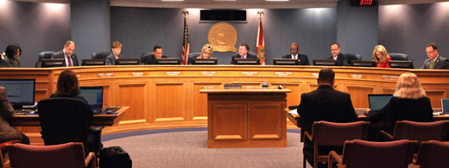
If Recommendations Rejected
Section 447.403 (4) (c), Fla. Stat.:
The legislative body or a duly authorized committee thereof shall forthwith conduct a public hearing at which the parties shall be required to explain their positions with respect to the rejected recommendations of the special magistrate.

Slide 44
The Insulated Period
Upon rejection of the Special Magistrate’s recommendations in whole or in part, the legislative body removes its “employer” hat and put on its “quasi-judicial body” hat.
Once the legislative body switches hats, the parties and their representatives can no longer speak to the elected officials about the matters at impasse

Slide 45
Legislative Body Hearing
Section 447.403 (4) (d), Fla. Stat.:
Thereafter, the legislative body shall take such action as it deems to be in the public interest, including the interest of the public employees involved, to resolve all disputed impasse issues.
Have to consider rejections and positions of both parties
Limited to issues addressed by SM and rejected
Only mandatory subjects

Slide 46
Post-Legislative Body Hearing
Agreed upon and legislatively resolved articles are packaged into a collective bargaining agreement.
Collective bargaining agreement is submitted to the employees and legislative body for ratification.
If the collective bargaining agreement is ratified by all parties, then the agreement goes into effect for the term spelled out in the agreement.
If the collective bargaining agreement is not ratified by all parties, the legislatively resolved items are imposed for the remainder of the first fiscal year at impasse.
Everything else remains status quo

Slide 47
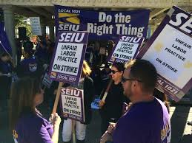
Unfair Labor Practices (ULPs)
Section 447.501(1), Florida Statutes
ULPs by the Employer
Section 447.501(2), Florida Statutes
ULPs by the Union
Process is the same for both
Charge
Within 6 months
Sufficiency Review
Hearing if sufficient
HORO
Final Order

Slide 48
ULPs Against Employers
Section 447.501(1), Florida Statutes:
(a) Interfering with, restraining, or coercing public employees in the exercise of any rights guaranteed them under this part.
Section 447.301(3) protected, concerted rights
(b) Encouraging or discouraging membership in any employee organization by discrimination in regard to hiring, tenure, or other conditions of employment.

Slide 49
Employer ULPs (con’t.)
(c) Refusing to bargain collectively, failing to bargain collectively in good faith, or refusing to sign a final agreement agreed upon with the certified bargaining agent for the public employees in the bargaining unit.
(d) Discharging or discriminating against a public employee because he or she has filed charges or given testimony under this part.
(f) Refusing to discuss grievances in good faith pursuant to the terms of the collective bargaining agreement with either the certified bargaining agent for the public employee or the employee involved.

Slide 50
Final Questions

