Slide 2
Bargaining in Uncertain Times: Current Pressures, Strategic Responses, and Legal Tips
FEN 45th Annual Spring Conference
May 8, 2025
Prepared by Leonard J. Dietzen, III © 2025 Rumberger, Kirk & Caldwell, P.A.

Slide 3
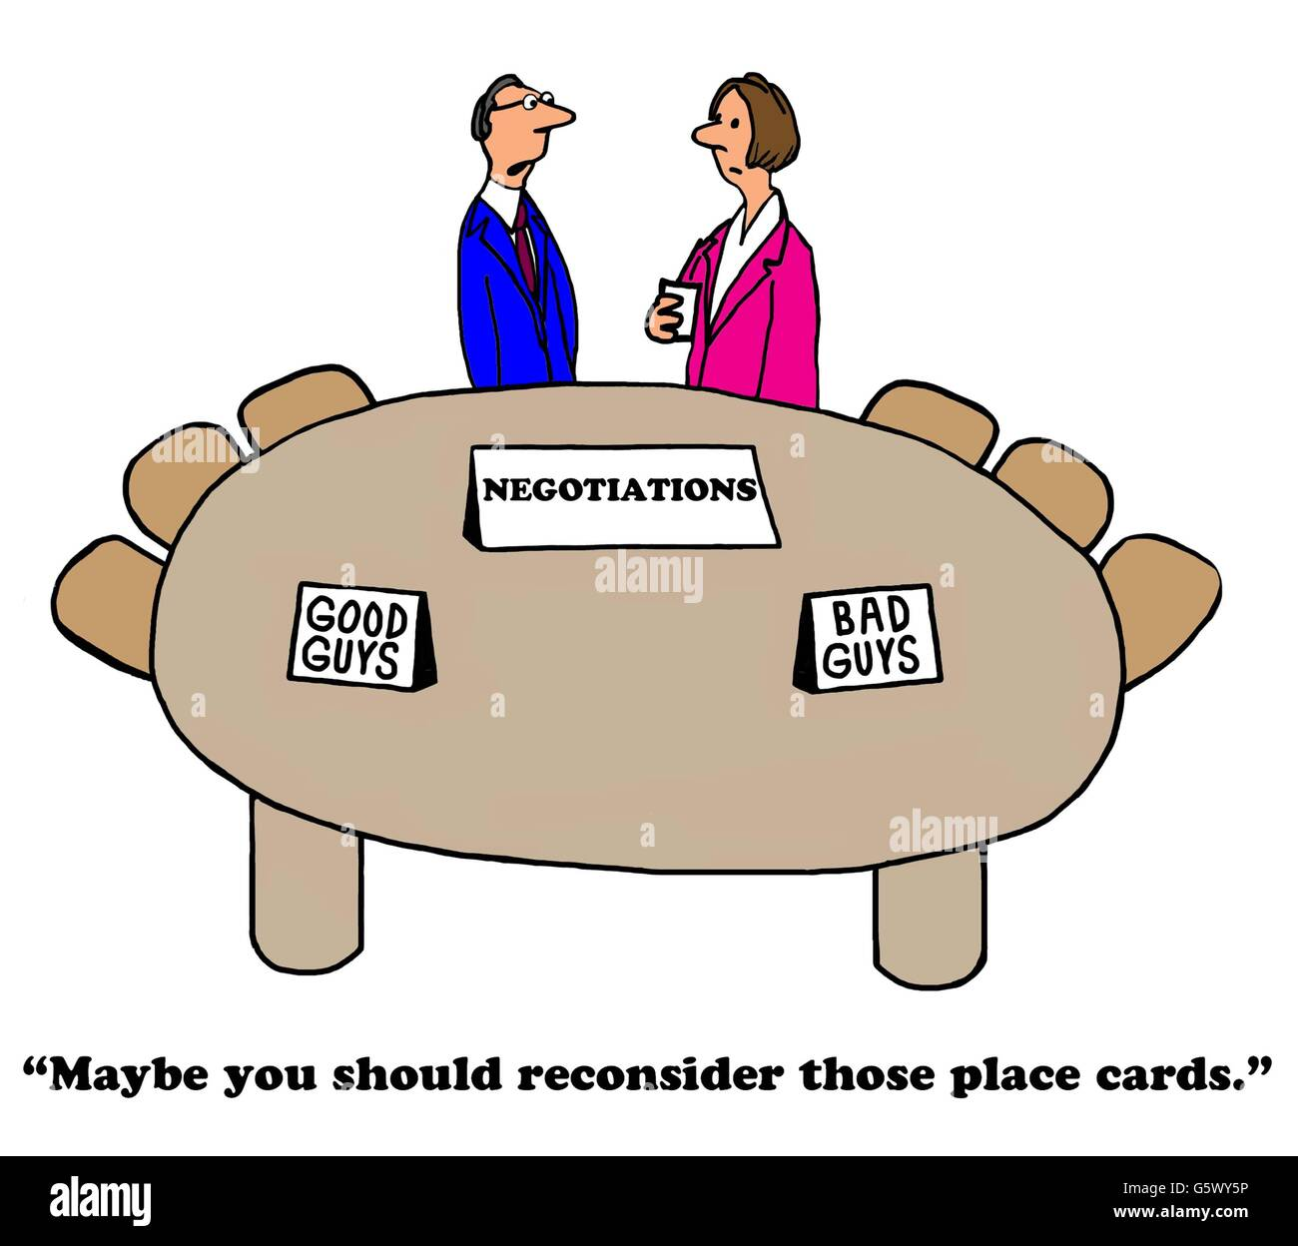
Introduction
Labor counsel for dozens of Florida K-12 School Boards
In 2024-2025 my clients have taught me one truth – you can’t make this %$@#& up!
© 2025 Rumberger, Kirk & Caldwell, P.A.

Slide 4
Overview
Topics we’ll cover:
Economic pressures on districts
The case for strategic staffing
Reductions in force (RIFs) under Florida law
Using transparency to manage expectations
Financial urgency – what it is and when to declare it
© 2025 Rumberger, Kirk & Caldwell, P.A.

Slide 5
The Shifting Fiscal Landscape Due to Death of ESSER Funds
Trends impacting Florida school districts
Falling FTE enrollment and consequent decrease in state funding under the FEFP.
Growth in charter school enrollment – competing for the same pool of students
Expansion of Family Empowerment Scholarships – loss of FTE funding as students shift out of traditional public schools.
Bottom line is less recurring revenue means less money is available for wage increases.
© 2025 Rumberger, Kirk & Caldwell, P.A.

Slide 6
Strategic Bargaining under Pressure
Districts must be honest about financial capacity.
Emphasize recurring revenue versus recurring expense in proposals.
© 2025 Rumberger, Kirk & Caldwell, P.A.

Slide 7
Remind Bargaining Teams
“You can’t bargain money you don’t have.”
“You can’t fix compression, give raises and pay for the lost steps in 2008-2012. Today’s shrinking funds can only fix some current problems.”
© 2025 Rumberger, Kirk & Caldwell, P.A.

Slide 8
The Case for “Right-Sizing”
Boards must proactively review and revised staffing plans.
Are class sizes aligned with actual enrollment?
Are support roles appropriately assigned given reduced student populations?
Do you need a paraprofessional scheduled beyond the student day?
© 2025 Rumberger, Kirk & Caldwell, P.A.

Slide 9
The Case for “Right-Sizing”
Use attrition, reassignments and restructuring before layoffs whenever possible.
Goal is to maintain instructional quality while staying within financial constraints.
© 2025 Rumberger, Kirk & Caldwell, P.A.

Slide 10
Reductions in Force: Know the Rules
Ch. 1012.33 (5) Fla. Stat. (2024) gives districts flexibility to manage teacher staffing:
(5) If workforce reduction is needed, a district school board must retain employees at a school or in the school district based upon educational program needs and the performance evaluations of employees within the affected program areas. Within the program areas requiring reduction, the employee with the lowest performance evaluations must be the first to be released; the employee with the next lowest performance evaluations must be the second to be released; and reductions shall continue in like manner until the needed number of reductions has occurred. A district school board may not prioritize retention of employees based upon seniority.
© 2025 Rumberger, Kirk & Caldwell, P.A.

Slide 11
Reductions in Force: Know the Rules
Review collective bargaining agreements for RIF procedures.
Notice requirements to union leaders and impacted employees.
Selection criteria (seniority, certification, performance).
© 2025 Rumberger, Kirk & Caldwell, P.A.

Slide 12
Reductions in Force: Know the Rules
Ensure compliance with statutory notice and procedural obligations.
Support staff CBAs often use seniority.
© 2025 Rumberger, Kirk & Caldwell, P.A.

Slide 13
Reduction in Force: Best Practices
Document enrollment and funding declines clearly.
Align staffing changes with long-term budget forecasts.
Maintain consistency with past practice or provide clear rationale for change.
Notify union president of possibility early.
Engage legal counsel (preferably me) early in the process to avoid procedural missteps.
© 2025 Rumberger, Kirk & Caldwell, P.A.

Slide 14
Financial Urgency – Florida Statute 447.4095
What it is: A legal declaration that allows school boards to modify contracts if fiscal conditions demand it.
Trigger: When funding shortfalls make compliance with the current contract impracticable. The legal test: To modify a CBA the employer must show that the funds are not available from any other possible reasonable source. See Headley vs. City of Miami, Florida, 215 So. 3d 1 (Fla. 2017)
© 2025 Rumberger, Kirk & Caldwell, P.A.

Slide 15
Financial Urgency – Florida Statute 447.4095
Once triggered must bargain for 14 days and, if not resolved, a party can declare impasse.
Use only when absolutely necessary – and document everything.
© 2025 Rumberger, Kirk & Caldwell, P.A.

Slide 16
Financial Transparency as a Bargaining Tool
Share openly:
Three-year fund balance trends
Enrollment and FTE data
Impacts of charter/scholarship programs
Budget forecasts and structural cost pressures
Helps labor teams align proposals with fiscal reality.
Builds credibility and reduces chances of misunderstanding or impasse.
© 2025 Rumberger, Kirk & Caldwell, P.A.

Slide 17
Final Thoughts
Bargaining in uncertain times requires discipline, transparency, and legal awareness.
Good faith + solid preparation = successful negotiations in any climate.
© 2025 Rumberger, Kirk & Caldwell, P.A.

Slide 18
Final Thoughts
Boards must:
Set clear financial limits;
Right-size responsibly;
Follow lawful procedures when reducing staff; and
Consider financial urgency declarations only with sound legal guidance.
© 2025 Rumberger, Kirk & Caldwell, P.A.

Slide 19
Disclaimer
The information provided during this presentation is not intended for legal advice. The presentation, and any handouts which may accompany it, provide general information on this topic and answers to common questions about this issue. Please consult an attorney to assure that this information, and your interpretation of it, is appropriate to your particular situation.
© 2025 Rumberger, Kirk & Caldwell, P.A.

Slide 20
Thank you!
Leonard J. Dietzen, III, Esquire
Rumberger, Kirk & Caldwell, P.A.
P.O. Box 10507
Tallahassee, FL 32302-2507
(850) 222-6550
ldietzen@rumberger.com
© 2025 Rumberger, Kirk & Caldwell, P.A.

