Slide 1
House Bill 1473 –Rule 6A-1.0018, Florida Administrative Code (F.A.C.) Enhancements to School Safety
New Safety Bill and Impacts to Public Schools

Slide 2
943.082 School Safety Awareness Program
Within the first five (5) days of each school year, each district must ensure that instruction on the use of FortifyFL is provided to all students.
Instruction on FortifyFL must be developmentally appropriate and must include the consequences of making a threat or false report as described in SS 790.162, 790.163, involving school or school personnel's property, school transportation, or a school-sponsored activity.
Any person who knowingly sends a false tip through Fortify FL may be subject to criminal penalties under Florida statute 837.05.
Notes:
This adds additional requirements regarding Fortify Florida. Fortify Florida will still need to be advertised on the school’s website, on flyers and posters in the school, etc. but now we need to give instruction on how it works and consequences they may face regarding false information. This instruction will be done during the first 5 days of school. We will put together a video which will explain this and some information on the Safer Spaces markings. This video will be part of the drill memo and tracked in CrisisGO like the Student Crime Watch video

Slide 3
Safe Spaces (Hard Corner Concept)
Now makes the establishment and demarcation of “safest spaces” a legislated requirement in ALL of Florida public schools (K-12).
“All school classrooms and other instructional spaces must clearly and conspicuously mark the safest areas in each classroom or other instructional space where students must shelter in place during an emergency.”
Notes:
There is new legislation that is currently being pushed, making it a requirement to have safe spaces/hard corners marked in every classroom and areas of instruction. We have trained our staff for years on identifying the hard corner/safe space and have implemented this concept in our drills. What we did not do by design is mark these areas. Since it will eventually become a legislative mandate we are going to shift our direction in this and mark them.

Slide 4
Safe Spaces (Hard Corner Concept)
Students must be notified of these safe areas within the first 5 days of the school year.
The Office of Safe Schools shall conduct a compliance inspection pursuant to s. 1001.212(14). Administrative personnel as defined in s. 1012.01(3) who knowingly violate the requirements of this paragraph are subject to disciplinary measures under ss. 1012.795 and 1012.796.
Notes:
If it is not feasible to clearly and conspicuously mark the safest areas in a classroom or other instructional space the school safety specialist or his or her designee must document such determination in writing and notify the Office of Safe Schools.
http://www.leg.state.fl.us/statutes/index.cfm?App_mode=Display_Statute&Search_String=&URL=1000-1099/1012/Sections/1012.795.html

Slide 5
*New Hard Corners/Safest Spaces, Student Crime Watch Video
Locating the conspicuously marked "hard corner/safest space" in each room or space where instruction may occur.
Purpose and concept behind "hard corners/safest space."
How to report suspicious or concerning behavior to authorities.
Use of Fortify FL, to include consequences for misuse of the system.
Videos must be age appropriate.
Notes:
These videos cover the new designated "safest spaces" in instructional areas, and the new student crime watch video. New school safety laws require that all teachers and staff are trained on the following the first week:
Locating the conspicuously marked "hard corner/safest space" in each room or space where instruction may occur.
Purpose and concept behind "hard corners/safest space."
How to report suspicious or concerning behavior to authorities
Use of Fortify FL, to include consequences for misuse of the system
Videos must be age appropriate
All of these things are covered with these videos, and we created three versions with a version for elementary, middle, and high school students inclusive of student actors from each associate peer group. Our SGTS and SROs worked with groups of students at Chasco Elem., HHS, and TEWMS to help them learn their speaking parts, and demo the hard corner drills for students.
Special thanks to Cpls. Sharkey, Healy, Ioppolo,
Middle School https://youtu.be/NfcsGtZS6WE
High School https://youtu.be/FmtqL8Bh_Os
Elementary- https://youtu.be/bNLTVvtF_I0

Slide 7
School Safety Requirements – FS 1006.07 (6)(f)
All campus access doors, gates, and other access points that allow ingress to or egress from a school building must remain closed and always locked when students are on campus to prevent ingress, unless:
A person is actively entering or exiting the door, gate, or other access point, OR
The SSS or designee has documented in FSSAT that the open and unlocked door, gate, or other access point is not subject to this requirement based upon other safety measures at the school.
School Exemption Assessment
Notes:
All campus access doors, gates, and other access points may be electronically or manually controlled by school personnel to allow access by authorized visitors, students, and school personnel.

Slide 8
School Exemption Assessment, Local Process
Documentation in FSSAT must include a description of other safety measures present and a photograph of the classroom door not subject to the requirement.
Any exemptions will be approved by the School Safety Specialist or Designee (Pasco Schools).
Assessment is made by the SRO, and includes recommendations and photographs of area in question.
This is then sent to your SRO SGT, and then it will be forwarded to Chief Baumaister’s Office.

Slide 9
Local School Impacts
These are all the gates and doors around the perimeter of the campus. They need to be locked. In the morning and afternoon for arrivals and dismissals, they can be opened as long as there are staff nearby to monitor the gates. This includes any area in the receiving area and near the plant manager's area.
This applies anytime there are students on the campus. We will create waiver submissions for the front Parking lots so they can be left accessible. Student and staff lots will have to be secured if there is a gate to secure them.

Slide 11
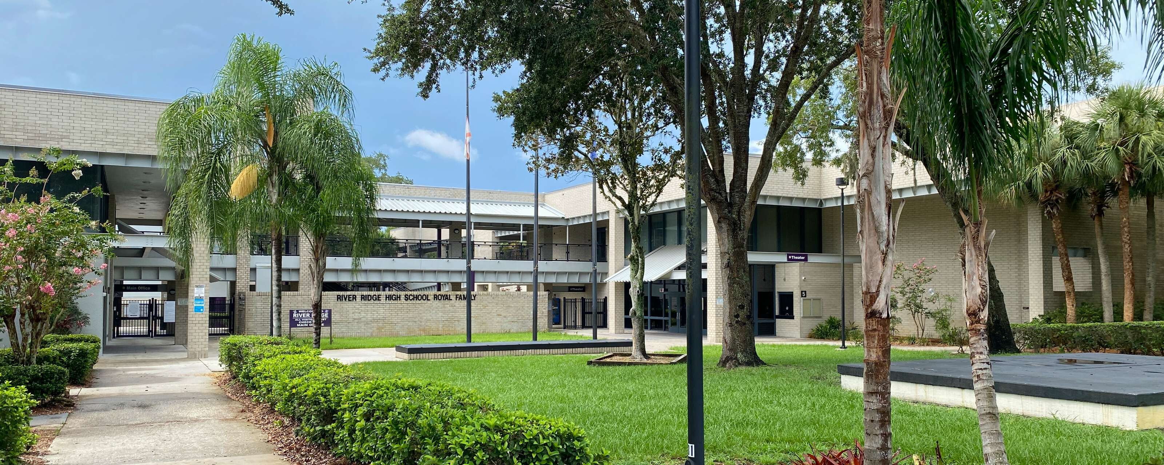
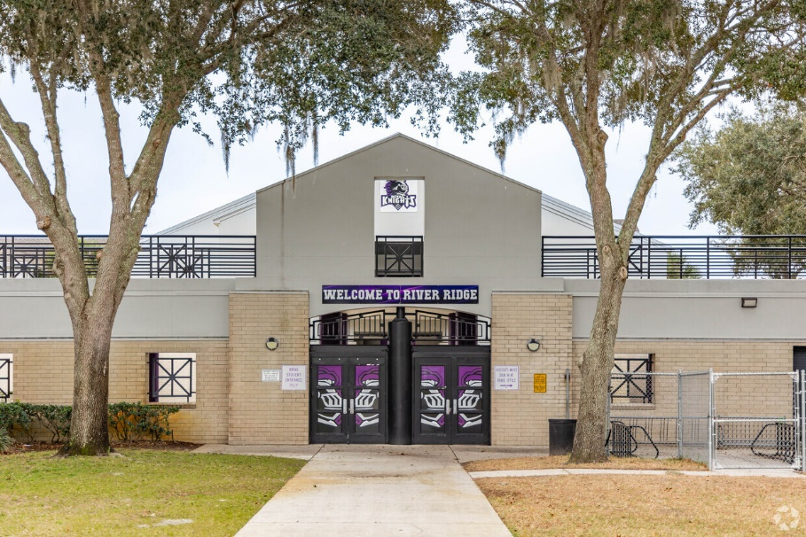

Slide 12
Notes:
We currently have all doors locked but this helps to give some direction. It also specifies Instructional spaces- these are areas that may not be a classroom where students receive instruction. If the door must be left open it can, but someone (staff member) needs to be seated or standing at the door. It also adds the exception for between class periods.

Slide 13
District Safety Compliance Inspections
School safety specialists (SSS) or their designees must investigate all reports of noncompliance.
Must conduct unannounced inspections at least annually of all public and charter schools within their district:
While school is in session, and
Must be documented on the District Safety Compliance Inspection Report within FSSAT.
Notes:
Formal documentation of compliance or noncompliance with school safety requirements in school districts and public schools, including charter schools and requirements for disciplinary action for non-compliance.

Slide 14
District Compliance Inspections
SSS must report violations of campus access control, classroom door and safest area requirements by administrative or instructional personnel to the superintendent or charter school administrator.
Quarterly, the SSS must report to the super-intendent and the school board any non-compliance with laws or rules regarding school safety.

Slide 15
District Compliance Inspections
The office of Safe Schools shall conduct unannounced inspections of all public schools, including charter schools, while school is in session, triennially and investigate ALL reports of noncompliance with school safety requirements.
Results are provided <3 Days, and must be acknowledged in writing by the School Safety Specialist in writing in 1 Day!
If there are any findings, they must be remediated in 3 school days and then the school will be reinspected within 6 months of the finding.

Slide 16
District Compliance Inspections
The SSS must respond in writing within 3 school days after receiving written notice of a suspected deficiency or after the completed compliance inspection report is posted.
The response must verify that the district or school has corrected the suspected deficiency or must include a written plan describing how the district will bring the identified school(s) into compliance.
A plan submitted must include:
an estimated date of completion, and
an explanation of alternate security measures designed to maintain a safe learning environment.

Slide 17
OSS Inspection Workflow, Summary
OSS conducts monitoring visit (every 3 years).
OSS provides SSS, principal/charter school administrator, and superintendent a copy of the compliance inspection report (within 3 school days of the visit).
SSS acknowledges receipt of the compliance inspection report (within 1 school day after posting).
SSS provides written corrective action plan to OSS (within 3 school days after posting).
Schools with areas of noncompliance are re-inspected by OSS (within 6 months).

Slide 18
District Compliance Inspections, Accountability
Any safety violation that was committed intentionally by instructional and administrative personnel not in compliance with the school safety rules outlined in the statute and on the Florida School Safety Compliance Inspection Report will be referred for discipline and the discipline will be shared with FLDOE.
The district school superintendent or charter school administrator must notify the office of the outcome of the disciplinary proceedings within 3 school days after the conclusion of the proceedings.
Notes:
Any school safety violation that was done intentionally by instructional and administrative personnel not in compliance with the school safety rules outlined in the statute and on the Florida School Safety Compliance inspection report will be referred for discipline and the discipline will be shared with FLDOE.

Slide 19
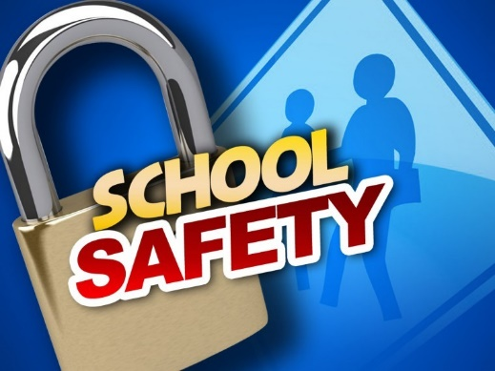
Progressive Discipline Policy FS 1006.07(6)(f)
Each district school board and charter school governing board shall adopt a progressive discipline policy for addressing any instructional personnel as defined in s. 1012.01(2) and any administrative personnel as defined in s. 1012.01(3) who knowingly violate school safety requirements.
Persons who are aware of a violation of this paragraph must report the violation to the school principal. The school principal must report the violation to the school safety specialist no later than the next business day after receiving such report.

Slide 20
District Compliance Inspections – SRO Role
SRO SGTS / SSG SGTS
Will work collaboratively to complete at least one inspection at all public schools at least once per school year.
Reports get logged and recorded in FSSAT
Reports are shared with School District and FDOE
SRO’s Responsibilities
Complete (1) Compliance Inspection Report each Semester (done on a non-ATP scenario drill month)
Daily – SROs are vigilant looking for any deficiencies,
Address them immediately with the source of the non-compliance.
Report them to your principal and SRO supervisor the same day.
FDOE 2024-2025 District Compliance Inspection Report

Slide 21
School Safety Guidelines ~ Continuity
Annually, at the beginning of the school year, notify all administrative and instructional personnel by electronic mail of the requirements of s. 1006.07(6)(f).
Each school year the requirements of the current school safety rules must be sent to all school personnel, so they have awareness. This is done to help ensure all of our schools are safe, and compliant with the very latest school safety legislation intended to keep our schools and our children safe to learn!

Slide 22
School Safety Drills
Drill records are audited regularly by the Florida Department of Education, Office of Safe Schools.
Each school must keep a record of the names of the law enforcement officers who were present for each active assailant drill and must provide those records to OSS upon request.

Slide 23
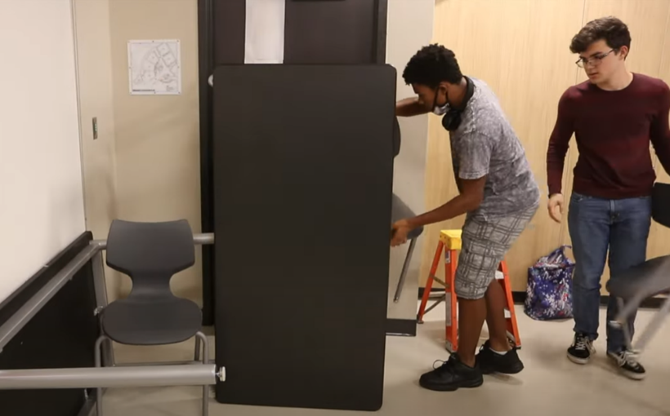
School Safety Drills
Emergency drills and fire drills must test all applicable functions included in the threat scenario, such as panic buttons, participant movement (lockdown, shelter-in-place, or evacuation), simulated communications with first responders, simulated notification to parents, and appropriate protective actions, such as turning off lights, and covering windows.
Notes:
As part of the ATP and Fire drills we now have to simulate a notification to parents. We also have to simulate communication to first responders. These items have been be added into the Drill Script.

Slide 24
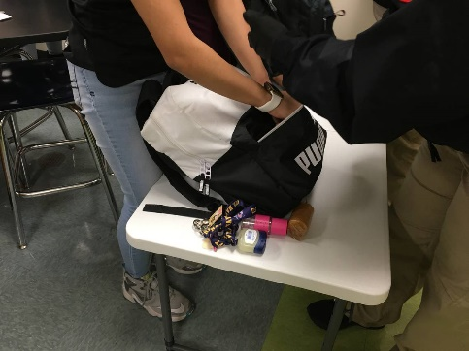
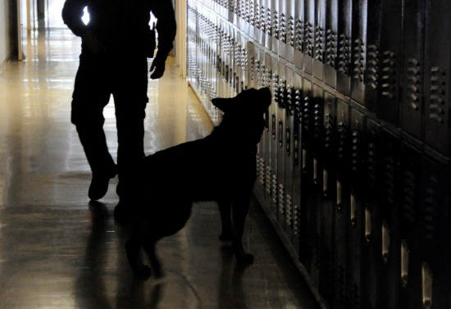
*NEW, Actual Emergency, or False Alarm
An actual emergency or other event, such as a false alarm, that elicits a school wide response including participant movement and appropriate protective actions, may substitute for one of the six required emergency drills.

Slide 25
Emergency Drills, Rule 6A-1.0018
1 Drill within first 10 days of school
Remaining drills every 45 days that school is in session.
(4) of the (6) Drills must address active threats.
Remaining (2) drills must address other emergencies e.g., severe weather, natural disasters, hazardous materials, or reunification.

Slide 26
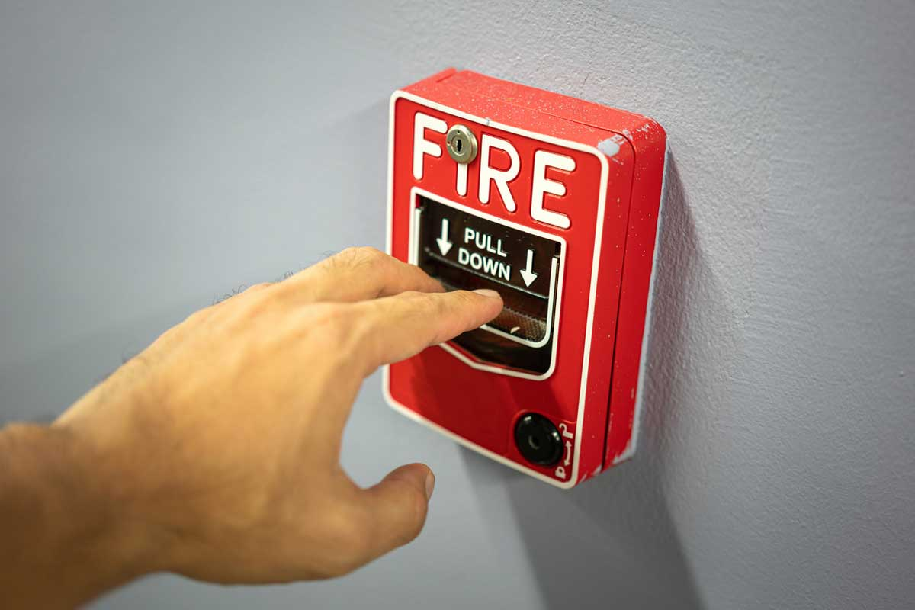
Fire Drills
Fire Drills must be pre announced.
Fire drills will be activated using the fire alarm system and
All public-school safety drills (non-video drills) must be activated using CrisisGo (drill mode) and logged into CrisisGo.
Notes:
The only drills that should have a manual entry into CrisisGo are video-based drills.

Slide 27
2024-25 School Safety Drill Schedule
In accordance with the Marjory Stoneman Douglas High School Public Safety Act, DOE Rule 6A-1.0018, Florida Fire Prevention Code 8th edition, NFPA 1-10.5, NFPA 1-10.5.2 and Florida Statutes, the following drill schedule is required of all public schools in Florida.
At-A-Glance

Slide 28
When should school administrators and staff consult law enforcement?
Threat to self/others
Threat assessment team
A potential criminal act has been committed, and must be investigated
Remember - all Pasco County Schools employees are mandatory reporters
Procedures apply to all students - note additional procedure when referring students with disabilities to law enforcement.

Slide 29
PRIMARY Responsibility of an SRO
The safety and security of the students and staff in Pasco Schools.
The SRO operational concept is based on three key functions: law enforcement officer, teacher, and counselor/mentor.
Notes:
The core of the SRO operational concept is based on three key functions: law enforcement officer, teacher, and counselor/mentor. However, an SRO’s highest priority and responsibility is the safety of students, and staff and the security of the campus.

Slide 30
Other Duties and Responsibilities of an SRO LED 635.1
SROs are expected to cultivate relationships within their campus community and utilize available resources to maintain situational awareness of current crime trends, threats to schools, and other pertinent information that has the potential to impact school safety.
Perform routine law enforcement duties
Campus Patrols
Security Fidelity Checks
Community Outreach and Crime Prevention
Coordinate security for extra-curricular activities

Slide 31
Thank You
Betsy Kuhn, Esq.
Deputy Superintendent
(813) 794-2203
ekuhn@pasco.k12.fl.us
Chief Michael Baumaister
School Safety
Pasco District Schools
(813) 794-7937
mbaumais@pasco.k12.fl.us

