Slide 1
Florida Care Provider Background Screening Clearinghouse
Notes:
Introduction-
Hello, my name is Taylor Haddock and I am an Assistant Deputy Secretary at the Agency for Health Care Administration and I am also the Director of the Care Provider Background Screening Clearinghouse
Introduce AHCA Staff Members (TBD)
Today I am here to talk about the Care Provider Background Screening Clearinghouse and screenings of school employees by the school districts, private schools and charter schools.

Slide 2
Clearinghouse Overview
Established by law in 2012 to reduce duplicative screenings
Provides a single data source for background screening results of persons required to be screened by law for employment in positions that provide services to children, the elderly and disabled individuals
Allows the results of criminal history checks to be shared among specified agencies when a person has applied to volunteer, be employed, be licensed or enter a contract that requires a state and national fingerprint-based criminal history check
Seven total state agencies participate in the Clearinghouse
Notes:
Will read the slide and answer any questions

Slide 3
Seven Agencies – One System

Slide 4
Clearinghouse Timeline
Clearinghouse established by Florida legislature to reduce duplicative screenings
Agency for Health Care Administration (AHCA) made parent agency
2012
2013
January – Agency for Health Care Administration (AHCA) launches the Clearinghouse with
Department of Health (DOH)
November – Managed Care joins the Clearinghouse
2014
Department of Education Vocational Rehabilitation (DOE-VR) joins the Clearinghouse
2015
May – Agency for Persons with Disabilities (APD) joins the Clearinghouse
July – Department of Children and Families (DCF) joins the Clearinghouse
September – Department of Elder Affairs (DOEA) joins the Clearinghouse
2016
Department of Juvenile Justice (DJJ) joins the Clearinghouse
2025
Florida Department of Education (FDOE) joins the Clearinghouse
2026
Volunteer and Employee Criminal History System (VECHS) joins the Clearinghouse
Notes:
Will read the slide and answer any questions

Slide 5
Senate Bill 676 (2023)
Section 1012.315, Florida Statutes – A person is ineligible for educator certification or employment in any position that requires direct contact with students in a district school system, a charter school, or a private school that participates in a state scholarship program under chapter 1002 if the person:
(1) Is on the disqualification list maintained by the department under s. 1001.10(4)(b);
(2) Is registered as a sex offender as described in 42 U.S.C. s. 9858f(c)(1)(C);
(3) Is ineligible based on a security background investigation under s. 435.04(2). Beginning January 1, 2025, or a later date as determined by the Agency for Health Care Administration, the Agency for Health Care Administration shall determine the eligibility of employees in any position that requires direct contact with students in a district school system, a charter school, or a private school that participates in a state scholarship program under chapter 1002;
(4) Would be ineligible for an exemption under s. 435.07(4)(c); or
(5) Has been convicted or found guilty of, has had adjudication withheld for, or has pled guilty or nolo contendere to:
(a) Any criminal act committed in another state or under federal law which, if committed in this state, constitutes a disqualifying offense under s. 435.04(2).
(b) Any delinquent act committed in this state or any delinquent or criminal act committed in another state or under federal law which, if committed in this state, qualifies an individual for inclusion on the Registered Juvenile Sex Offender List under s. 943.0435(1)(h)1.d.
Notes:
In 2023, SB 676 amended sections 1012.315 and 1012.467, F.S. to add the following requirements –
Will read the slide and answer any questions

Slide 6
Senate Bill 676 (2023)
435.12 Care Provider Background Screening Clearinghouse.—
3)(a) Employees of each district unit under s. 1001.30, special district units under s. 1011.24, the Florida School for the Deaf and the Blind under s. 1002.36, the Florida Virtual School under s. 1002.37, virtual instruction programs under s. 1002.45, charter schools under s. 1002.33, hope operators under s. 1002.333, private schools participating in an educational scholarship program established pursuant to chapter 1002, and alternative schools under s. 1008.341 must be rescreened in compliance with the following schedule:
1. Employees for whom the last screening was conducted on or before June 30, 2021, must be rescreened by June 30, 2025.
2. Employees for whom the last screening was conducted between July 1, 2021, and June 30, 2022, must be rescreened by June 30, 2026.
3. Employees for whom the last screening was conducted between July 1, 2022, and December 31, 2023, must be rescreened by June 30, 2027.
(b) A person is not required to be rescreened before January 1, 2023, solely for the purpose of retention under this section if the person was screened before participation by the specified agencies named in paragraph (a) in the clearinghouse.
Notes:
SB676 2023 also added a rescreening schedule. This is mandated by law and can only be changed through legislation.
Will read the slide and answer any questions

Slide 7
Clearinghouse Process for Education Screenings
School district initiates the screening of the faculty or staff person they intend to hire in the Clearinghouse Results Website (CRW).
Faculty/staff is fingerprinted for employment by the school district or school.
Criminal history is sent to AHCA.
AHCA reviews the criminal history and makes an eligibility determination under standards in section 435.04(2), F.S.
This includes persons subject to the provisions of this section who have not been arrested for and are awaiting final disposition of, have been found guilty of, regardless of adjudication, or entered a plea of nolo contendere or guilty to, or have been adjudicated delinquent and the record has not been sealed or expunged for, any offense prohibited under this section of state law or similar law of another jurisdiction.
Notes:
This is a high-level overview of how my team and I picture the process for school employee screenings.
Will read the slide and answer any questions

Slide 8
Clearinghouse Process for Education Screenings
Once an eligibility determination has been made, a notification is sent to the school district to check the Clearinghouse Results Website.
The school district checks the Clearinghouse Results Website to view the eligibility determination of the faculty/staff.
If the faculty/staff is eligible, then the school district also reviews a copy of the criminal history within CRW for additional hiring standards.
If the faculty/staff is not eligible, then the school district may NOT hire them, unless an exemption from disqualification has been approved.
Notes:
Will read the slide and answer any questions

Slide 9
Livescan Information
For a Clearinghouse screening to be shared the person must have three things:
Retained prints,
Signed privacy policy, and
A photograph taken at the time of screening
The Clearinghouse has over 1500 Livescan locations across the state of Florida that are Clearinghouse compliant and locations in all 50 states as well.
Livescan machines can be bought or updated to be Clearinghouse compliant.
Notes:
Will read the slide and answer any questions
We have reached out to some livescan vendors and have quotes, but you may want to reach out yourselves if you already own your equipment.

Slide 10
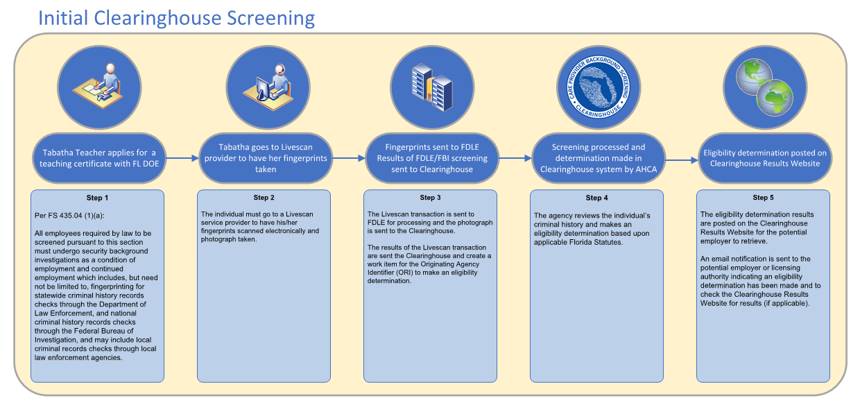
Real-World Example
Notes:
Will read the slide and answer any questions

Slide 11
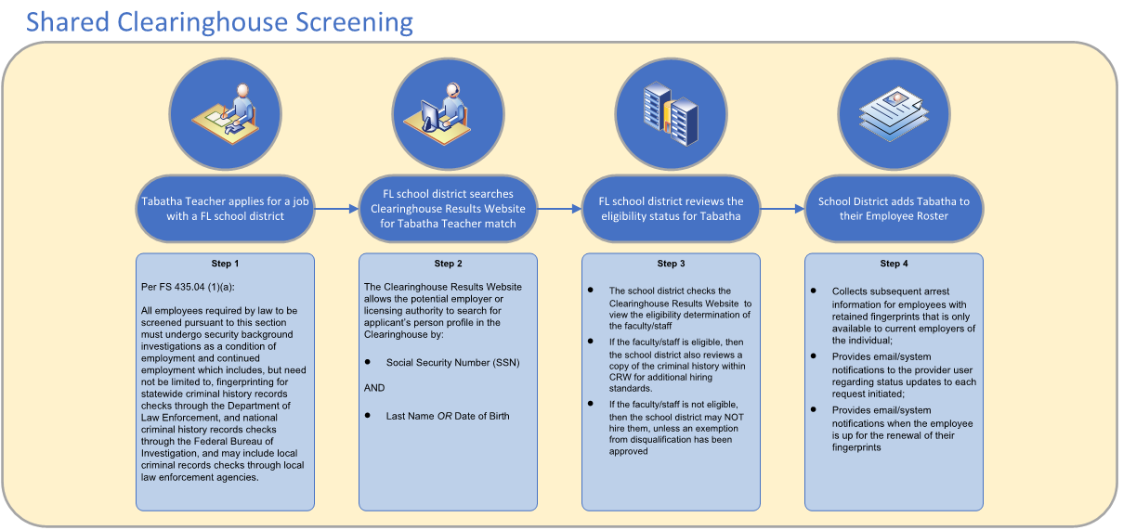
Real-World Example
Notes:
Will read the slide and answer any questions

Slide 12
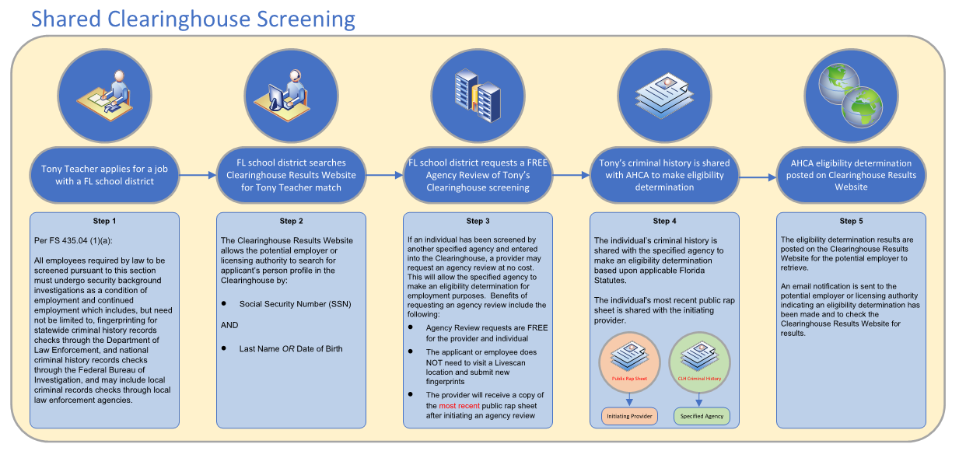
Real-World Example
Notes:
Will read the slide and answer any questions

Slide 13
Benefits of the Clearinghouse
Shares results of criminal history checks among specified agencies, providing cost savings to individuals and providers.
Collects subsequent arrest information for employees with retained fingerprints that is only available to current employers of the individual.
Tracks screenings from the time the screening request is initiated in the Clearinghouse until a determination is made.
Provides email notification to the provider user regarding status updates to each request initiated.
Allows provider to search for a Livescan Service Provider by entering certain criteria (county, name, etc.) and connects to the fingerprint service provider’s website to make appointments.
Notes:
Will read the slide and answer any questions

Slide 14
Benefits of the Clearinghouse
Maintains an employee roster by entering hire and separation dates for each employee. This facilitates a notification to the employer if the eligibility status of an employee changes.
Allows for providers to request and pay for the renewal of fingerprints all in one system while also receiving cost savings. This allows for:
The current cost for a Clearinghouse Renewal is $42.00. That’s a cost-saving of over $30 with the average cost for a new screening being $75.00;
Faster processing time since the request is immediately sent to the Clearinghouse. No need to wait for the employee to be fingerprinted at a Livescan Service Provider;
An updated criminal history to ensure compliance with background screening requirements;
Extends the retained prints expiration by another 5 years.
Notes:
Will read the slide and answer any questions

Slide 15
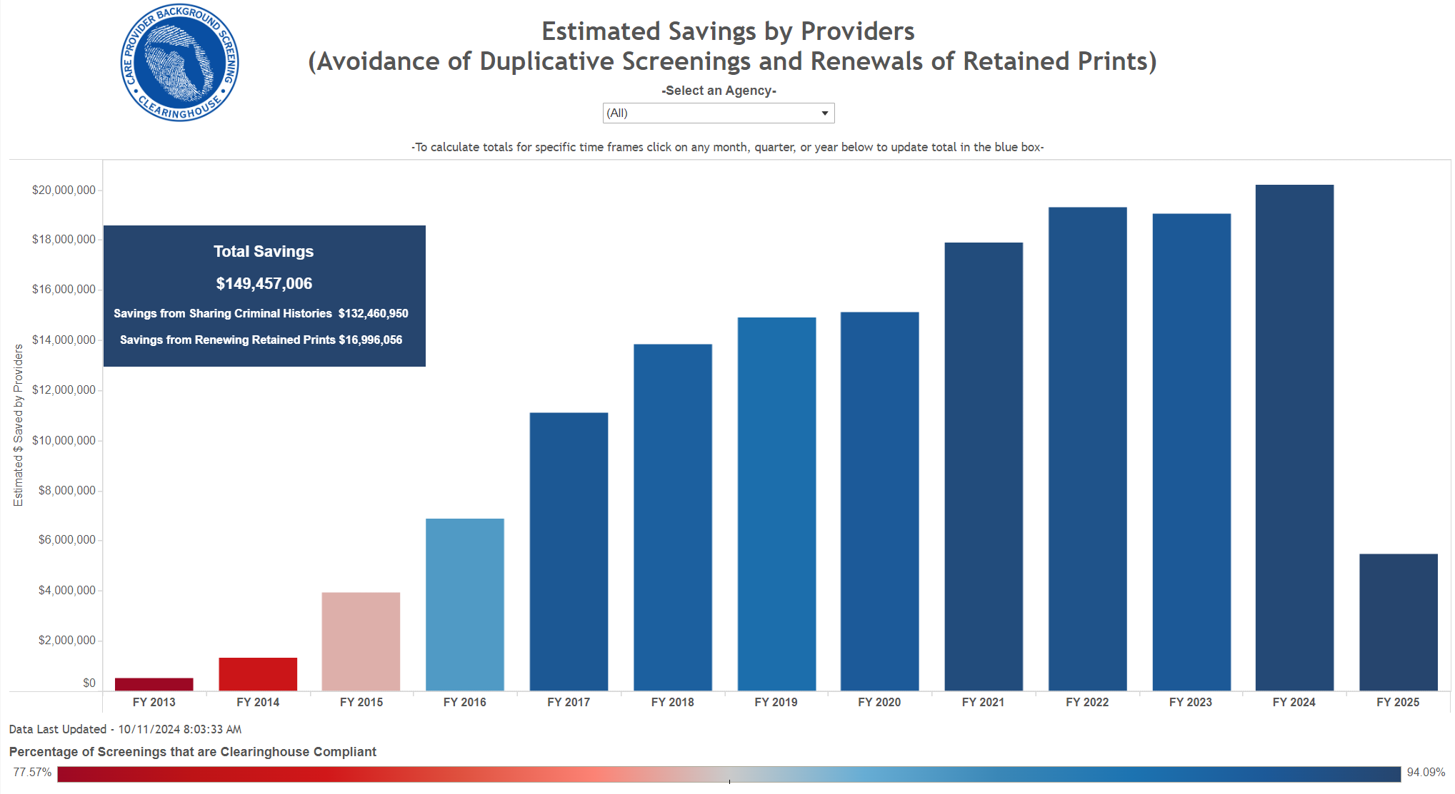
Benefits of the Clearinghouse
The Clearinghouse has proven to be a major cost-saving initiative for the State, while also providing safeguards to protect the health and welfare of vulnerable populations receiving health care services.
Taxpayer Savings
Since implementation began January 1, 2013, the Clearinghouse has processed over 8 million screenings and has collectively saved providers/employers and licensees over $150 million by sharing screenings through the Clearinghouse.
Notes:
Will read the slide and answer any questions

Slide 16
Benefits of the Clearinghouse
The Clearinghouse has proven to be a major cost-saving initiative for the State, while also providing safeguards to protect the health and welfare of vulnerable populations receiving health care services.
Reduced Risks
By maintaining up-to-date and real-time notifications of information and employee arrests, the Clearinghouse has greatly reduced provider liability. Since implementation in January 2013, the Clearinghouse received notification of over 400,000 individuals who were arrested after they were screened. Over 25% of those arrested went from Eligible to work with vulnerable individuals to Not Eligible. Many of these arrests were for serious offenses including:
Grand theft;
Battery and assault;
Sex offenses;
Exploitation of the elderly; and
Offenses against a child.
Notes:
Will read the slide and answer any questions

Slide 17
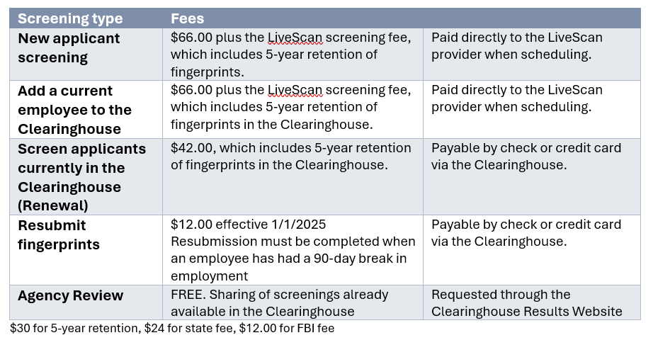
Cost of Clearinghouse Screenings
Per section 435.08, F.S., The employer or the employee is responsible for paying the costs of screening. Current costs for screenings, including the 5-year retention are:
Notes:
Will read the slide and answer any questions

Slide 18
Contact Information
Taylor Haddock, Director of the Clearinghouse
Taylor.Haddock@ahca.myflorida.com
Manit Patel, Clearinghouse DOE Project Manager
Manit.Patel@ahca.myflorida.com
Notes:
Will read the slide and answer any questions

